Slide 1

Diabetes-Predominant Chronic Limb-Threatening Ischaemia in Sri Lanka Compared with a UK Cohort: Demographic, Anatomical, and Outcome Differences in a Bi-National Study
N. Gowcikan
Teaching Hospital Anuradhapura
Sri Lankan Society for Vascular Surgery

Slide 2
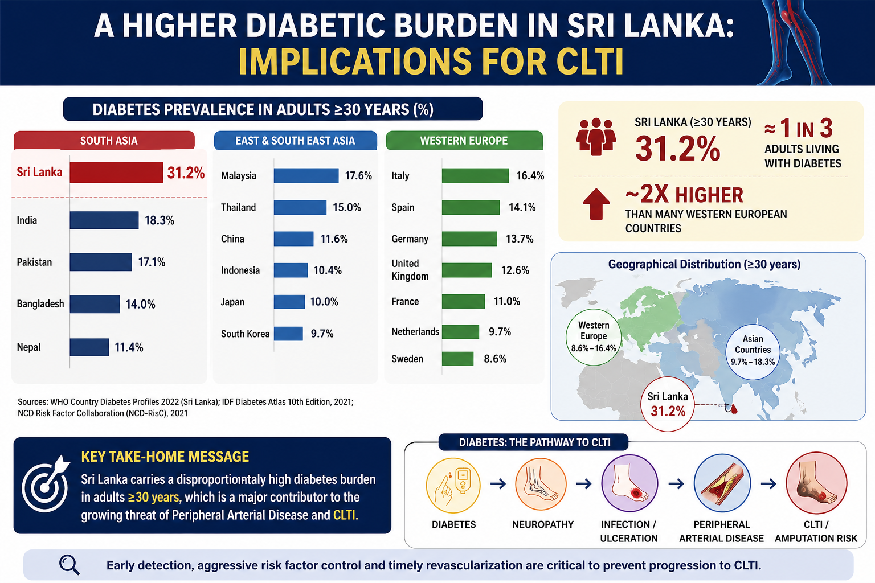

Slide 3
Why This Study?
Current CLTI evidence is largely western-derived and may not fully reflect south Asian disease patterns
Understanding our local disease pattern is essential to develop context-specific treatment strategies
No published study has directly compared CLTI between Srilanka and the UK
TO TREAT OUR PATIENT BETTER, WE MUST FIRST UNDERSTAND OUR DISEASE BETTER.

Slide 4
Methods
Retrospective comparative cohort Study
  Srilankan tertiary vascular centre (NHSL Prof Unit) : n = 150
  Royal Free Hospital, London : n= 108
Variables: Demographic, disease severity, anatomy, intervention, and outcomes
Statistical analysis: independent t-test and Chi-square analysis

Slide 5
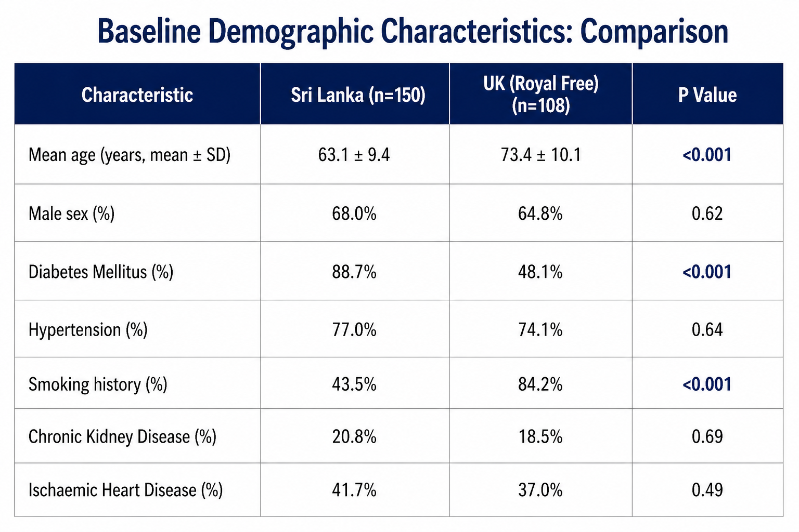

Slide 6
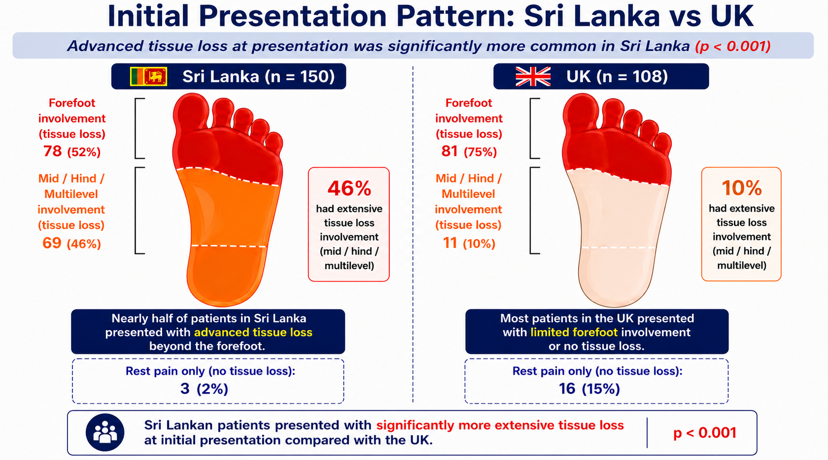

Slide 7
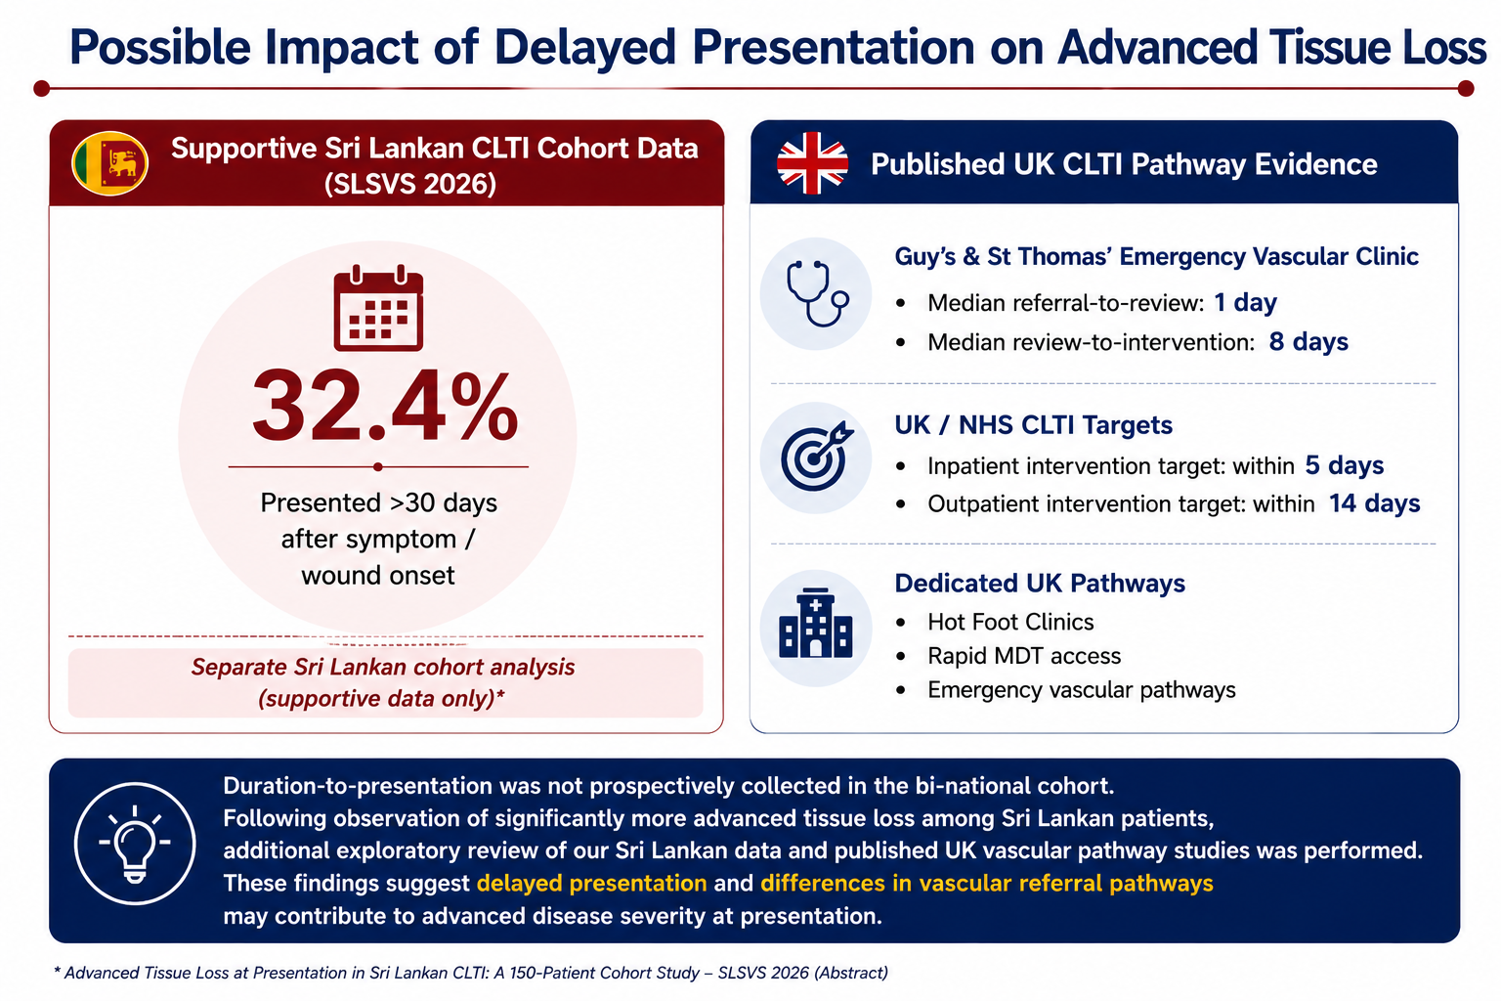
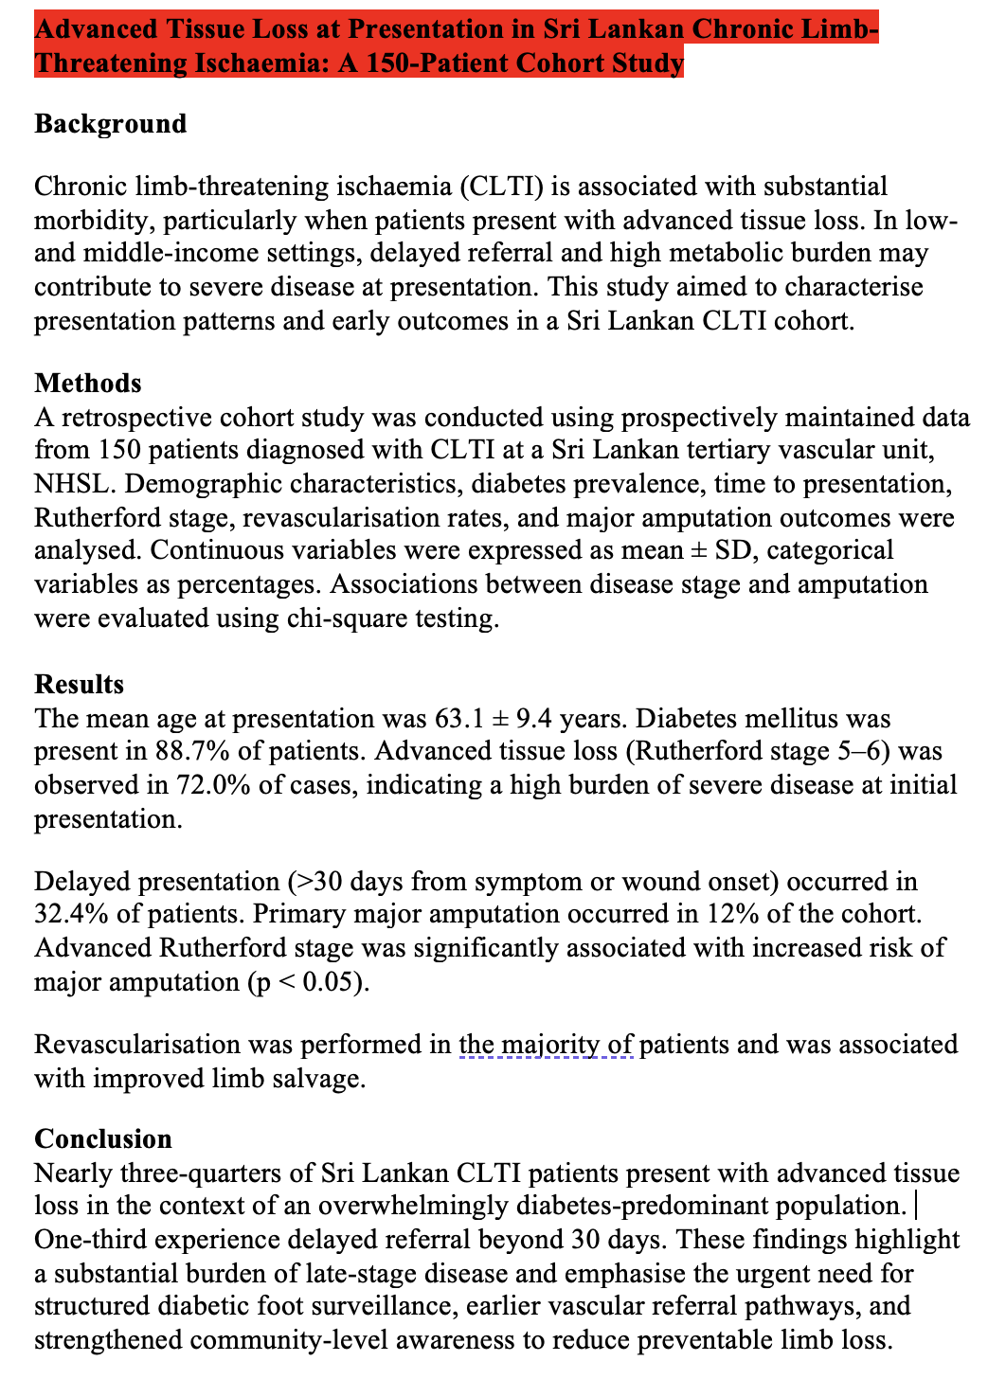

Slide 8
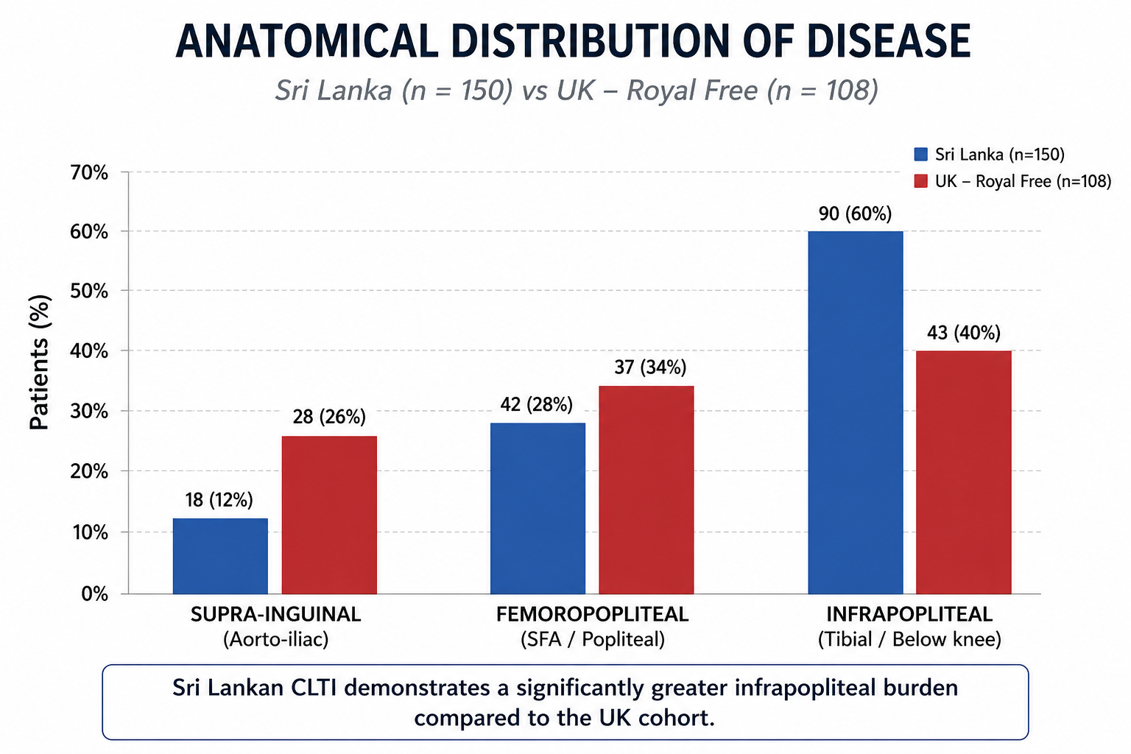

Slide 9
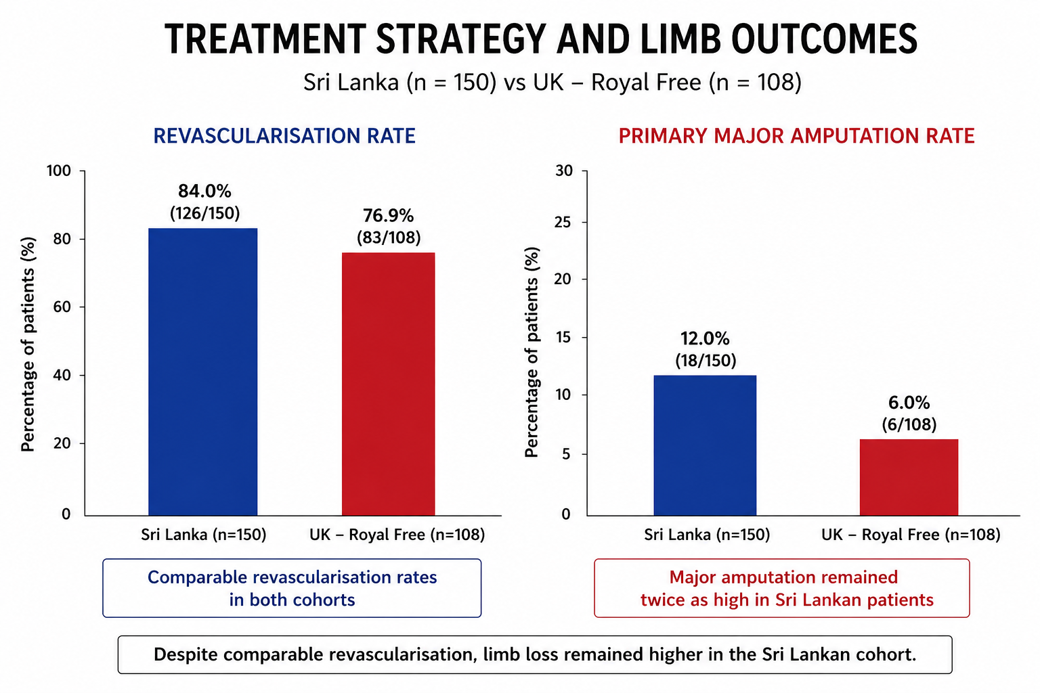

Slide 10
CONCLUSION
Sri Lankan CLTI presents earlier than the UK cohort (~10 years younger)
Markedly higher diabetes burden suggests a distinct diabetes-driven disease phenotype
Disease demonstrates a greater infrapopliteal burden with more advanced tissue loss at presentation
Despite comparable revascularisation, major amputation remained higher in Sri Lankan patients
SRI LANKAN CLTI REPRESENTS A DISTINCT VASCULAR PHENOTYPE REQUIRING CONTEXT-SPECIFIC MANAGEMENT STRATEGIES

Slide 11
RECOMMENDATIONS
Early diabetic foot screening and surveillance
Aggressive risk-factor modification (glycaemic, lipid, smoking control)
Rapid vascular referral pathways for limb-threatening disease
Develop South Asian / Sri Lankan CLTI pathways based on local disease patterns
Further multicentre prospective studies to guide evidence-based regional practice
BETTER UNDERSTANDING OF OUR DISEASE IS THE FIRST STEP TOWARD BETTER LIMB SALVAGE.

Slide 12
THANK YOU

