Slide 1

Impact of Presentation Delay on Outcomes in Acute Limb Ischemia
Time Is Limb
Prasanga RPS¹, Vishwajith RMP¹, Fonseka HFDGD¹, Sancheevan S¹, Gunawansa N²
National Hospital of Sri Lanka

Slide 2
Introduction
Acute Limb Ischemia (ALI) → vascular emergency
Delays → irreversible ischemic damage
“Time is limb” principle
Limited local data on impact of delay

Slide 3
Aim
To assess the relationship between presentation delay and clinical outcomes in ALI
Limb salvage
Amputation
Survival

Slide 4
Methods
Outcomes
  Limb salvage
  Amputation
  Survival
147 ALI patients
Stratified by time to presentation:
  Group A: <12 hours
  Group B: 12–24 hours
  Group C: 1–7 days
  Group D: >7 days

Slide 5
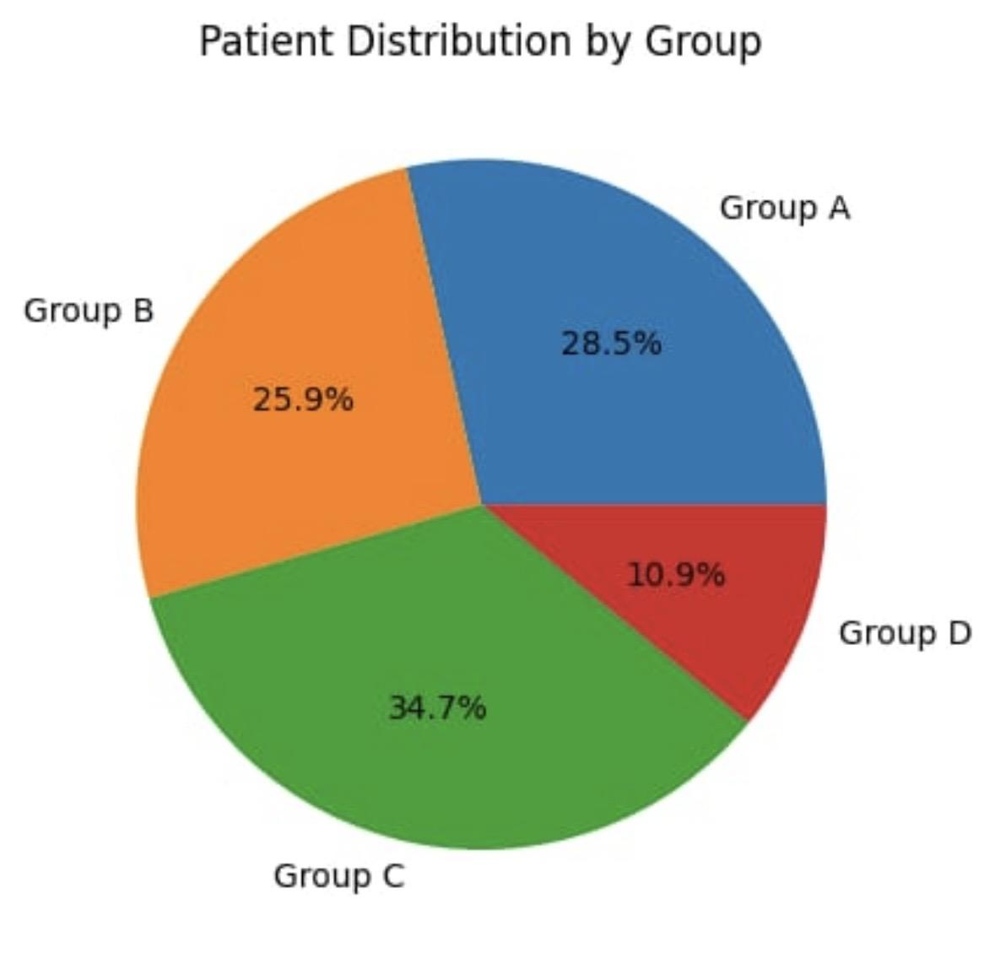

Slide 6
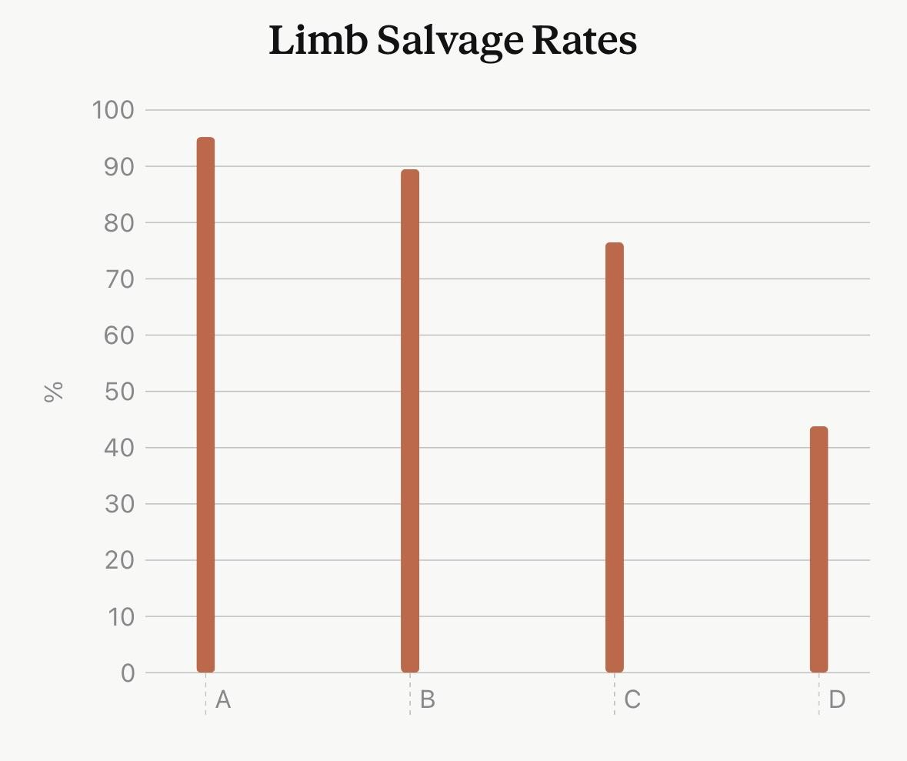
Limb Salvage
)
A: 95.2%
B: 89.5%
C: 76.5%
D: 43.8%

Slide 7
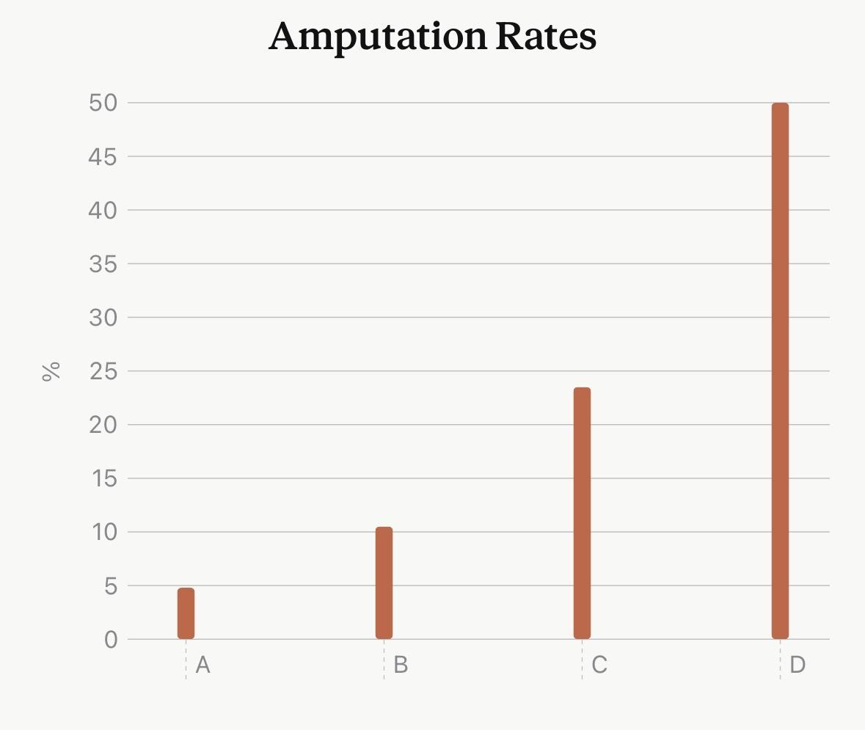

Slide 8
Severity & Mortality
Rutherford grade 3:
  A: 4.8%
  D: 43.8%
📈 Severity increases with delay
Mortality:
  Higher in delayed groups
  Better survival with early presentation

Slide 9
Conclusion
Delay → ↓ limb salvage, ↑ amputation, ↑ mortality
Strong time-outcome relationship
Early presentation is critical
🔑 Take-home:
“Time is limb — early recognition and urgent revascularization save both limb and life.”

Slide 10
Thank you!

