Slide 1


Real-World Outcomes in Mesenteric Ischaemia: A Five-Year Tertiary Centre Experience
Five-year single-centre retrospective descriptive study
²De Fonseka HFDG, ¹Navi A, ²Mohotti N, ²Nazeer I, ¹Wijewardena C.
¹ Consultant in Vascular and Transplant Surgery, National Hospital Sri Lanka
² Senior Registrar in Vascular and Transplant Surgery, National Hospital Sri Lanka
Tertiary referral arterial centre (vascular network hub) | Cambridge University Hospitals (Addenbrooke’s Hospital)

Slide 2

Clinical context & objectives
Why this matters
Study objectives
Mesenteric ischaemia is a potentially life-threatening condition
Time-critical vascular emergency
Nonspecific presentation makes challenging decision-making
Describe demographics and comorbidity burden
Characterise management strategy: endovascular, open, medical, mixed
Quantify outcomes
Explore univariate predictors of mortality
Cambridge University Hospitals
n=43 | Jun 2020–Apr 2025

Slide 3
Methods
Design : Retrospective descriptive study
Study period: June 2020 – April 2025
Location- Addenbrooke’s Hospital ,Cambridge University Hospital
Outcome definition:
Primary outcome - mortality
Secondary outcomes - reintervention, intensive care unit(ICU) length of stay(LOS) and days of total parenteral nutrition(TPN)
Methods summary
n=43 | Jun 2020–Apr 2025

Slide 4
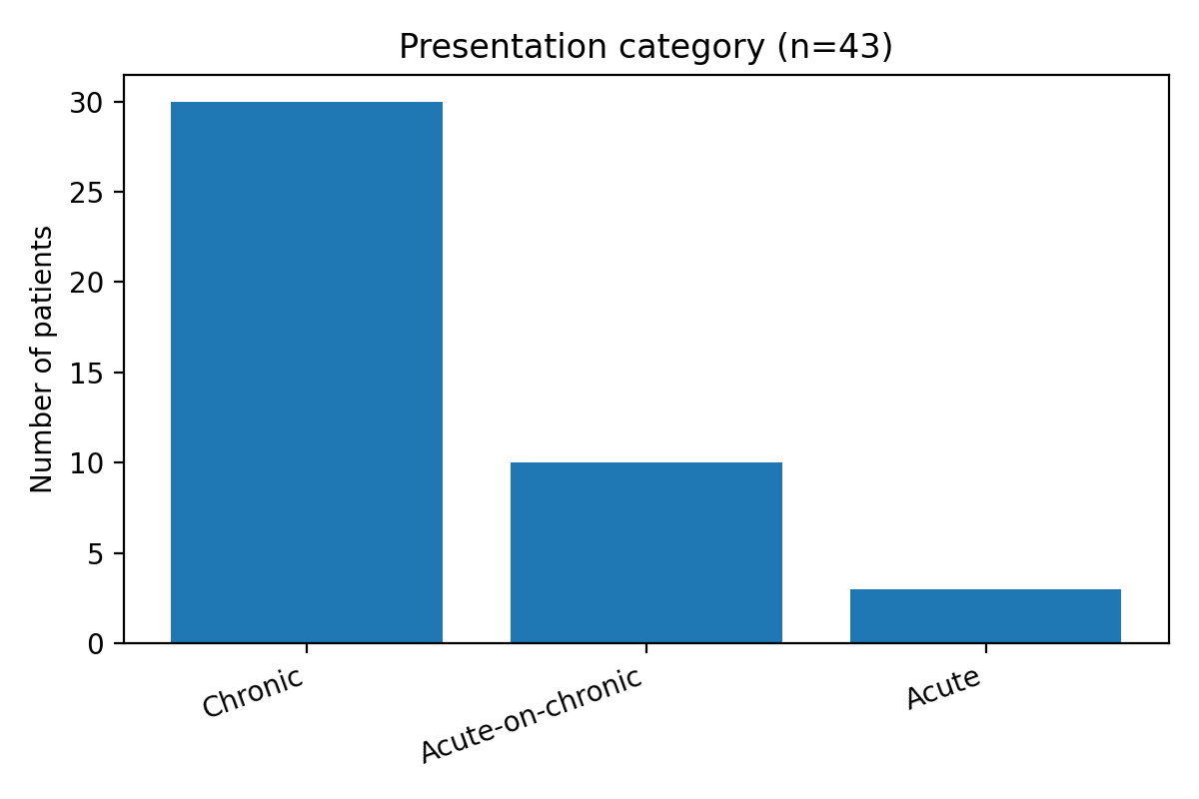
Results
Presentation category
Key messages
Cohort is predominantly chronic disease (69.8%)
Acute subgroup is small (n=3)
Chronic 30 | AoC 10 | Acute 3
Case-mix
n=43 | Jun 2020–Apr 2025

Slide 5
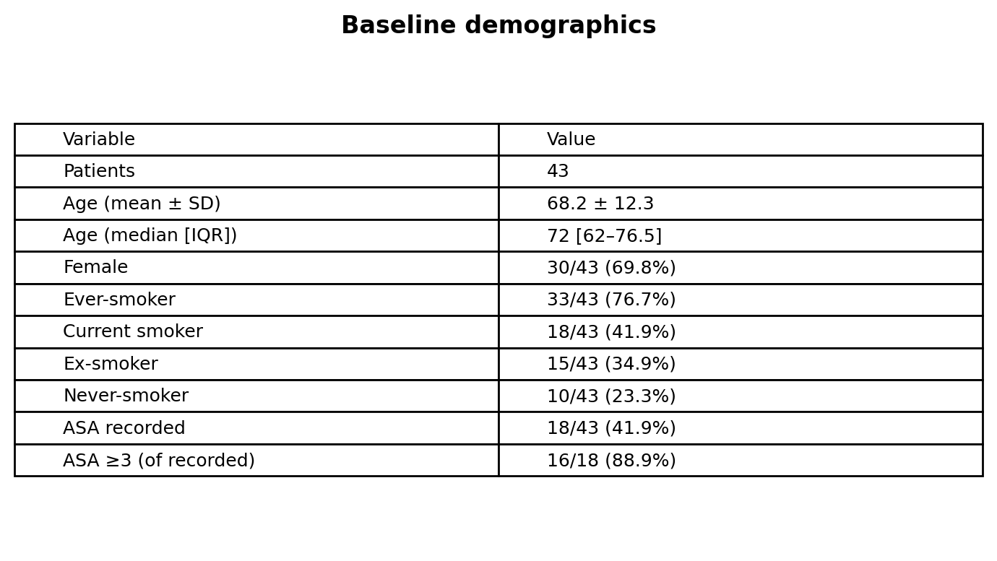
Baseline demographics
Summary
Demographics
n=43 | Jun 2020–Apr 2025

Slide 6
Baseline demographics

Slide 7
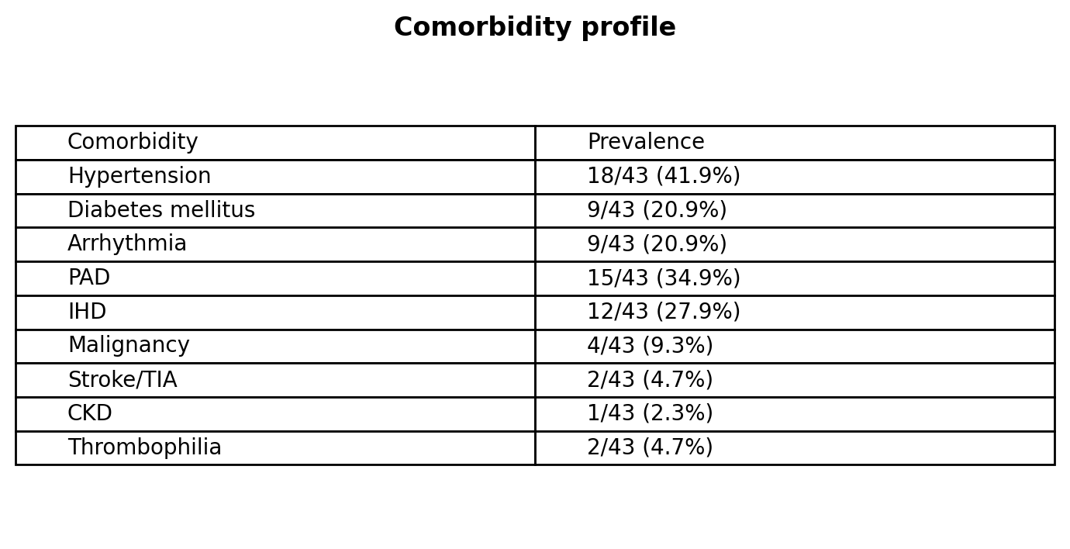
Comorbidity profile
Prevalence
Clinical interpretation: high atherosclerotic burden (PAD/IHD) and frequent arrhythmia (likely AF phenotype).
Risk factors
n=43 | Jun 2020–Apr 2025

Slide 8
Comorbidity profile

Slide 9
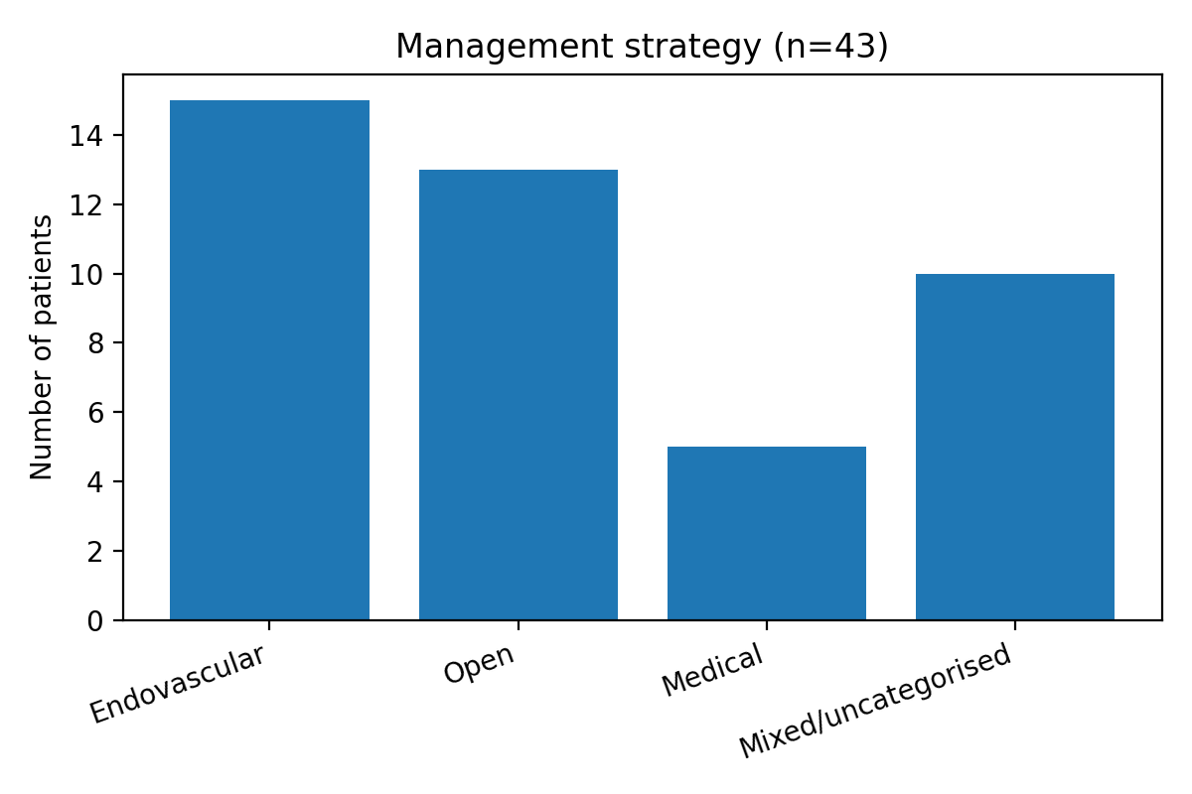
Management strategies
Strategy distribution
Endovascular 15 | Open 13 | Medical 5 | Mixed/uncategorised 10
Interventions
n=43 | Jun 2020–Apr 2025

Slide 10
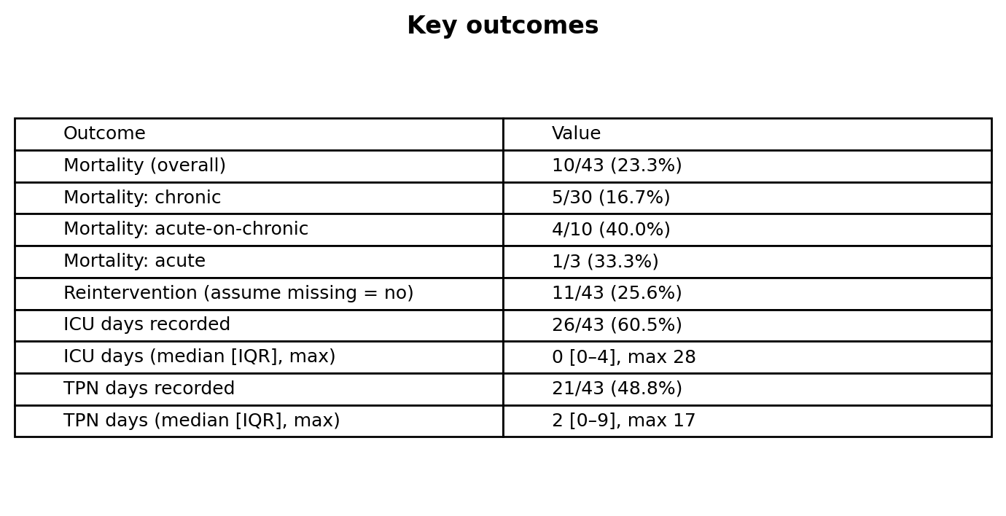
Key outcomes
x
Outcomes summary
Outcomes
n=43 | Jun 2020–Apr 2025

Slide 11
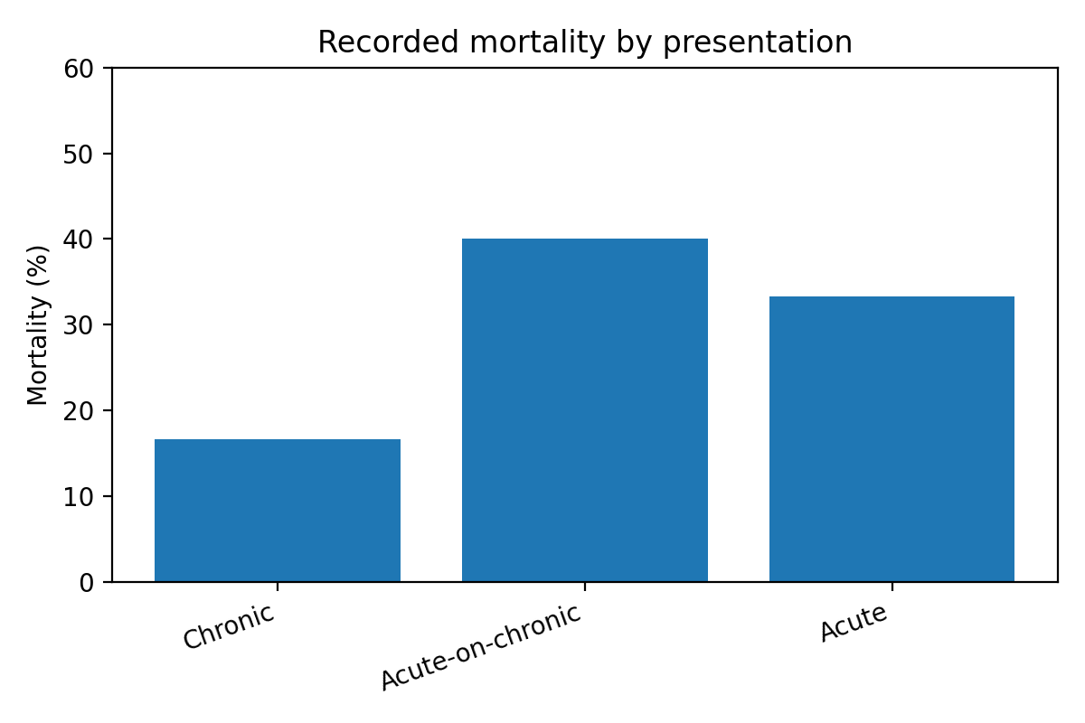
Mortality patterns
By presentation
Take-home points
AoC carries the highest observed mortality (40.0%)
Acute subgroup is small
Mortality
n=43 | Jun 2020–Apr 2025

Slide 12
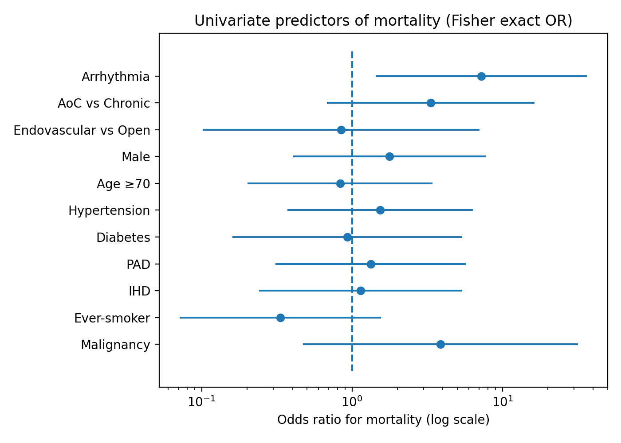
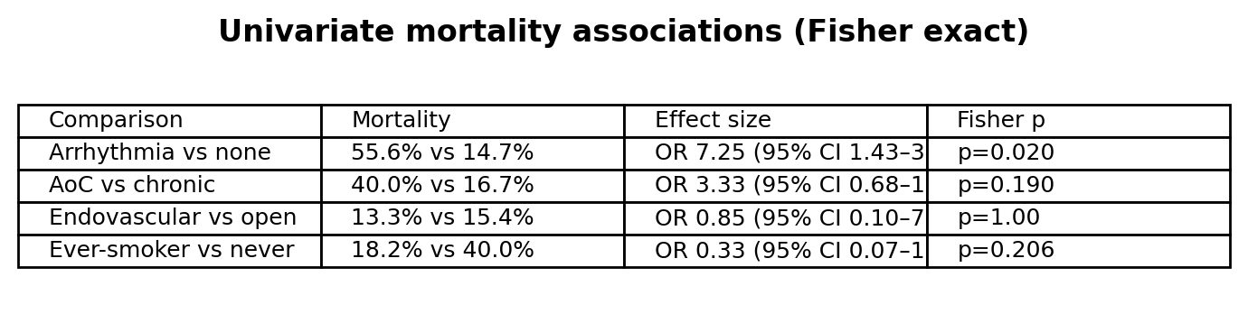
Predictors of mortality (univariate)
Odds ratios (log scale)
Key comparisons
Interpretation
Arrhythmia signal is statistically significant and clinically plausible
AoC vs chronic shows a strong trend but underpowered for significance
No detectable EV vs Open mortality difference
Statistics
n=43 | Jun 2020–Apr 2025

Slide 13
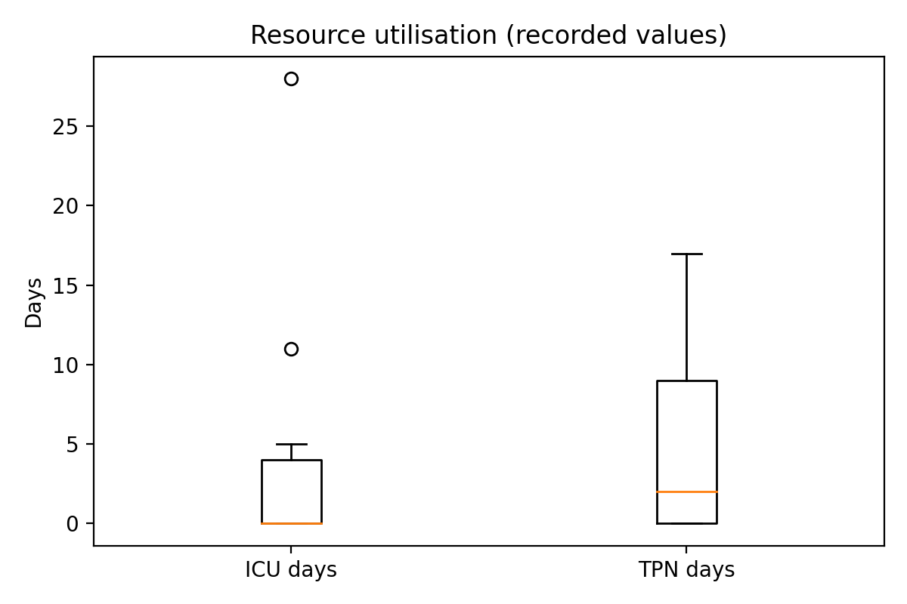
Resource utilisation
ICU & TPN days (recorded)
Clinical interpretation
Most recorded ICU stays are short, but a tail of prolonged dependency exists
TPN requirement is variable; when required can be prolonged (max 17 days)
ICU / Nutrition
n=43 | Jun 2020–Apr 2025

Slide 14
Reintervention
What we observed
Reintervention recorded in 11/43 (25.6%)
Both early technical failure and late restenosis/occlusion are plausible drivers
Durability
n=43 | Jun 2020–Apr 2025

Slide 15
Limitations
Important limitations (transparent reporting)
Single-centre retrospective dataset; small acute subgroup and wide confidence intervals
Outcome is “recorded mortality” (follow-up horizon not standardised)
Modality and reintervention fields include documentation gaps; mixed category reflects this
Selection bias limits interpretation of EV vs Open comparisons
Limitations
n=43 | Jun 2020–Apr 2025

Slide 16
Conclusions
Recorded mortality was 23.3% (10/43) with a clear resource signal (ICU up to 28 days; TPN up to 17 days)
Acute-on-chronic disease showed higher observed mortality than chronic disease (40.0% vs 16.7%)
Arrhythmia was a statistically significant mortality predictor (OR 7.25; p=0.020) — actionable high-risk phenotype
Reintervention was recorded in 25.6% (missing treated as no): supports early surveillance and durability focus

Slide 17

THANK YOU….

