Slide 1
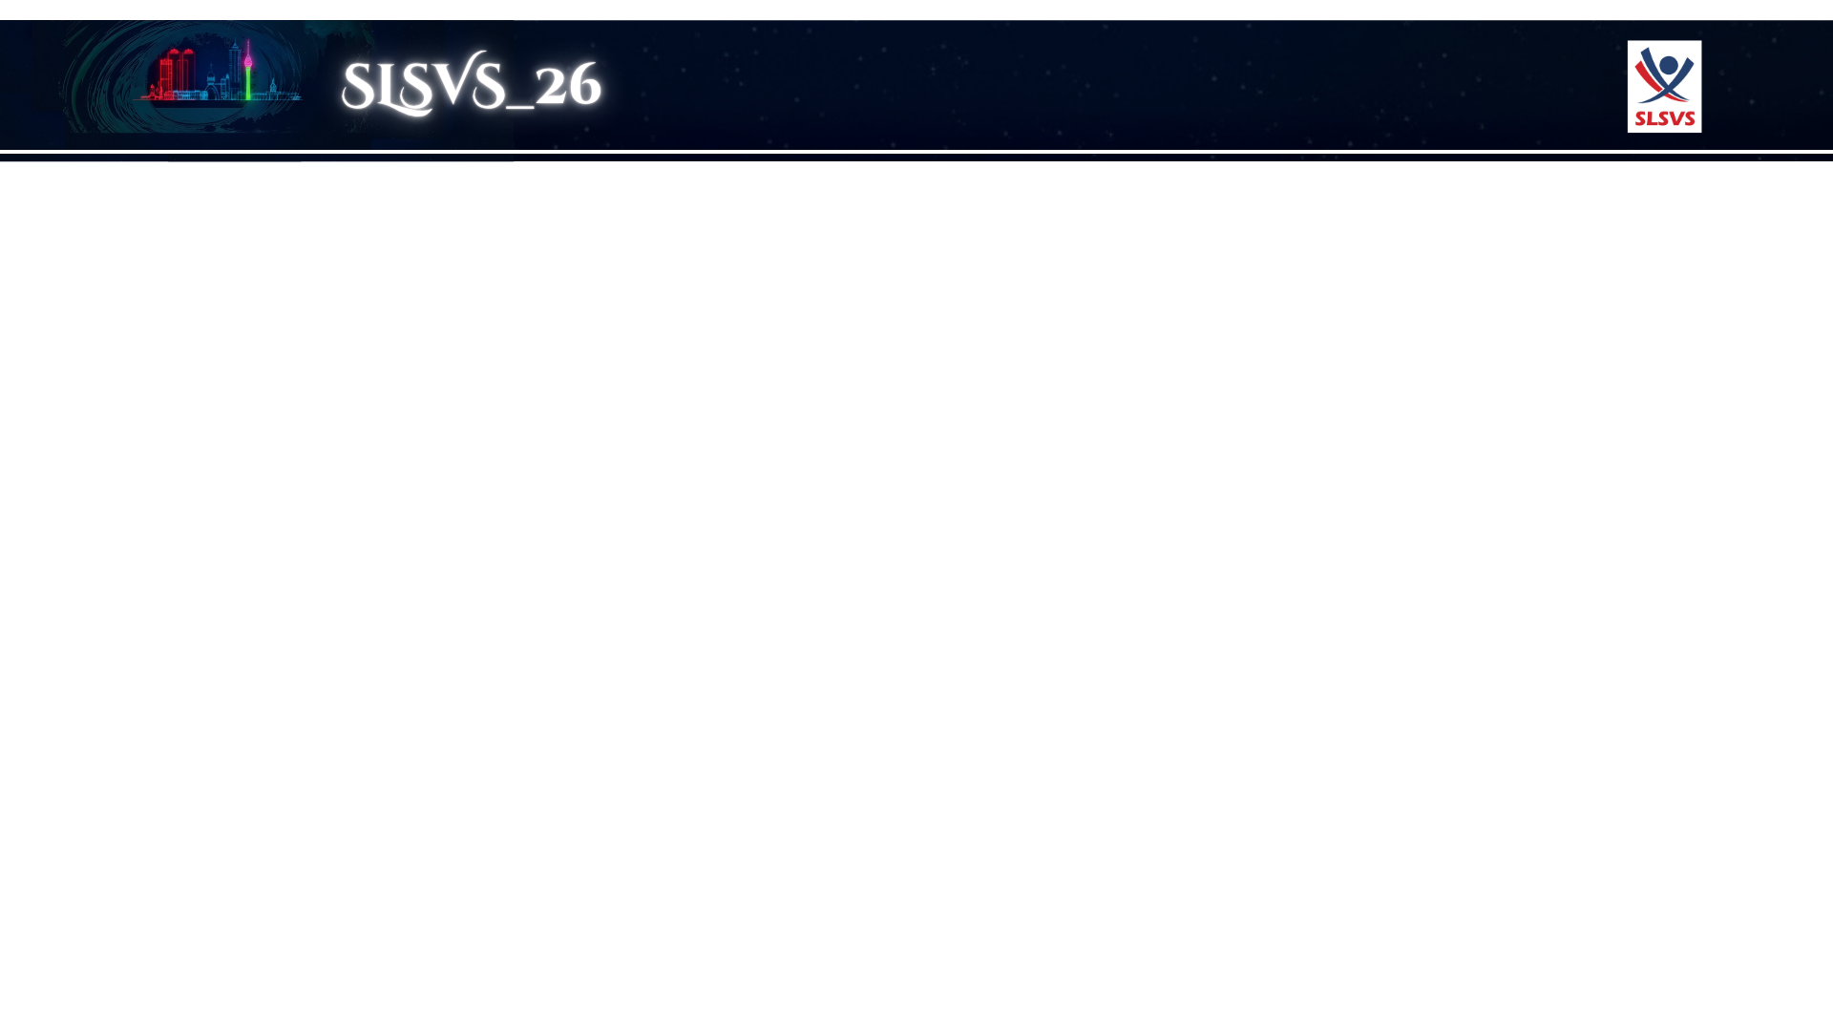
Fasciotomy in Acute Limb Ischemia: Therapeutic Necessity or Marker of Severe Disease?
Experience from a Tertiary Care Vascular Unit
²De Fonseka H.F.D.G. , ²Prasanga R.P.S , ²Vishwajith R.M.P. , ²Sancheevan S. , ²Indunil L.A. , ¹Gunawansa N.
¹ Consultant in Vascular and Transplant Surgery
² Senior Registrar in Vascular and Transplant Surgery
Vascular Unit 2- National Hospital Sri Lanka

Slide 2
Clinical Problem
Limb loss & mortality remain high in ALI
ALI → Revascularization → Reperfusion Injury → Compartment Syndrome
The Controversy
Key unanswered questions:
Who truly needs fasciotomy?
Should we do prophylactic vs therapeutic?
Does fasciotomy improve outcomes or just mark severe disease?

Slide 3
Study Objectives
Primary Aim:
Evaluate role, indications, timing, outcomes of fasciotomy in ALI
Secondary Aim:
Compare fasciotomy vs non-fasciotomy groups
Methods
Study design: Retrospective observational cohort study (comparative analysis)
Study location: Vascular Unit 2- National Hospital Sri Lanka
Study period: June 2019- June 2025 : 6 years

Slide 4
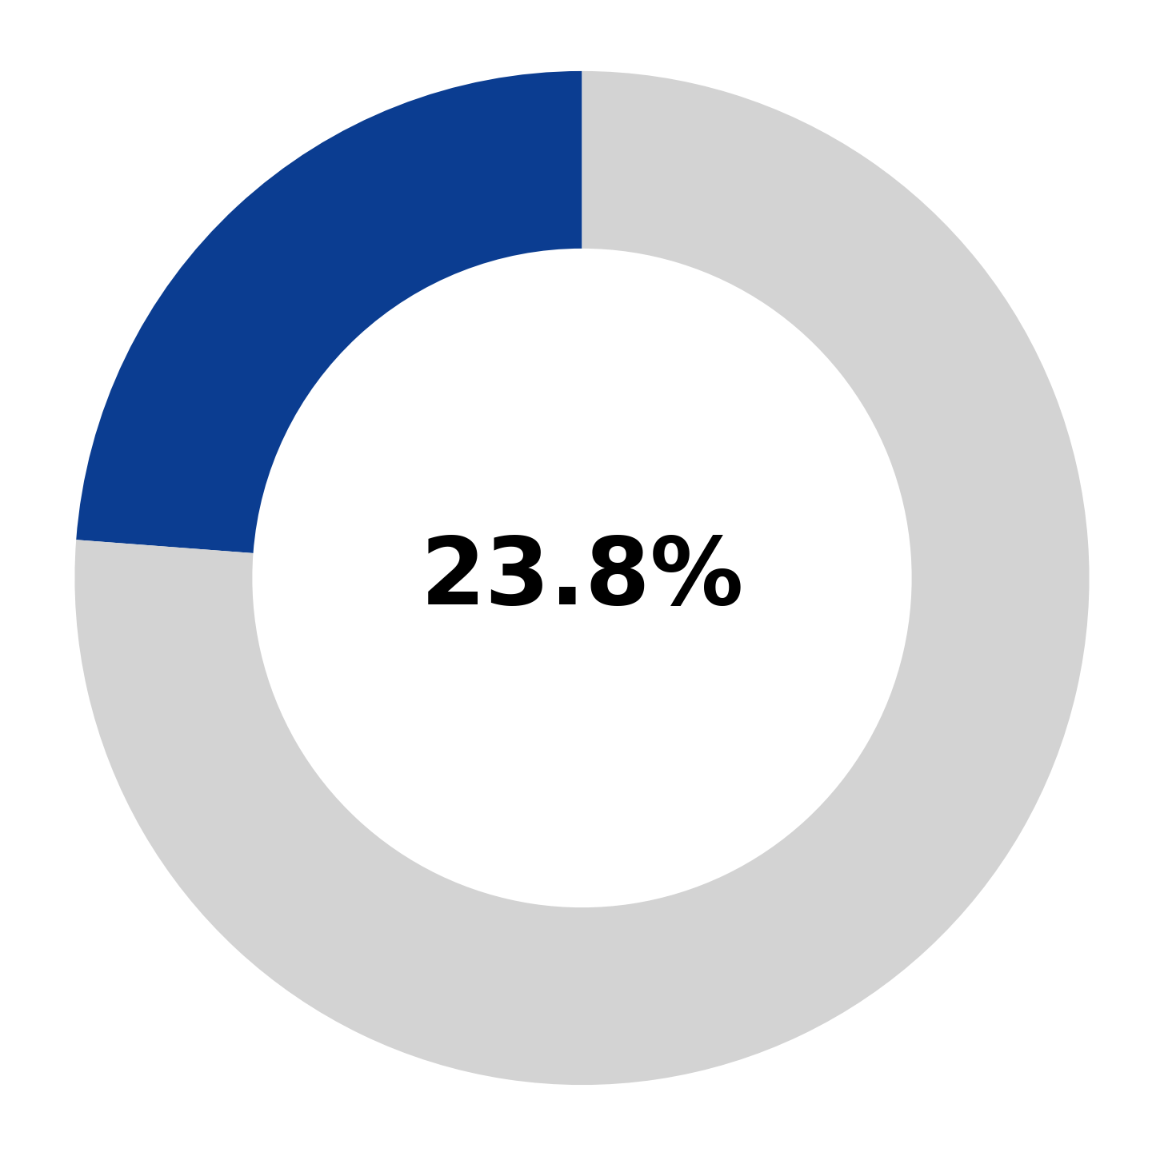
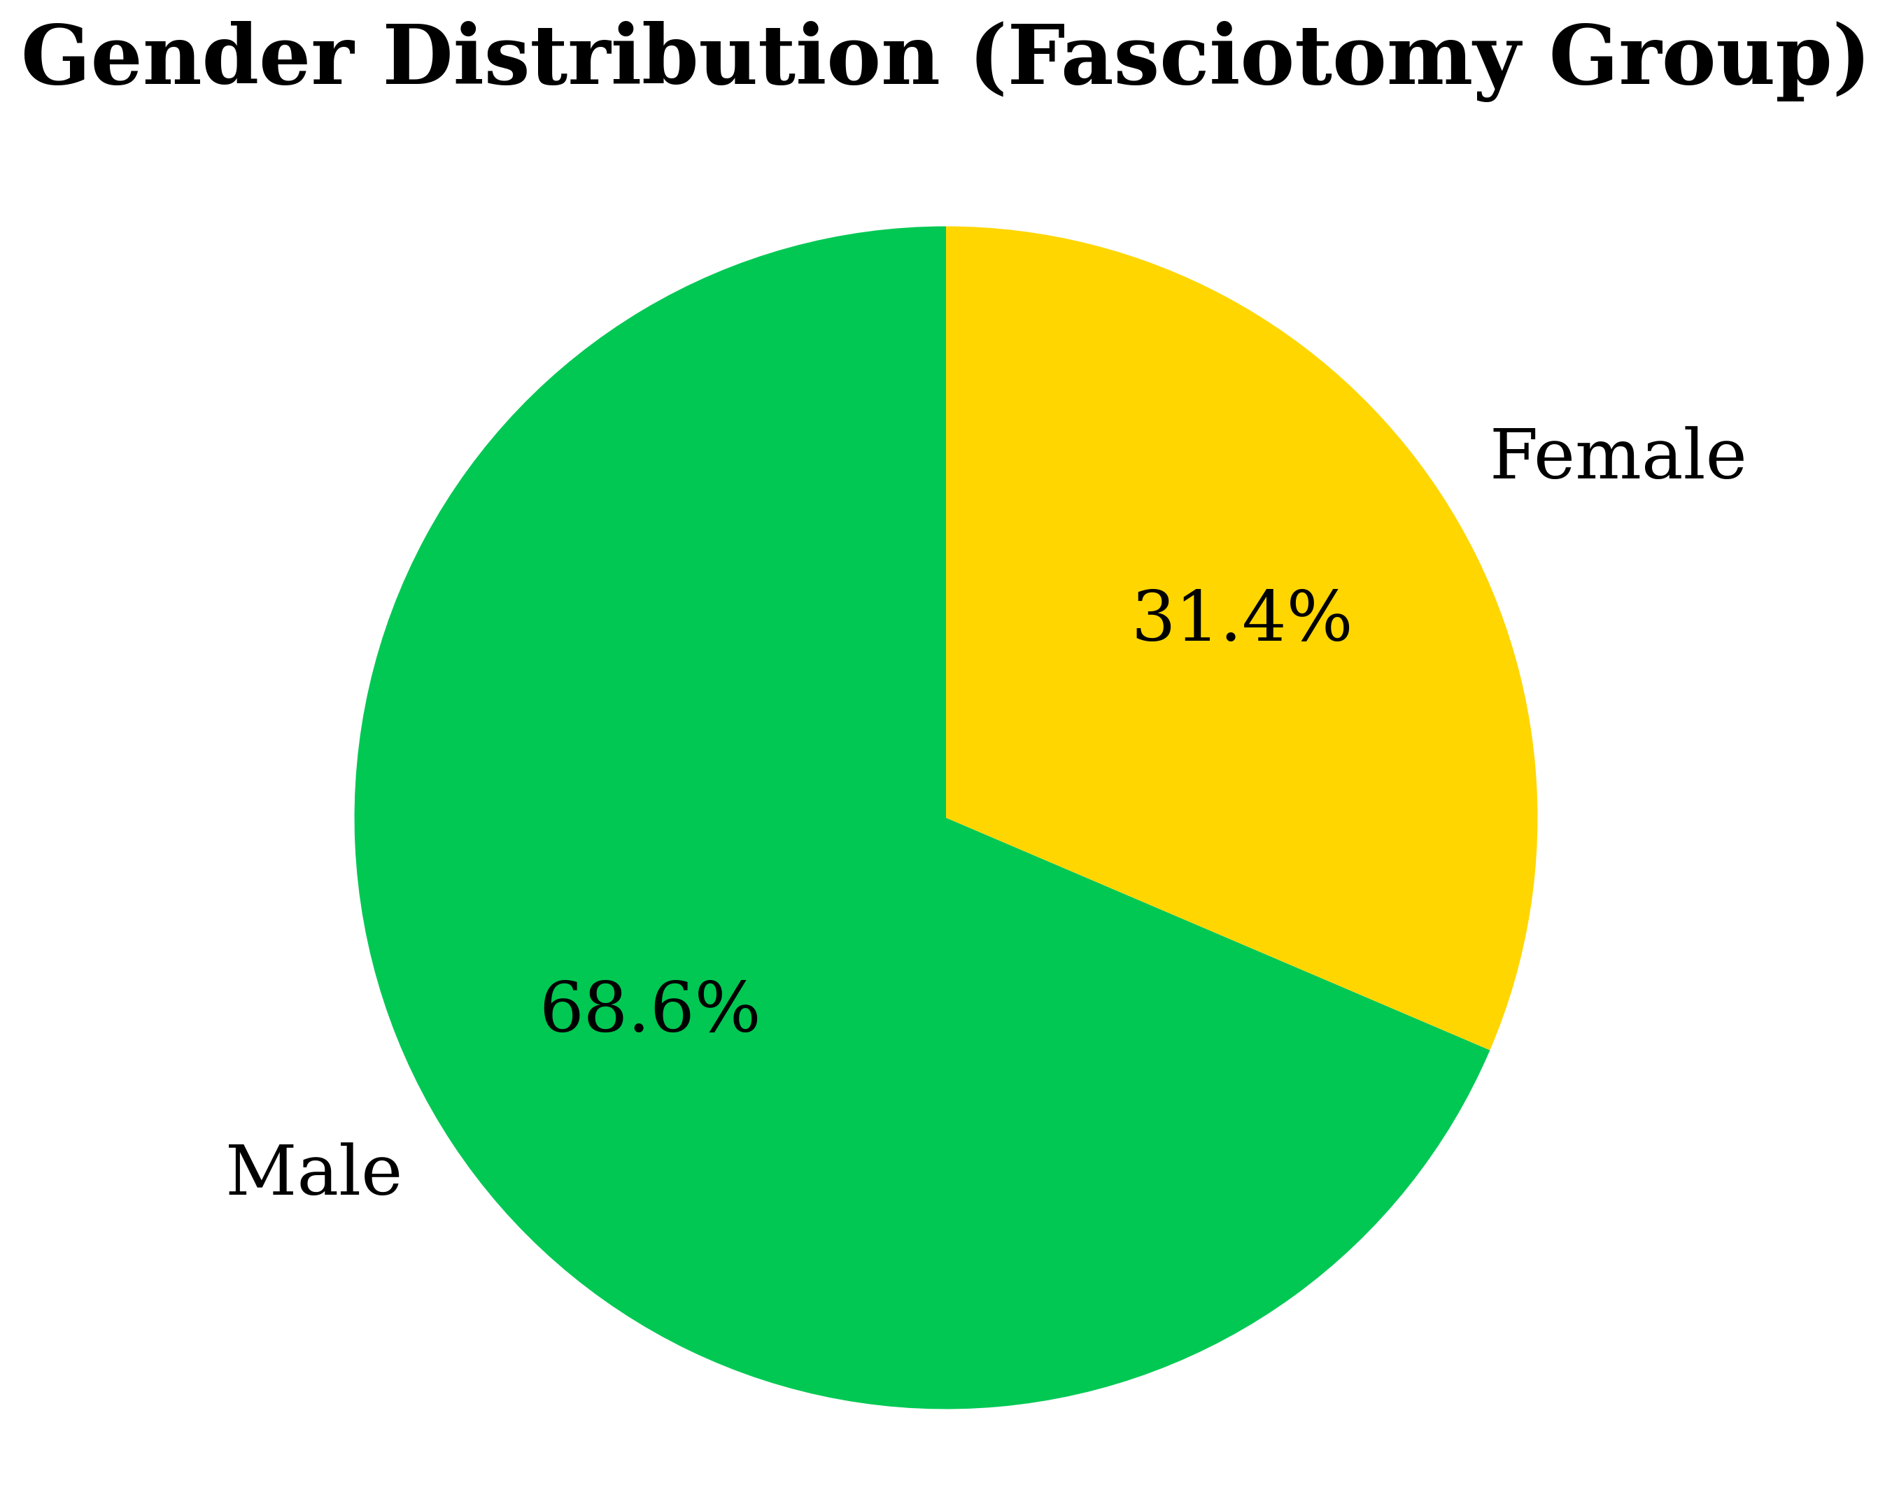
Results
Patient Distribution
Total ALI patients: 147 Fasciotomy: 35 (23.8%)
Comparison group: 112
Age (mean 57.8)
🔵 Fasciotomy (23.8%)
⚪ No fasciotomy (76.2%)

Slide 5
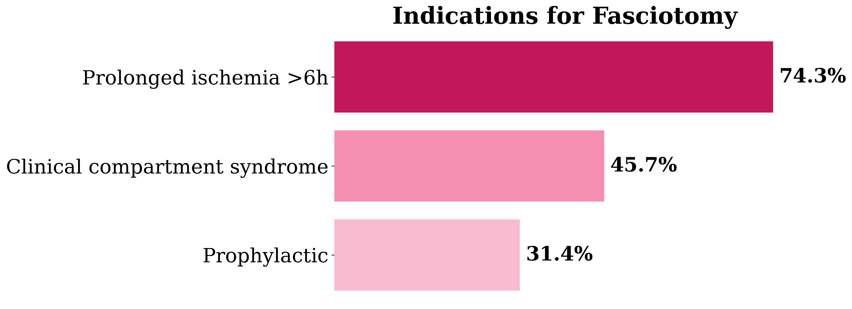
Indications for Fasciotomy
(Multiple indications per patient are possible)
Prolonged ischemia >6h → 74.3%
Clinical compartment syndrome → 45.7%
Prophylactic during revascularization → 31.4%

Slide 6
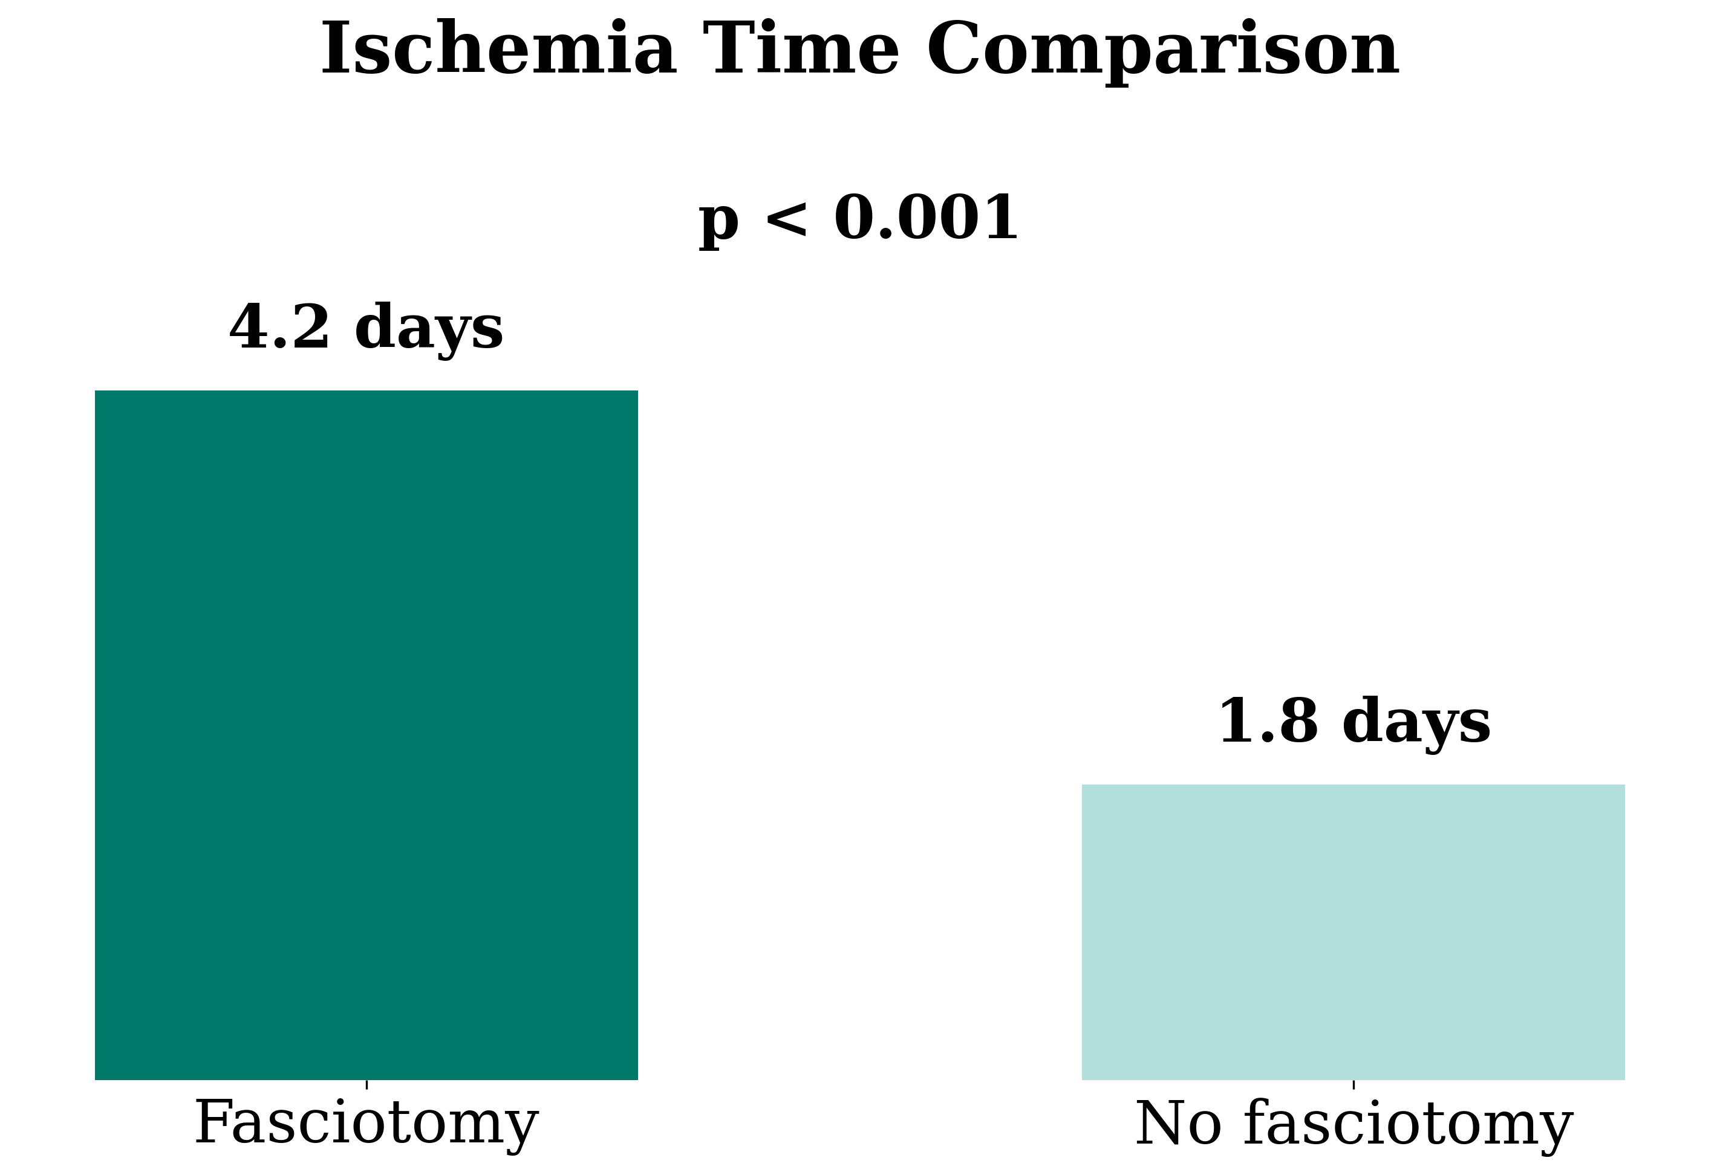
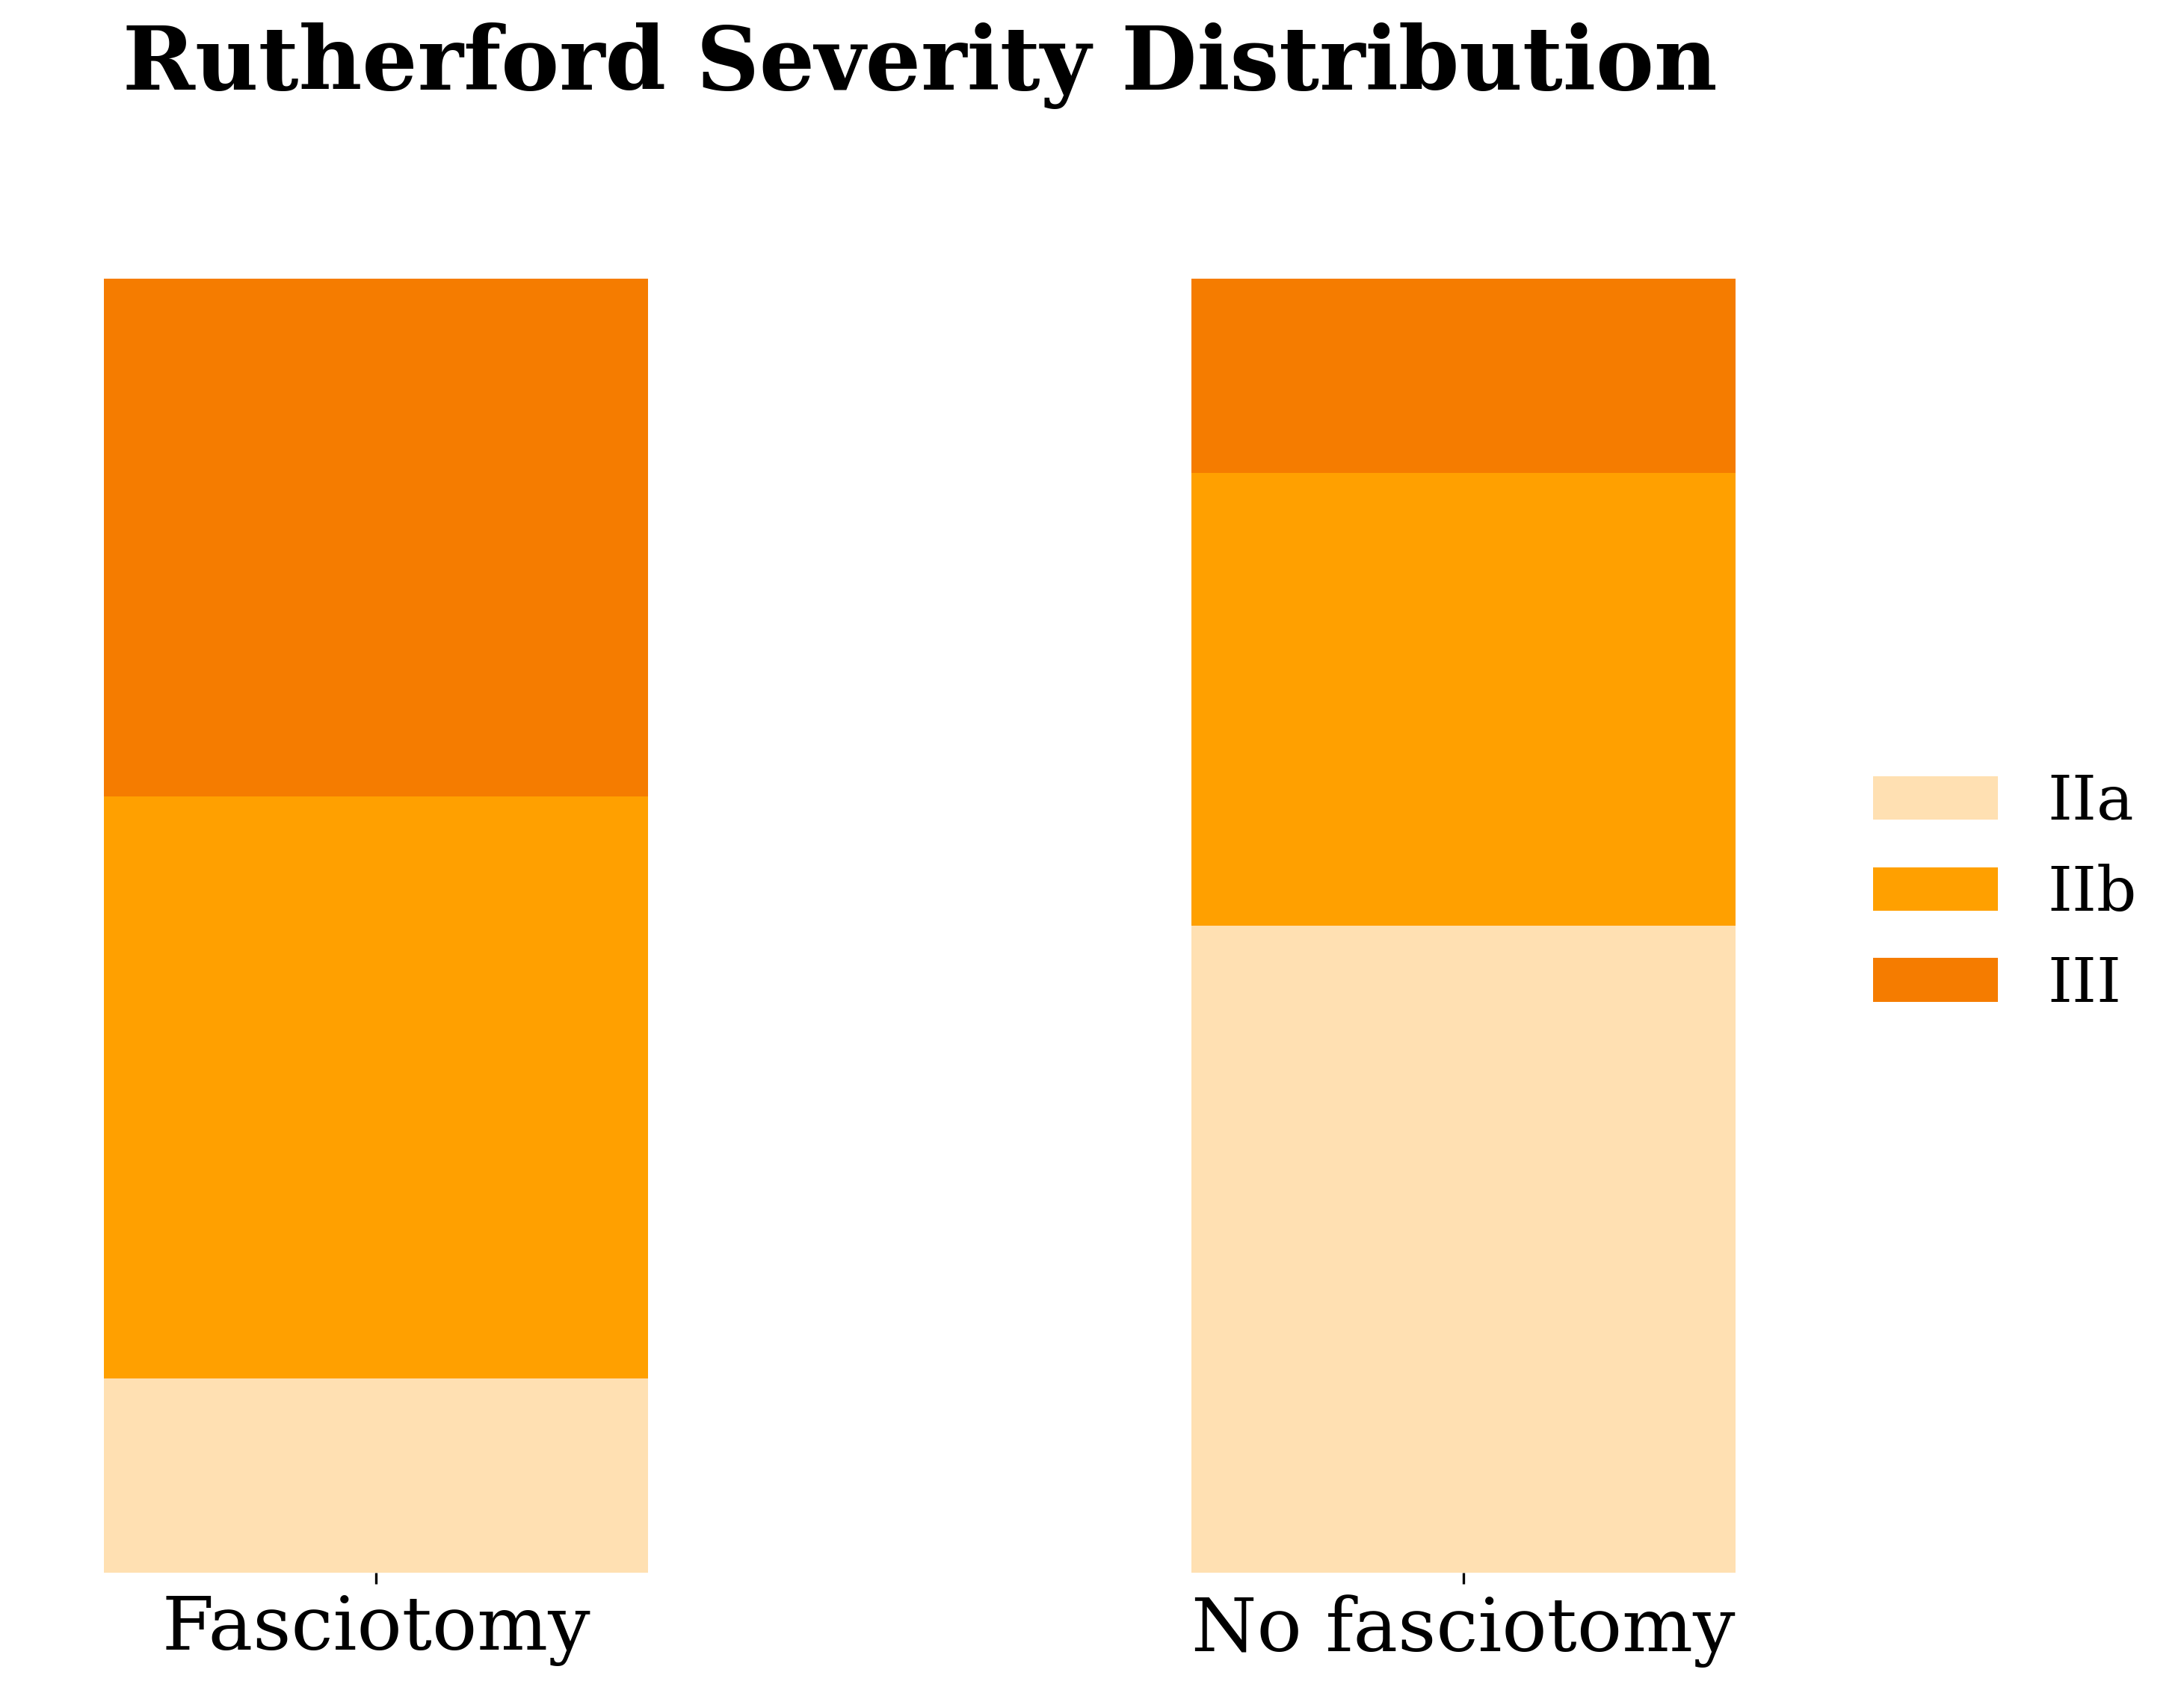
Disease Severity
Ischemia time:
4.2 days vs 1.8 days (p<0.001)
Higher Rutherford grades:
IIb & III predominance
Fasciotomy group = significantly sicker

Slide 7
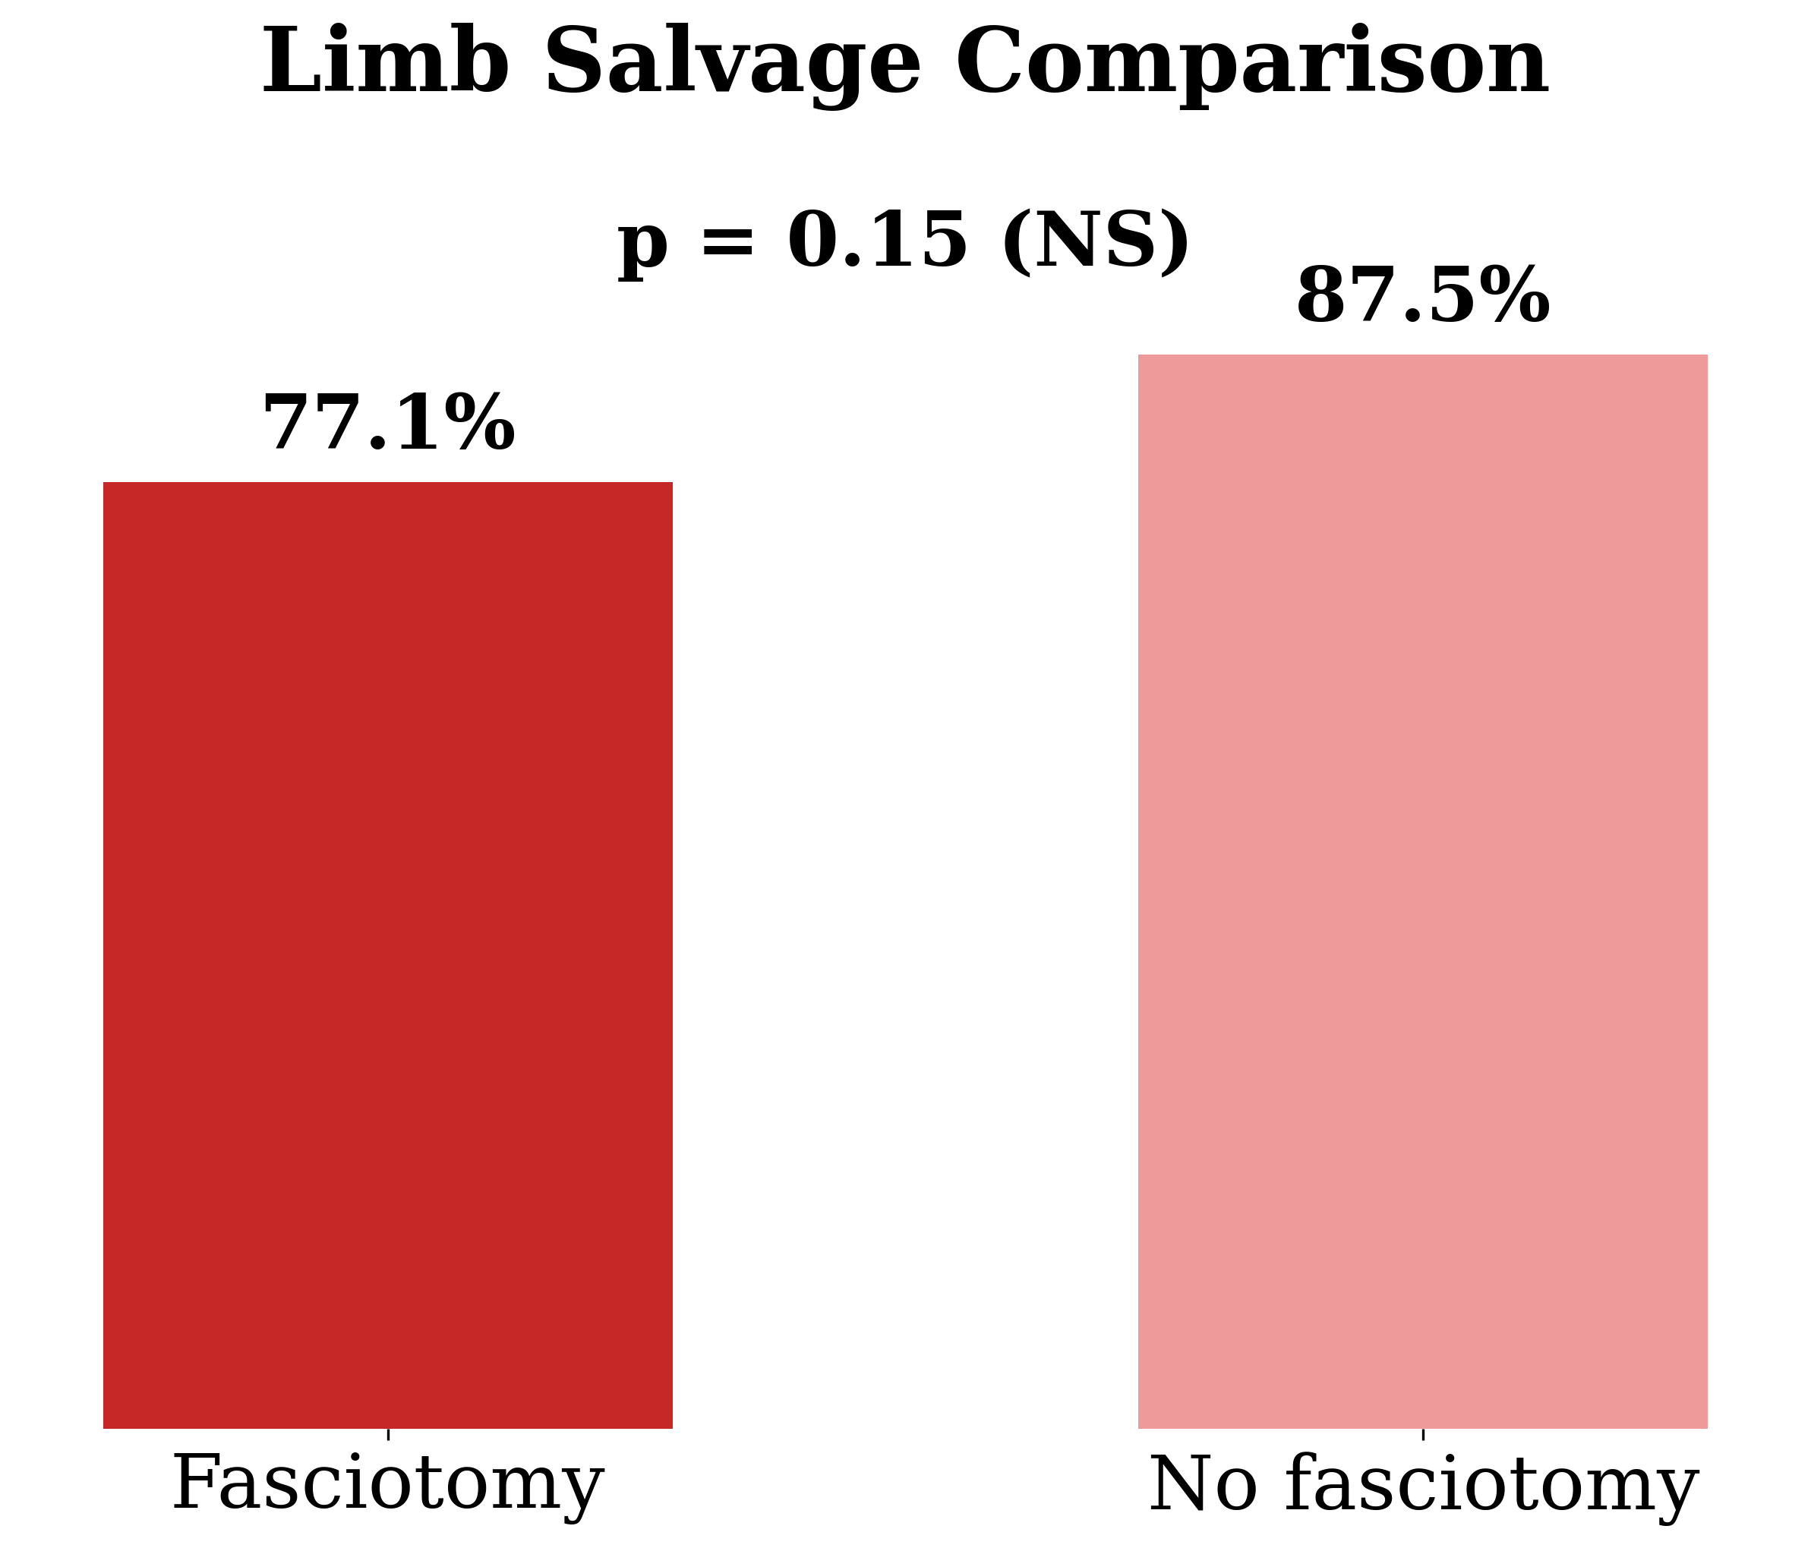
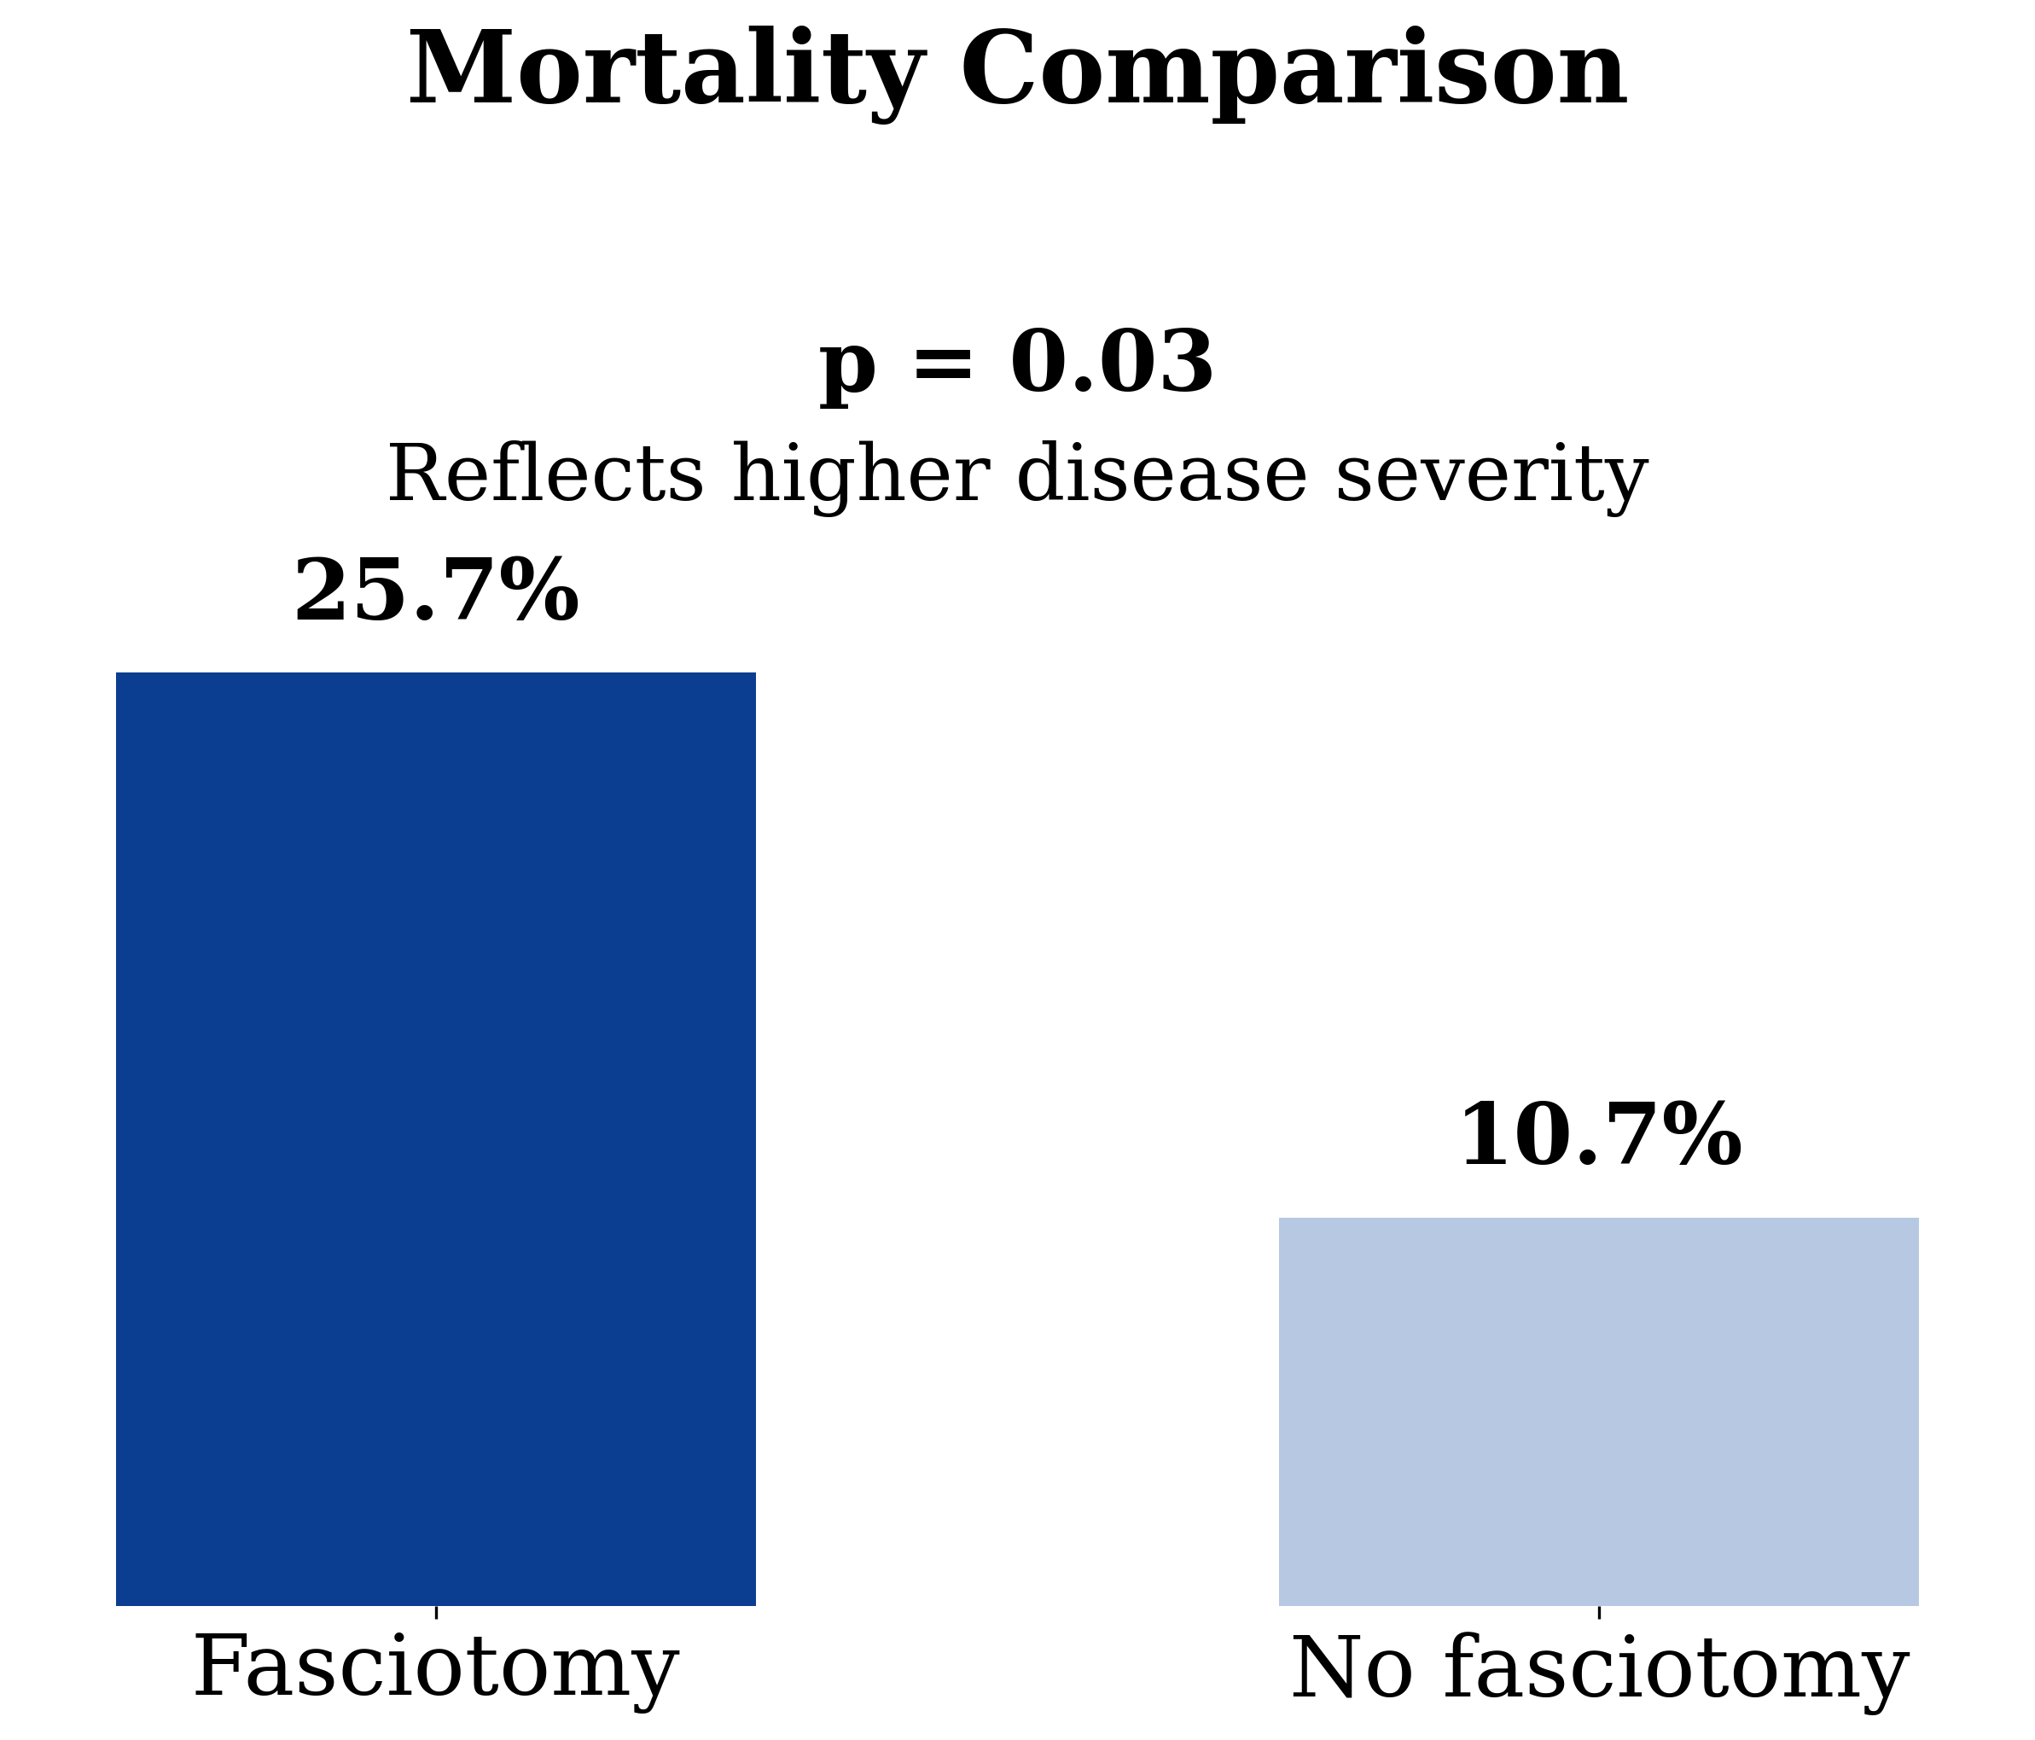
Outcomes
1. Limb salvage:
77.1% vs 87.5% (p=0.15) → NS
2. Mortality:
25.7% vs 10.7% (p=0.03)
Interpretation
Key Insight:
Higher mortality ≠ fasciotomy harm
Reflects severity of ischemia + systemic insult

Slide 8
Clinical Application
ALI Revascularization Risk assessment
Immediate fasciotomy
Low risk
Compartment syndrome
High risk
Ischemia >6hours
Rutherford 2b
Delayed revascularization
Consider prophylactic fasciotomy
Observe
Proposed approach
Immediate fasciotomy if:
Clinical compartment syndrome
Strongly consider if:
Ischemia >6 hours
Rutherford IIb
Delayed revascularization
Avoid routine prophylactic use in low-risk patients

Slide 9
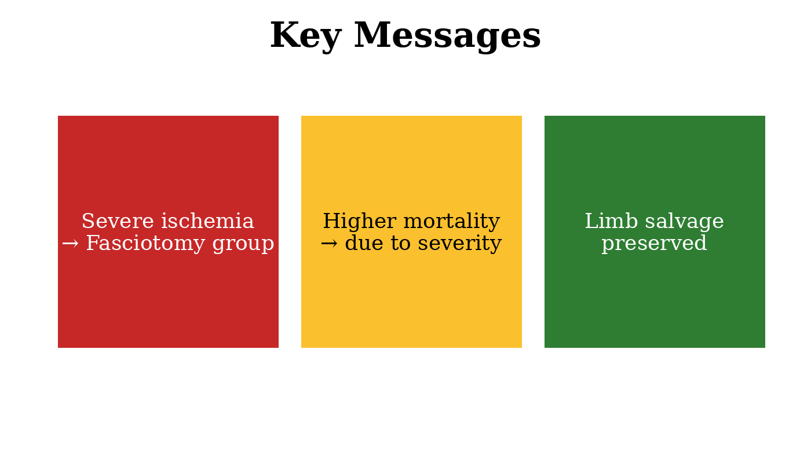
Conclusion
Three key messages:
Fasciotomy is selective, not routine
It identifies severe ALI patients
When timely, it enables acceptable limb salvage despite high risk

Slide 10

THANK YOU…

