Slide 1

Late Presentation in Sri Lankan CLTI:
A High Burden of Advanced Tissue Loss in a Diabetes- Predominant Cohort
N. Gowcikan
Vascular Professorial Unit, National Hospital of Sri Lanka
Sri Lanka Society for Vascular Surgery

Slide 2
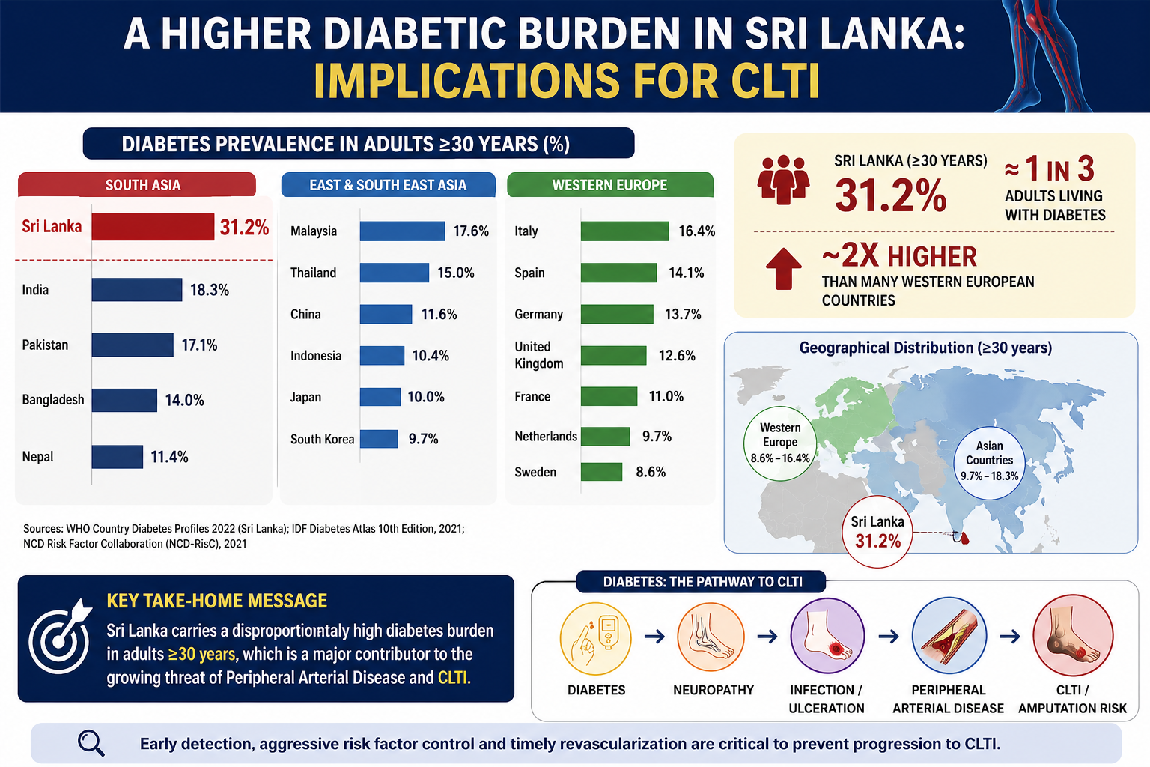

Slide 3
Why This Study?
Current CLTI evidence is largely western-derived and may not fully reflect south Asian disease patterns
Understanding our local disease pattern is essential to develop context-specific treatment strategies
Lack of local data on severity at presentation and need to quantify late-stage disease burden

Slide 4
Methods
Retrospective cohort (n = 150)
NHSL vascular Professorial unit
Variables: DM Prevalence, CLTI Presentation time, Primary amputation rate
Chi-square analysis

Slide 5
Patient Profile
Mean age: 63.1 ± 9.4
Diabetes: 88.7%
Delayed presentation >30 days: 32.4%

Slide 6
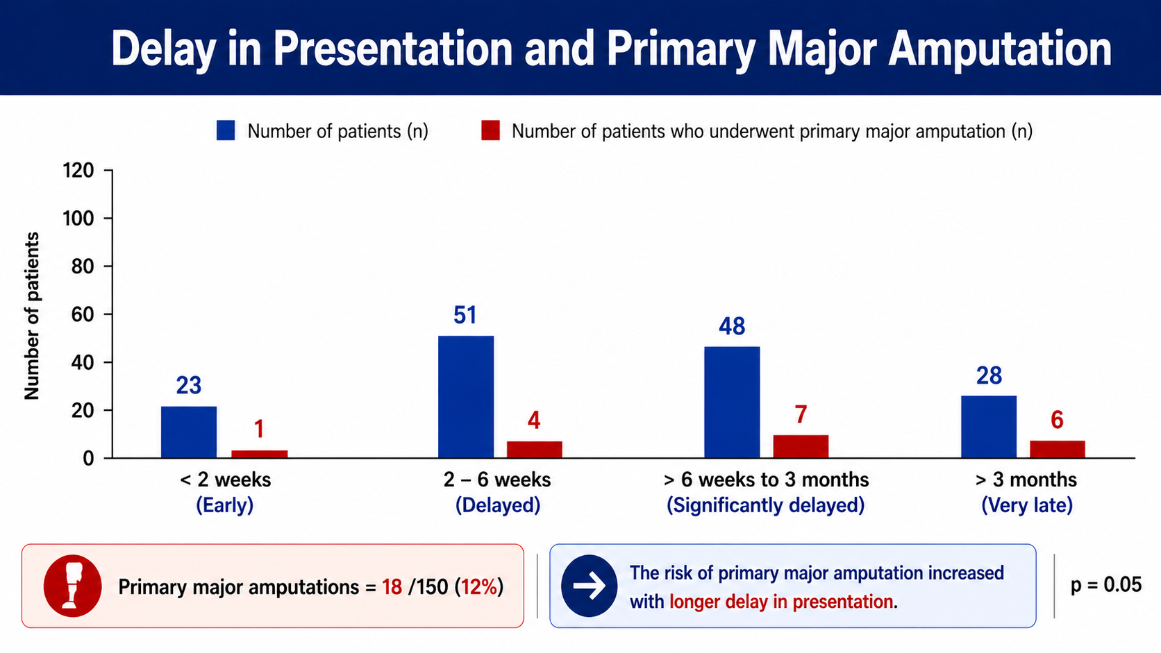

Slide 7
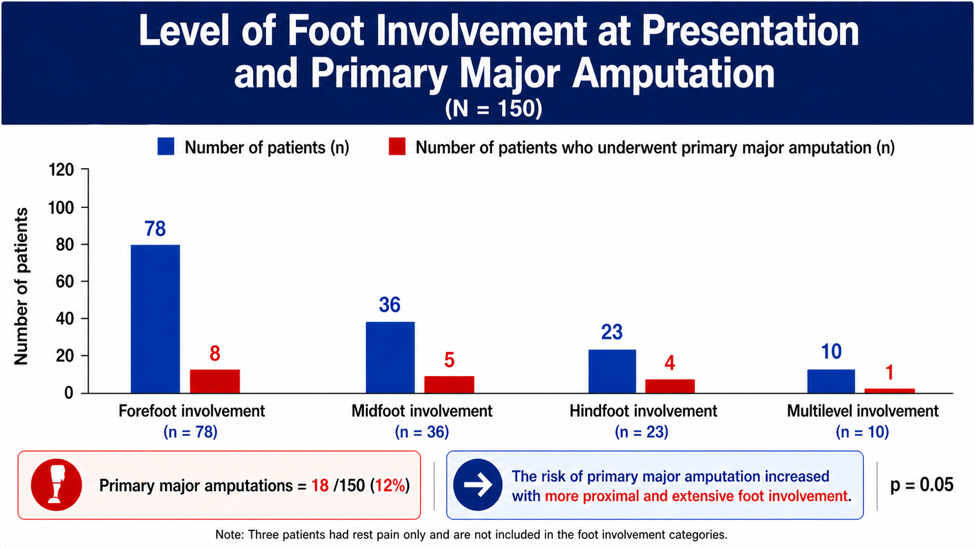

Slide 8
Interpretation
Late, advance tissue loss presentation is common in Sri Lanka
High diabetes burden drives disease severity to more complex

Slide 9
Implications
Diabetic foot screening programs
Early vascular referral pathways
Community awareness

Slide 10
THANK YOU

