Slide 1

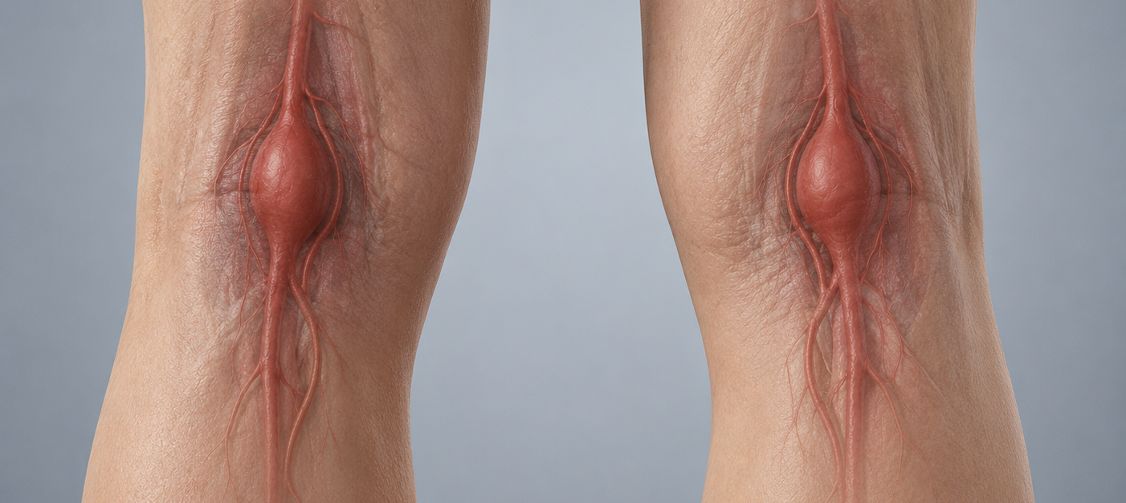

Bilateral Popliteal Artery Aneurysms: A Five-Patient Case Series Demonstrating the Spectrum of Presentation and Management
Presenting author - Sancheevan S
RMP Vishwajith, S. Sancheevan, L.A. Indunil, R.P.S. Prasanga, HFDG Fonseka, N. Gunawansa
NATIONAL HOSPITAL OF SRI LANKA

Slide 2
Introduction
Popliteal artery aneurysm (PAA) is the most common peripheral arterial aneurysm and is frequently bilateral.
Acute limb ischaemia remains the commonest mode of presentation.
The management of bilateral PAAs requires individualised decision-making based on anatomical complexity, conduit availability, aneurysm characteristics, and patient fitness.
We present a five-patient bilateral PAA case series demonstrating the broad clinical spectrum and varied management strategies.

Slide 3
Demographic
  Five patients
  All male
  Mean age - 80.8 years (range: 64–93).
Presentation
  Three patients presented with acute or acute-on-chronic limb ischaemia (Rutherford IIa)
  Other two patients incidental diagnosis

Slide 4
Management
  Three patients underwent surgical intervention.
  Two nonagenarians (>90 years) were deemed unfit for surgery due to advanced age and comorbidity and were managed conservatively with systemic heparin anticoagulation alone.
Surgical management included aneurysm ligation and reversed saphenous vein graft (RSVG) bypass without excision via medial approach and PTFE interposition grafting via posterior approach.
Bilateral popliteal aneurysms were repaired sequentially in separate admissions

Slide 5
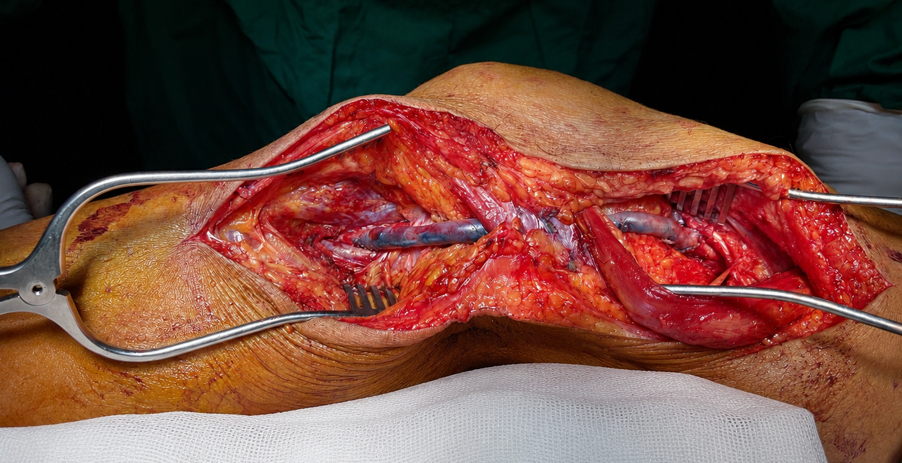
Aneurysmal popliteal artery is ligated proximally and distally
Reversed saphenous vein graft is used for bypass from distal SFA to popliteal artery distal to aneurysm

Slide 6
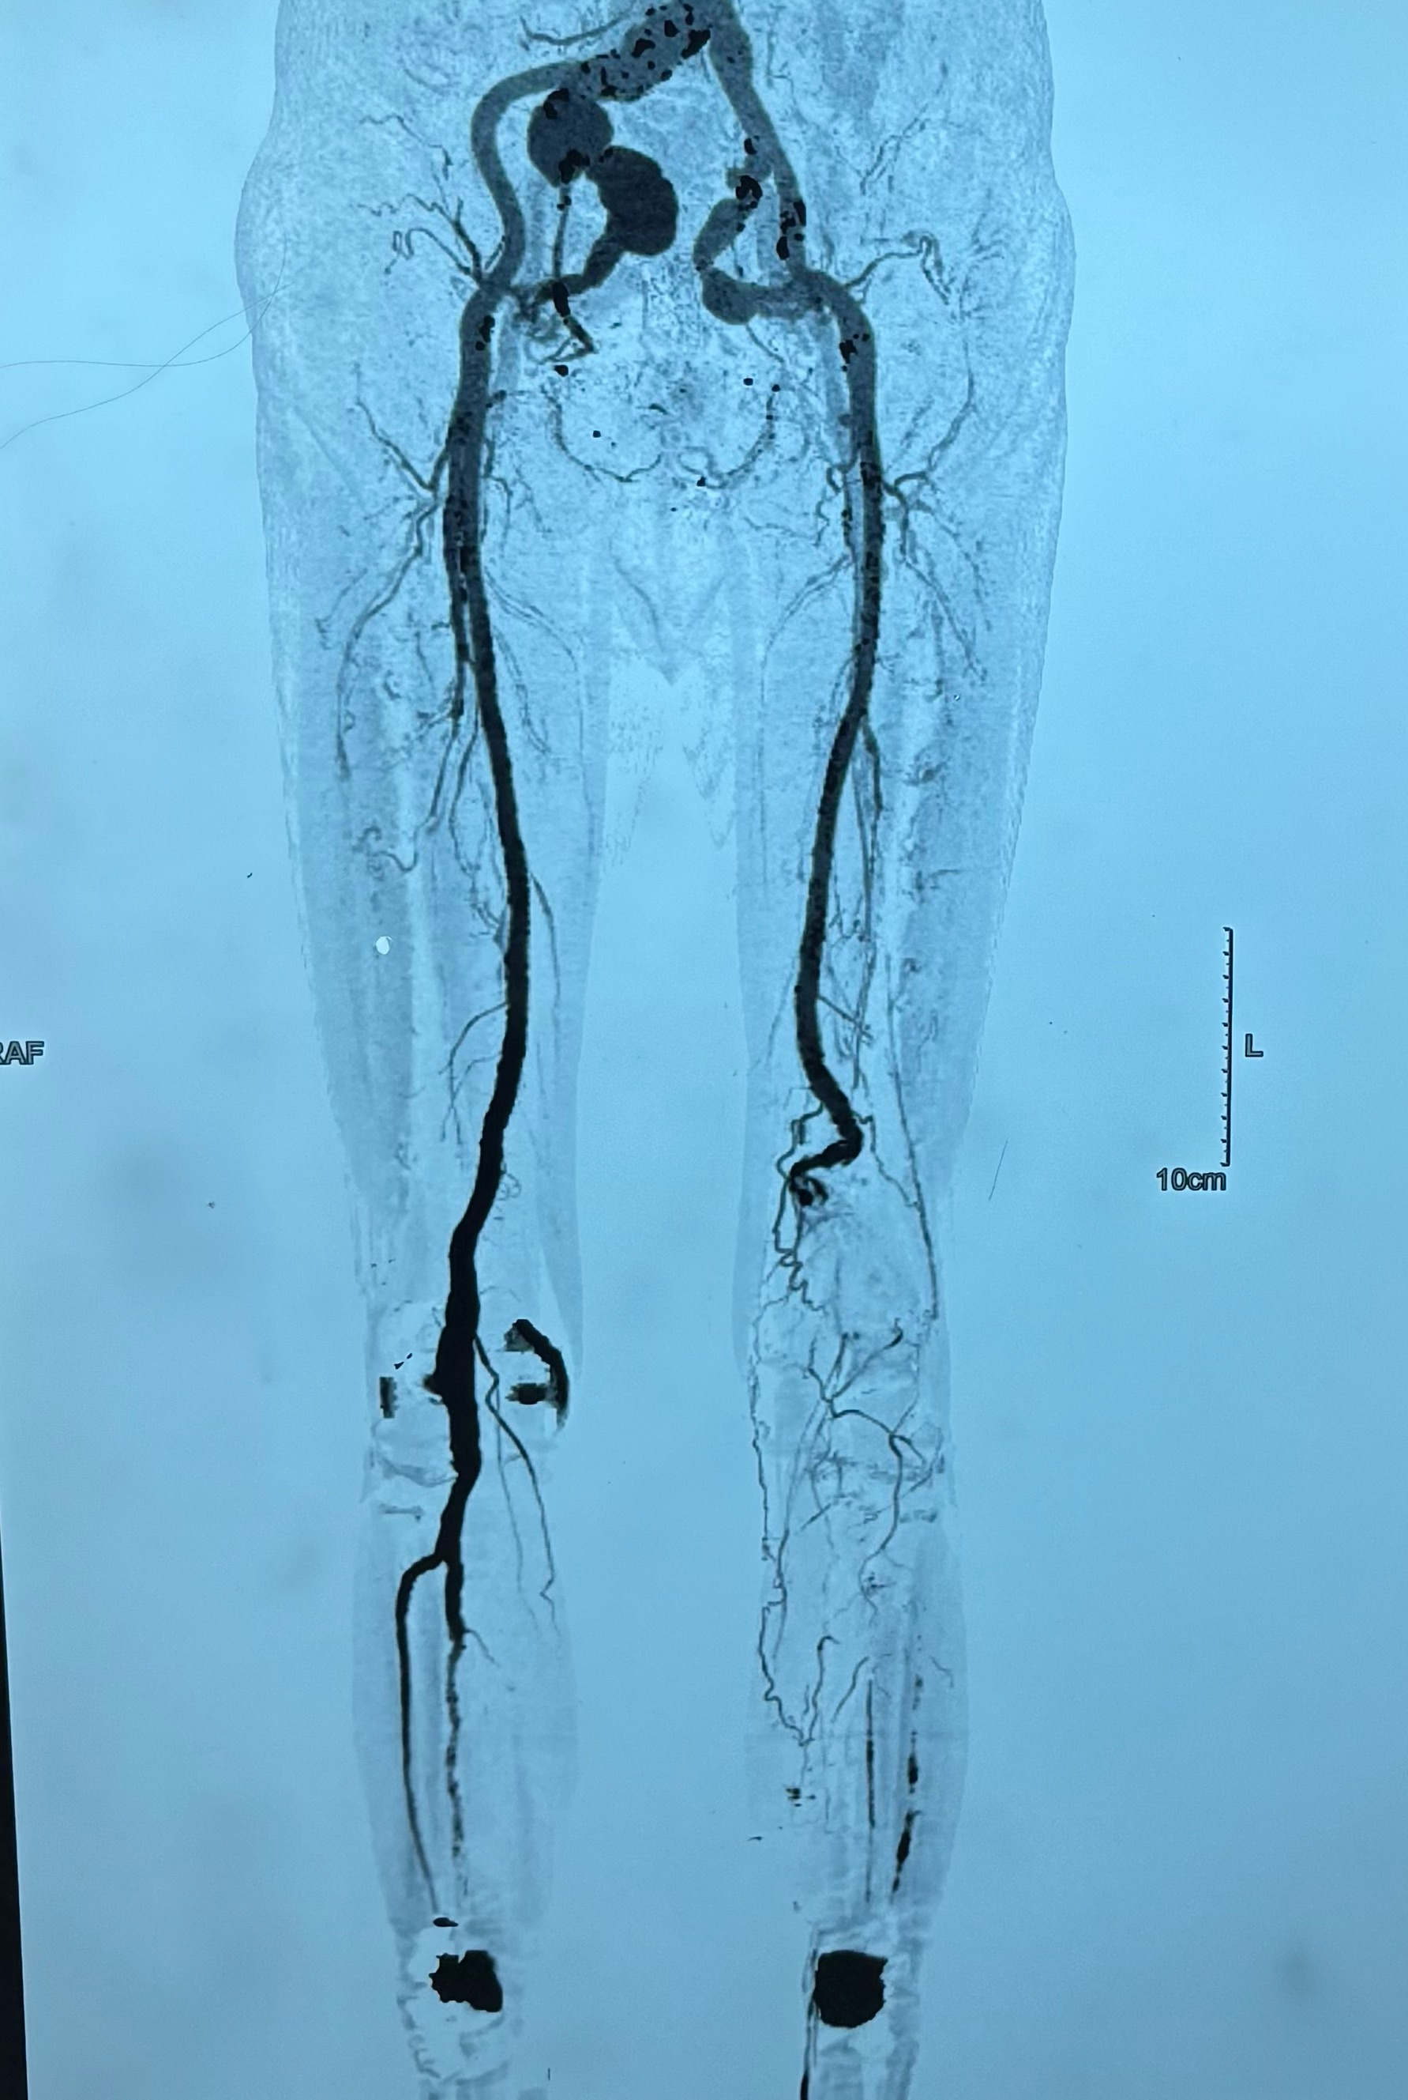

Slide 7
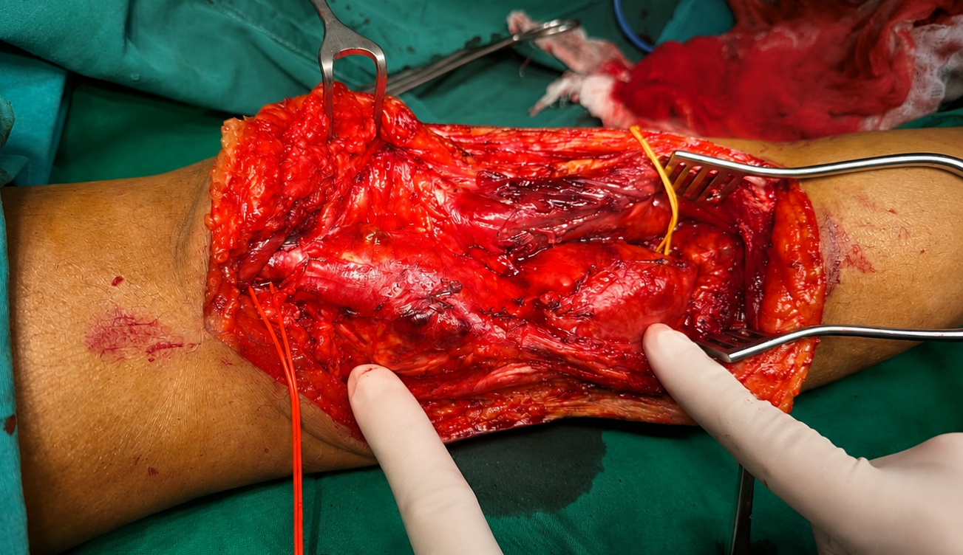
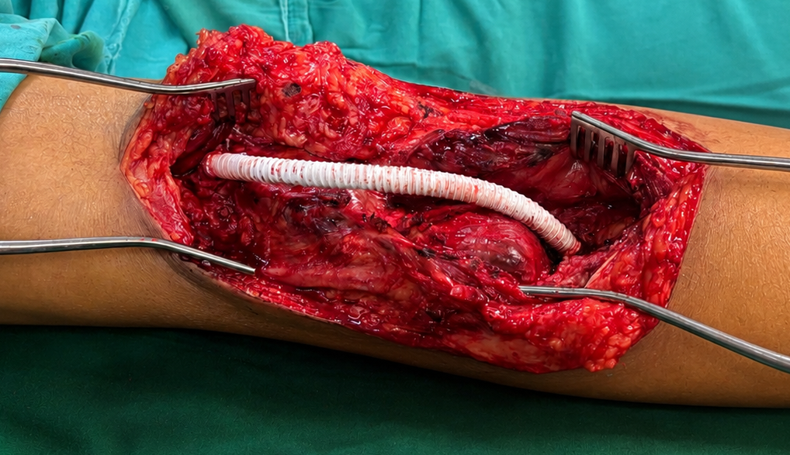
Proximally and distally transected and repaired with interposition graft (reinforced PTFE)
Two aneurysms in popliteal artery
Presented with thrombosis and ALI

Slide 8
Immediate outcome
Surgically treated patients
  Symptoms improved
  Postoperative course was uneventful
  Discharged on 3- 5 days after surgery
Conservatively managed patients
Symptomatic improvement with heparin infusion

Slide 9
Outcome
Long-term follow-up was available for three patients. The 64-year-old patient, a foreign national, remains asymptomatic with normal limb function at 1-year follow-up.
The 68-year-old patient is clinically well with no vascular complications.
One 90-year-old patient died three months post-presentation due to pneumonia, unrelated to aneurysm pathology or management.
The second conservatively managed nonagenarian remained clinically stable, survived 14 months following aneurysm detection, and died from unrelated causes.
Limb salvage was achieved in all surgically treated patients.

Slide 10
Discussion
This series highlights the variable presentation of bilateral PAAs and reinforces the importance of tailored operative strategy.
Autologous vein remains the conduit of choice when feasible, while PTFE grafting is a valuable alternative in selected cases.
In carefully selected nonagenarian patients unfit for surgery, conservative management with anticoagulation alone may be appropriate.

Slide 11
Conclusion:
Bilateral PAAs require individualised, risk-adapted management.
Consideration of patient age, aneurysm size, clinical presentation, and physiological reserve is essential to optimise outcomes.

Slide 12
Thank you

