Slide 1

Etiology-Based Outcome in Acute Limb Ischemia : Cardiac Embolism vs Atherosclerotic Disease
Presenting author - Sancheevan S
VISHWAJITH RMP, PRASANGA RPS, SANCHEEVAN S, INDUNIL LA, DE FONSEKA HFDG, GUNAWANSA N
NATIONAL HOSPITAL OF SRI LANKA

Slide 2
Background
Acute limb ischemia (ALI) arises from diverse etiologies, which may influence clinical presentation and outcomes.
This study compares outcomes between cardiac embolic and atherosclerotic causes of ALI.

Slide 3
Methodology
A comparative analysis was conducted on 147 patients with ALI
Stratified by etiology: cardiac embolism and atherosclerotic disease
  Patients with other etiologies were excluded.
Outcomes assessed included limb salvage and mortality

Slide 4
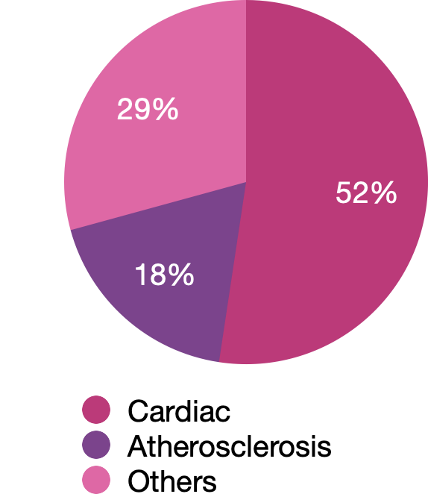
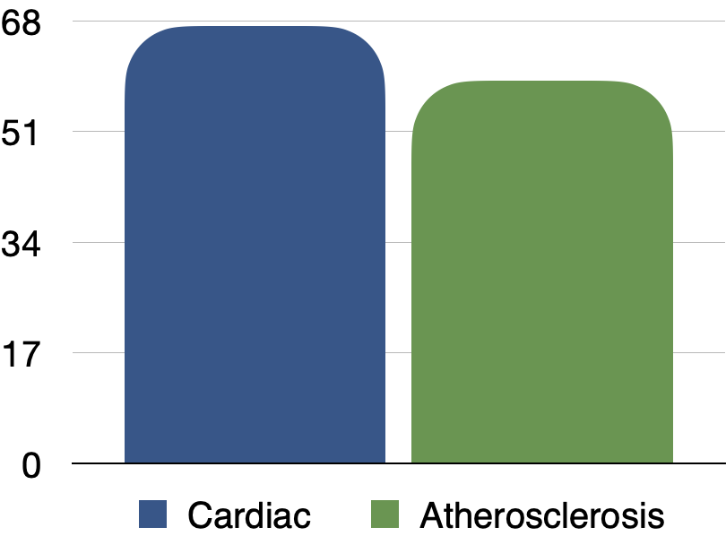
Cause for ALI
Age
67.3
58.9
p = 0.02
Most common causes for cardiac emboli - atrial fibrillation and recent myocardial infarction.

Slide 5
Results
Atherosclerotic disease more frequently presented as acute-on-chronic ischemia (37% vs 8%, p < 0.001).
Rutherford grade distribution differed significantly, with cardiac embolic cases presenting with more severe ischemia.

Slide 6
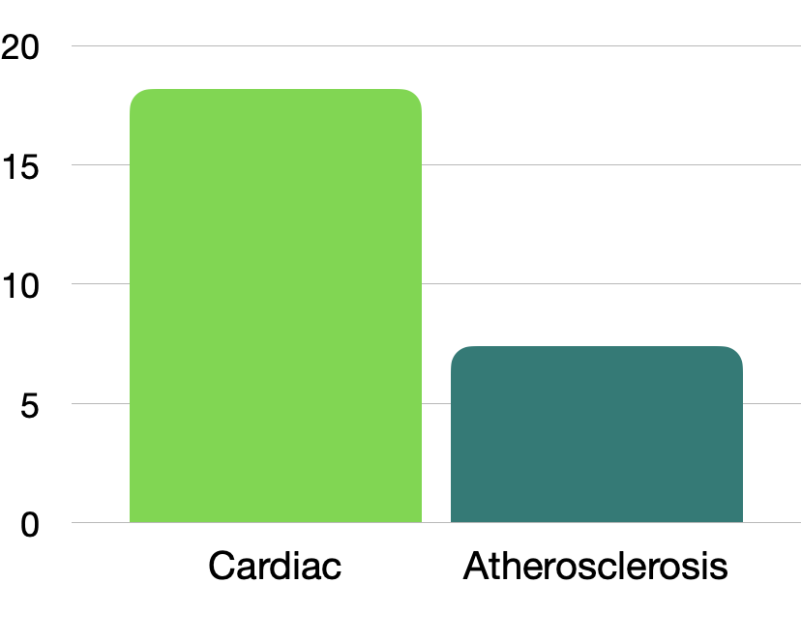
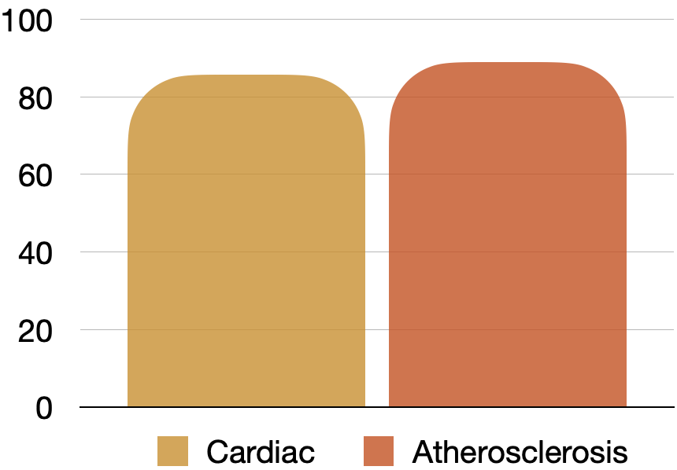
Mortality
Limb Salvage
18.2%
85.7%
88.9%
7.4%
Limb salvage rates were comparable between groups (p = 0.72).
Mortality was higher in the cardiac embolism group (p = 0.17), largely due to underlying cardiac comorbidities.

Slide 7
Conclusions
While limb salvage rates are similar across etiologies
Cardiac embolic ALI is associated with increased mortality related to cardiac comorbidity.
Optimized cardiac management and appropriate anticoagulation are essential in these patients.

Slide 8
Thank you

