Slide 1

EARLY OUTCOMES OF OPEN ABDOMINAL AORTIC ANEURYSM REPAIR: A FIVE-YEAR RETROSPECTIVE STUDY IN A SRI LANKAN TERTIARY CARE SETTING
Samarasinghe AKBBTB, Rathnayake RMJBS, Liyanage VDP
Department of Surgery, Faculty of Medicine, University of Peradeniya,
Sri Lanka

Slide 2
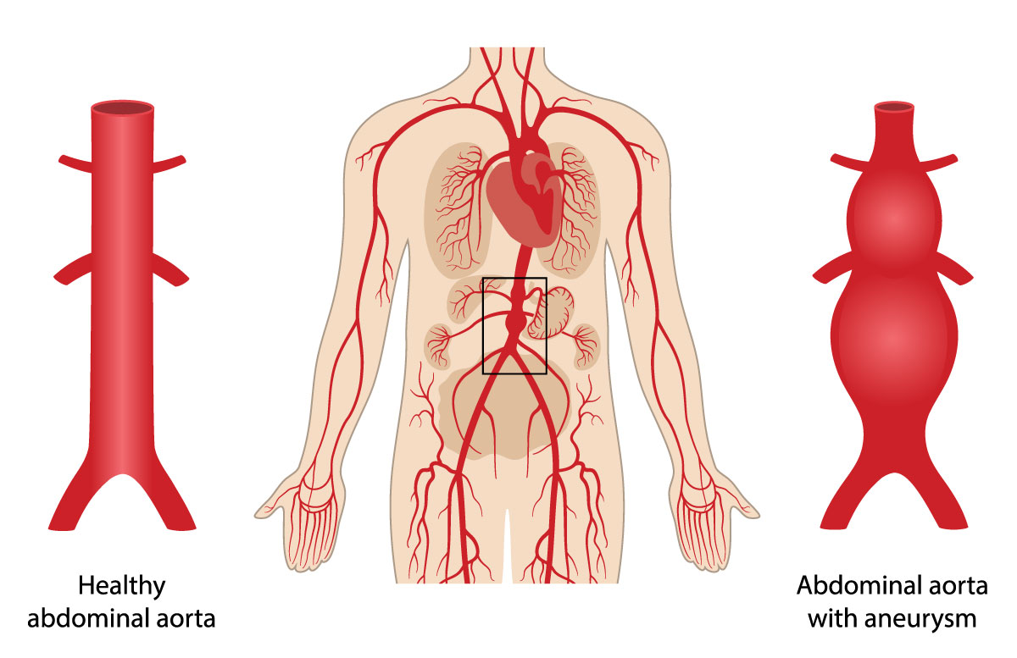
INTRODUCTION: ABDOMINAL AORTIC ANEURYSM (AAA)
Permanent, localized dilatation of the abdominal aorta, typically defined when the diameter exceeds 3 cm or is more than 50% greater than normal.
Surgical management options
  Open surgical repair
  Endovascular aneurysm repair (EVAR)
Open surgical repair remains essential in centres where EVAR is limited or anatomically unsuitable

Slide 3

OBJECTIVES
To evaluate early outcomes of AAA cases managed over a five-year period at a tertiary care centre, focusing on postoperative mortality, complications, and intensive care unit (ICU) utilisation following open repair.

Slide 4
METHODOLOGY: STUDY DESIGN AND PARTICIPANTS
Study design: Retrospective study
Setting: Tertiary care centre, Sri Lanka
Period: January 2020 – December 2024
AAA cases (2020–2024)
n = 31
↓
Excluded (died prior to surgery)
n = 2
↓
Open AAA repair
n = 29
↓
Outcome assessment
(Mortality, Complications, ICU stay)

Slide 5

METHODOLOGY: DATA ANALYSIS
Data were analysed using IBM SPSS
Subgroup comparisons between acute and elective presentations using Fisher’s exact and Mann–Whitney U tests.
The significance level was set at a cut-off p-value of 0.05

Slide 6
RESULTS
Table 1: Baseline Demographic and Clinical Characteristics
Table 2: Postoperative Complications
Variable | Value
Total number | 29
Mean age (years) | 67.4
Male (%) | 93.1%
Acute presentation (%) | 20.7%
Complication | n (%)
Any complication | 10 (34.5%)
Pulmonary complications | 5 (17.2%)
Acute kidney injury | 2 (6.9%)
Atrial fibrillation | 2 (6.9%)
Stroke | 1 (3.4%)
Re-exploration | 1 (3.4%)
Table 3: ICU Utilisation
Table 4: Mortality
Variable | Value
Median ICU stay | 3.5 days
Outcome | n (%)
Postoperative mortality | 1(3.4%)

Slide 7
RESULTS
Table: Subgroup Analysis (Acute vs Elective Presentation)
Outcome | Elective | Acute | p-value
Complications | 46.2% | 66.7% | 0.628
Median ICU stay (days) | 3 | 5 | 0.086

Slide 8
CONCLUSIONS
Open AAA repair showed acceptable early outcomes
Mortality (3.4%) consistent with international benchmarks
Complications occurred in 34.5%, most commonly pulmonary
Acute presentation showed higher complication rates and ICU stay
Larger studies are needed to identify predictors of adverse outcomes

Slide 9
ACKNOWLEDGEMENTS
To all the patients who participated in the study
To all the theatre staff and everybody who helped in taking care of the patients

Slide 10
REFERENCES
Kent KC. Clinical practice. Abdominal aortic aneurysms. New England Journal of Medicine. 2014;371(22):2101–2108.
Paravastu SCV, Jayarajasingam R, Cottam R, et al. Endovascular repair of abdominal aortic aneurysm. Cochrane Database of Systematic Reviews. 2014;(1):CD004178.
Lederle FA, Freischlag JA, Kyriakides TC, et al. Outcomes following open repair of abdominal aortic aneurysm. New England Journal of Medicine. 2002;346(19):1437–1444.
Wanhainen A, Verzini F, Van Herzeele I, et al. Editor’s choice – European Society for Vascular Surgery (ESVS) 2019 clinical practice guidelines on the management of abdominal aorto-iliac artery aneurysms. European Journal of Vascular and Endovascular Surgery. 2019;57(1):8–93.

Slide 11
REFERENCES
Reimerink JJ, van der Laan MJ, Koelemay MJW, et al. Systematic review and meta-analysis of population-based mortality from ruptured abdominal aortic aneurysm. British Journal of Surgery. 2013;100(11):1405–1413.
Mani K, Björck M, Lundkvist J, et al. Improved long-term survival after elective abdominal aortic aneurysm repair. Circulation. 2009;120(3):201–211.
Ultee KHJ, Bastos Gonçalves F, Hoeks SE, et al. Long-term outcomes of open abdominal aortic aneurysm repair. Journal of Vascular Surgery. 2016;63(6):1545–1552.
Dimick JB, Stanley JC, Axelrod DA, et al. Variation in mortality after abdominal aortic aneurysm repair in the United States. Annals of Surgery. 2002;235(4):579–585.

Slide 12
Thank you

