Slide 1


Management Strategies and Early Clinical Outcomes of Aortic Dissection
A Single-Centre Experience from a Tertiary Vascular Unit
Authors: Rukshan Siriwardana, Joel Arudchelvam, Hansani Hagodagedara, Rezni Cassim, Thushan Gooneratne
Vascular and Transplant Unit, Faculty of Medicine, University of Colombo
Notes:
Good morning all, I am Rukshan Siriwardana and i d be spending the next couple of minutes discusssing my study on …………….

Slide 2


Background
Aortic dissection is a life-threatening vascular emergency. Clinical outcomes depend on early diagnosis, anatomical extent, and timely selection of proper treatment.
10% early mortality - uncomplicated TBAD
20-30% mortality - complicated TBAD
Data from SL Vascular units are limited!
Cooper, M., Hicks, C.W., Ratchford, E.V., Salameh, M.J. and Malas, M.B., 2016. Diagnosis and treatment of uncomplicated type B aortic dissection. Vascular Medicine, 21(6), pp.547–552.

Slide 3
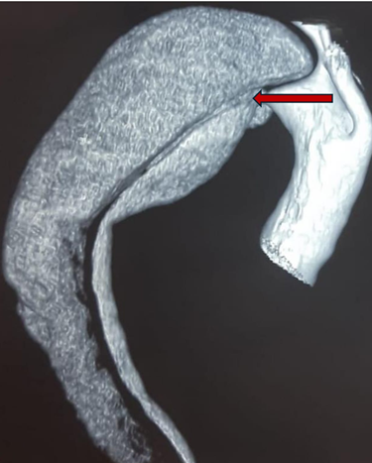
Objective
Methodology
To highlight varied presentations, anatomical patterns, and management strategies in Type B aortic dissection
Study Design: Observational Case Series.
Study population: 14 patients with radiologically confirmed aortic dissection
Diagnosis
CT Angiography

Slide 4
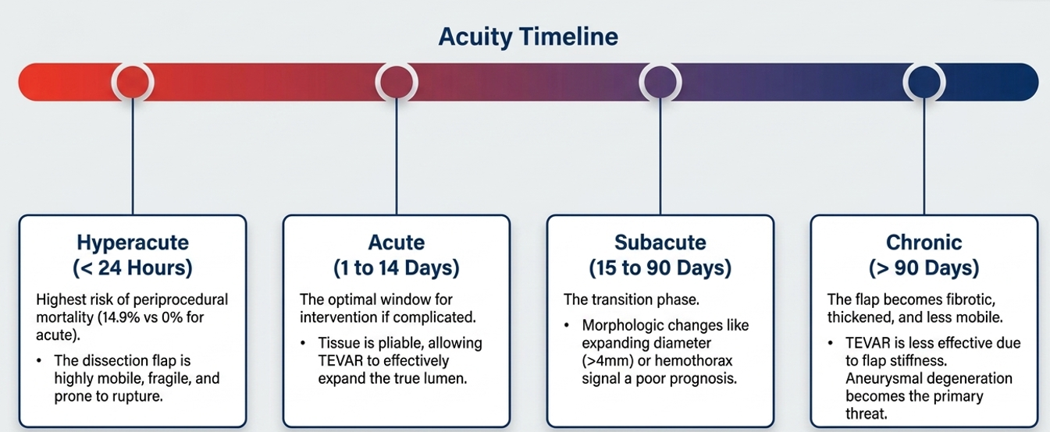
Definition
A life-threatening emergency characterized by an intimal tear that allows blood to enter and propagate within the medial layer of the aortic wall. This creates a true lumen (TL) and a false lumen (FL) separated by a dissection flap
MacGillivray, T.E. et al., 2022. The Society of Thoracic Surgeons/American Association for Thoracic Surgery clinical practice guidelines on the management of type B aortic dissection. Annals of Thoracic Surgery, 113(4), pp.1073–1092. .
Notes:
however having said that, CKD is known to have implications on the vessel anatomy by inducing endothelial dysfunction, chronic inflammation, medial arterial calcification, oxidative stress, and microvascular impairment from stage 3 onward. These mechanisms accelerate distal arterial disease progression and impair tissue perfusion way before dialysis dependence develops.

Slide 5
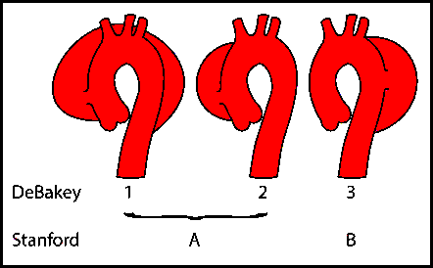

Classification
Our Case Series…
Stanford Type B - 78.6%
Distal extension to illiac arteries - 55.6%
One patient - Total Occlusion in the Right Common Iliac Artery
Others - partial occlusions in the illiacs
Stanford & De Bakey

Slide 6
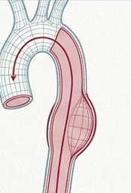
Clinical Presentation
Abdominal Pain or Discomfort: 14.3%
Gradually worsening Limb Ischemia: 14.3%
Hoarseness of Voice (Nerve Compression): 7.1%
Asymptomatic (Incidental Detection): 7.1%
Acute chest pain (85.71%) - commonest presentation
IRAD Average 85%
Structural complications: Aneurysms: 21.42%
Hagan PG, Nienaber CA, Isselbacher EM, et al. The International Registry of Acute Aortic Dissection (IRAD): new insights into an old disease. JAMA. 2000;283(7):897–903.

Slide 7
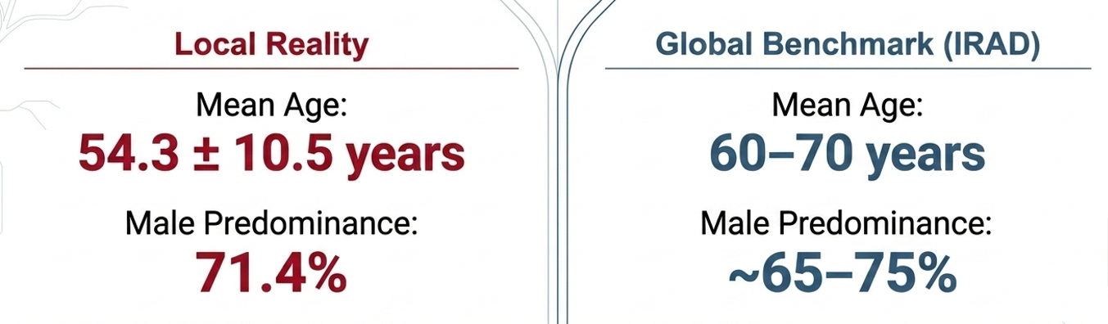

Risk factors & Demographics
Risk Factor | Number of Patients | Percentage Prevalence
Hypertension | 9 | 64.3%
Aortic Aneurysm | 4 | 28.6%
Chronic Kidney Disease | 1 | 7.1%
Inflammatory Disease (Rheumatoid Arthritis) | 1 | 7.1%
Hagan PG, Nienaber CA, Isselbacher EM, et al. The International Registry of Acute Aortic Dissection (IRAD): new insights into an old disease. JAMA. 2000;283(7):897–903.

Slide 8
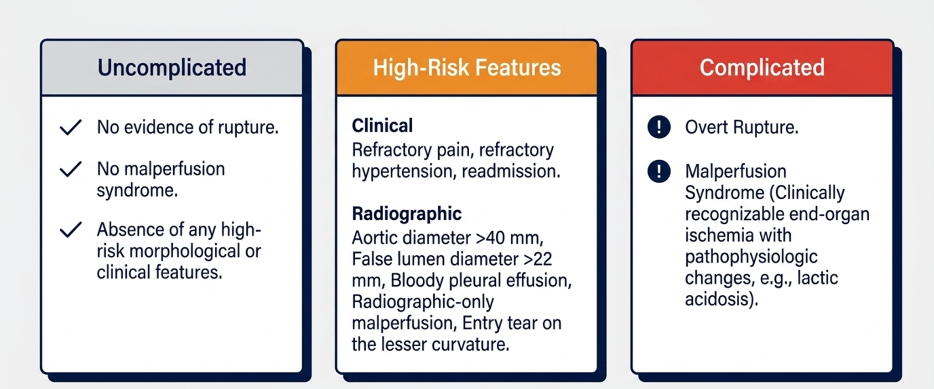
Risk Stratification
Our Case Series…
Uncomplicated - 2 (14.28%)
High risk - 6 (42.85%)
Complicated - 6 (42.85%)
MacGillivray, T.E. et al., 2022. The Society of Thoracic Surgeons/American Association for Thoracic Surgery clinical practice guidelines on the management of type B aortic dissection. Annals of Thoracic Surgery, 113(4), pp.1073–1092. .

Slide 9
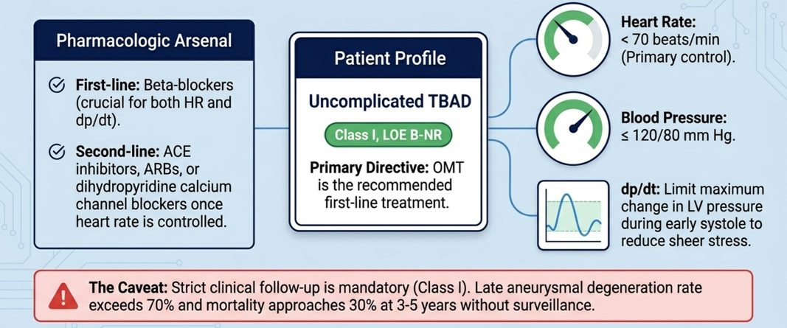
Uncomplicated TBAD Management
Our Case Series…
9 Patients Medically managed
(One complicated TBAD - death before intervention)
8 patients - exclusively medically managed
MacGillivray, T.E. et al., 2022. The Society of Thoracic Surgeons/American Association for Thoracic Surgery clinical practice guidelines on the management of type B aortic dissection. Annals of Thoracic Surgery, 113(4), pp.1073–1092. .

Slide 10
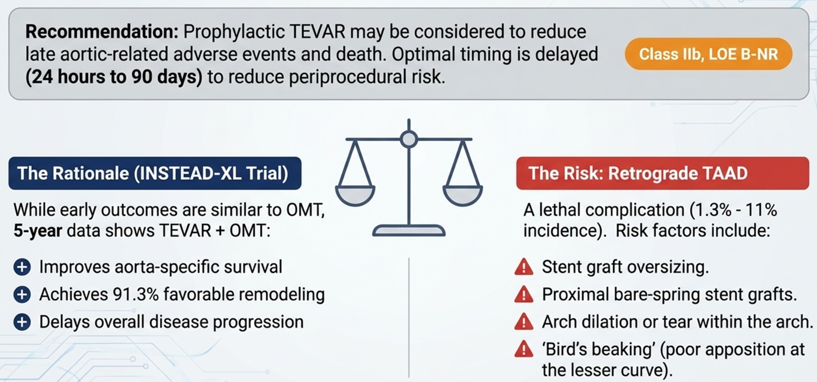
Prophylactic TEVAR in Uncomplicated/High Risk TBAD Management
Our Case Series…
No cases
Risks vs Benefits?
Resource limitation
MacGillivray, T.E. et al., 2022. The Society of Thoracic Surgeons/American Association for Thoracic Surgery clinical practice guidelines on the management of type B aortic dissection. Annals of Thoracic Surgery, 113(4), pp.1073–1092. .

Slide 11
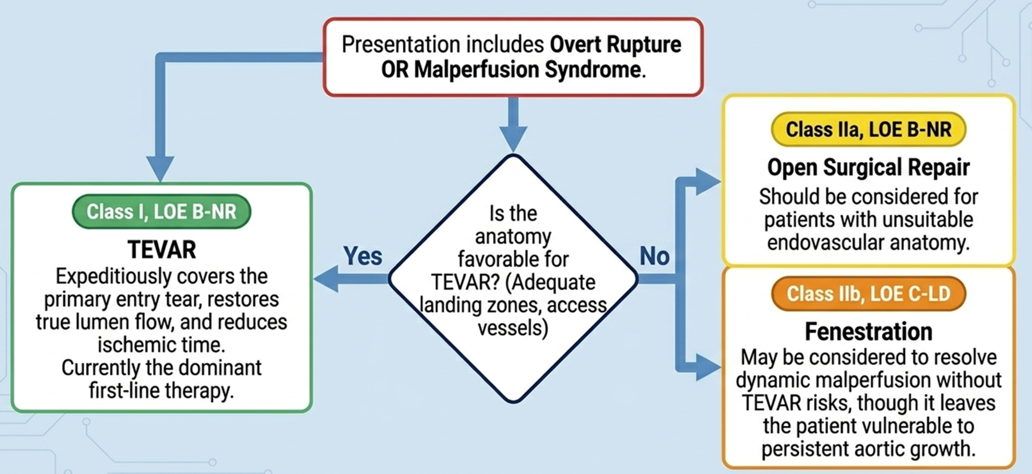
Aneurysmal expansion | LCC debranching +TEVAR
Limb Ischemia | Surgical Axillofemoral Bypass
Renal Failure, abd/thoracic aneurysms | Debranching only, palliative care due to overall poor health condition
Limb Dysfunction/ hoarseness/ saccular aneurysm | Planned TEVAR & Awaiting intervention
Aortic Leak suspected in CT | Conservative / Medically treated initially and in the repeat scans stable, no fx of leaking
Aortic Leak | Medical / Supportive, intervention delayed causing Death
Complicated TBAD Management
MacGillivray, T.E. et al., 2022. The Society of Thoracic Surgeons/American Association for Thoracic Surgery clinical practice guidelines on the management of type B aortic dissection. Annals of Thoracic Surgery, 113(4), pp.1073–1092. .

Slide 12
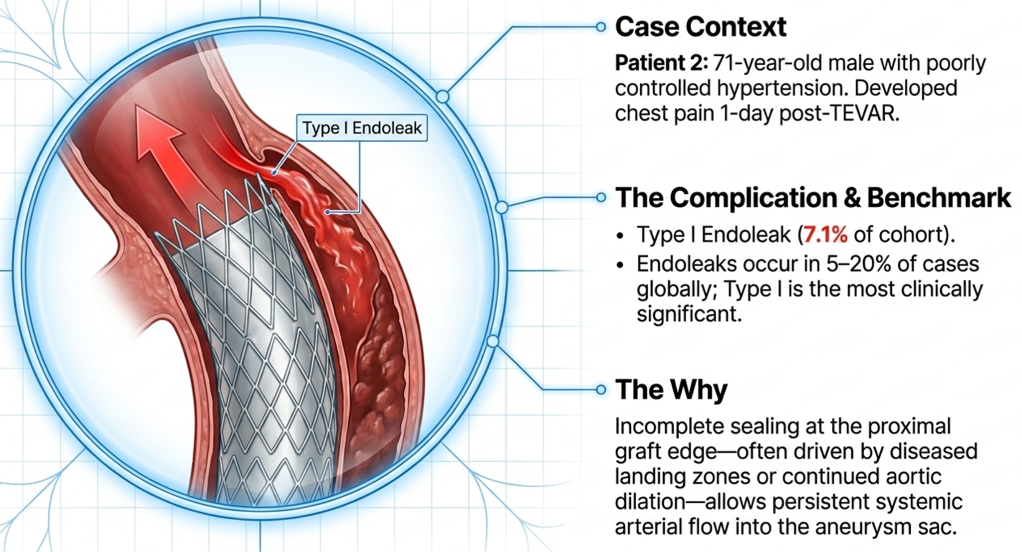
Post TEVAR Complication - Type 1 Endoleak

Slide 13
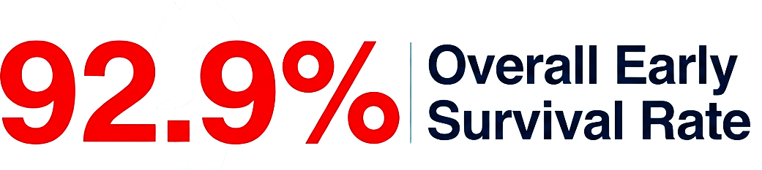

Survival Outcomes
High Survival rate - due to majority of uncomplicated cases/early hemodynamic stabilization
Single case of mortality due to delay in timely intervention
Mandates early diagnosis, choice of appropriate treatment & timely intervention!

Slide 14
Thank you
Q & A?

