Slide 1
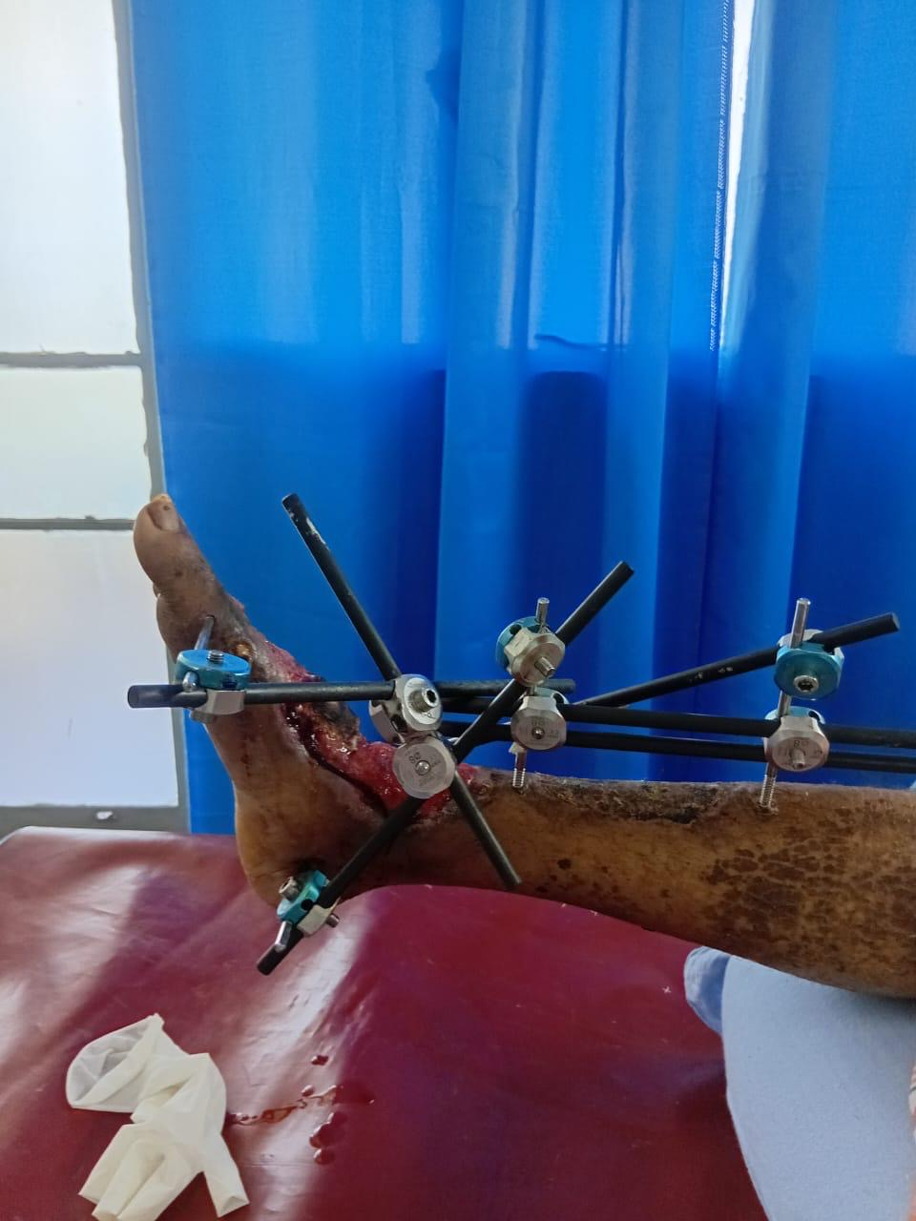
Salvaging the 'Unsalvageable ' foot
A modified external fixation technique for complex diabetic Charcot Arthropathy in a resource limited setting – Initial Results
Surgical Professorial Unit
Dr Thushan Gunarathne(VVS)
Dr R Gnanasekaram (VOS)
Dr M R A Rahuman (SR)

Slide 2
Introduction
Introduction
Advanced Diabetic Charcot Foot ulcers with osteomyelitis involving midfoot and hindfoot which has poor outcomes often requires primary amputation.
Amputation carries a heavy burden, including a 5-year mortality rate as high as 70% and a 25–40% increase in oxygen consumption during gait.
Despite advances in amputation care , the lack of well developed prosthetic solutions and rehabilitation capable of fully restoring mobility and gait continues to negatively impact patient outcomes.
Consequently many amputees experience impaired quality of life , reduced functional independence and lower long-term survival rates.

Slide 3
“
External Fixators facilitates ulcer healing by,
Stabilizing the foot
Reduction of shear stress
Redistributing planter pressure
Correcting Deformity
Rigid offloading
Circular External Fixation is an evolving treatment modality over recent years which salvages the limb.
External fixation acts as a biological support system by addressing neuropathy, ischemia, and infection while providing surgical offloading. It redistributes weight-bearing forces away from the foot, reducing plantar pressure and promoting tissue healing.”
We introduced a modified low-cost external fixator construct for patients who were conventionally planned to undergo amputation.

Slide 4
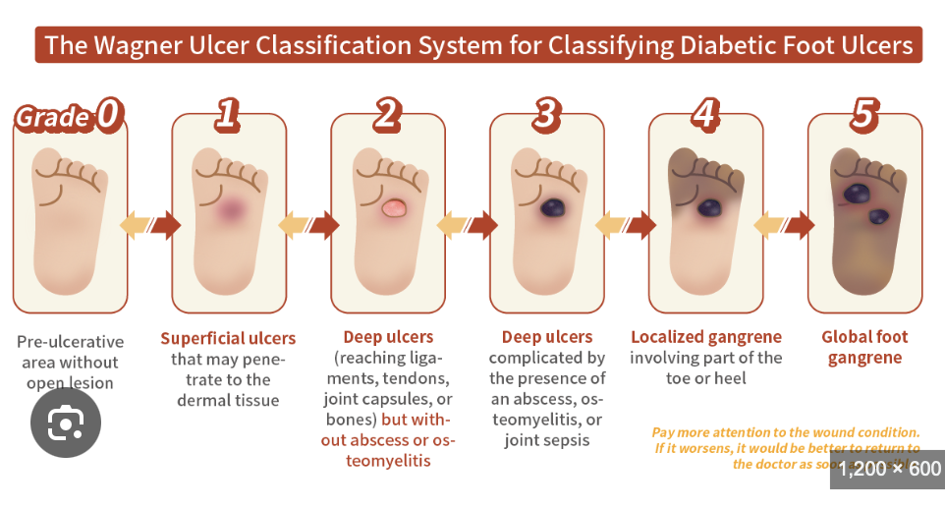
Methodology –PICO tool
An observational prospective review conducted at a single tertiary care hospital
Patient Inclusion /Exclusion criteria :
  Patient selection – External Fixators should be considered when all of three are present.
Severe Ulcer
Wagner grade -3 , 4 OR
Osteomyelitis involving midfoot /hindfoot.
Mechanical failure
Charcot instability OR
Midfoot collapse OR
Recurrent pressure deformity OR
Failed TCC /Offloading
Limb salvage intent
Adequate Vascularity AND
Motivated ambulatory patient

Slide 5
Consecutive Patients assessed for eligibility with diabetic/Charcot foot pathology- 100% of the patients are destined for conventional amputation.
(n = 15)
Met inclusion criteria:
• Severe ulcer (Wagner grade 3–4)
• Osteomyelitis / hindfoot involvement
• Mechanical instability / deformity
• Limb salvage intent
• CLTI without revascularization
• Unable to follow-up
• Financial constraints – Lack of affordability
Unavailability of EF
• Medically unfit
No
Yes
Final study population included
for external fixation / limb salvage
analysis (n = 9)
Excluded patients
(n = 6)
STROBE-style flowchart demonstrating patient inclusion and exclusion methodology.

Slide 6
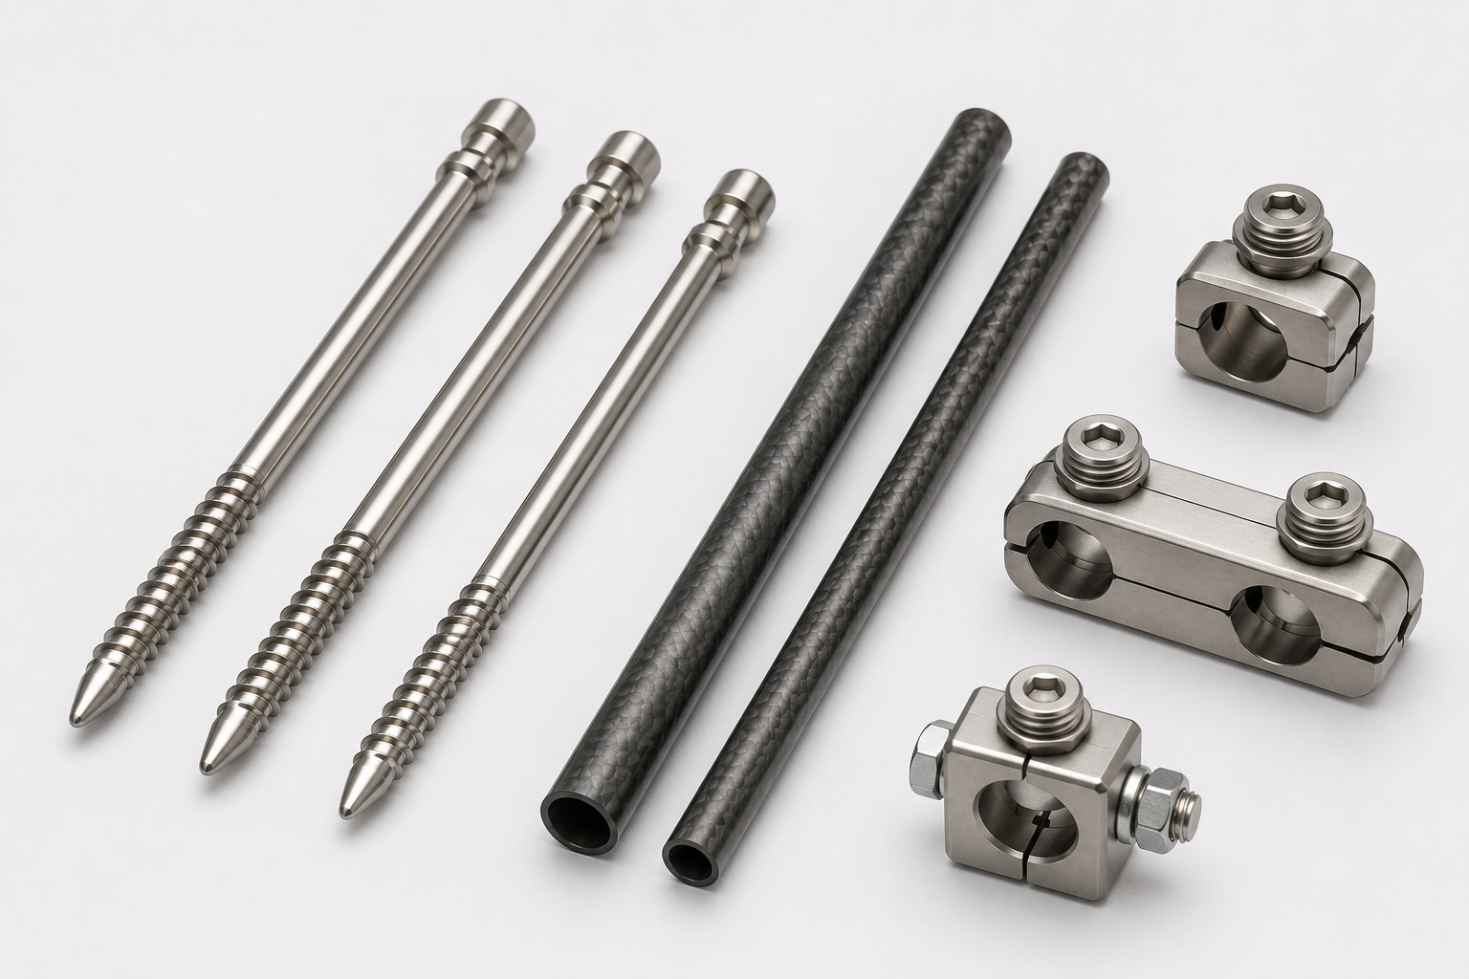
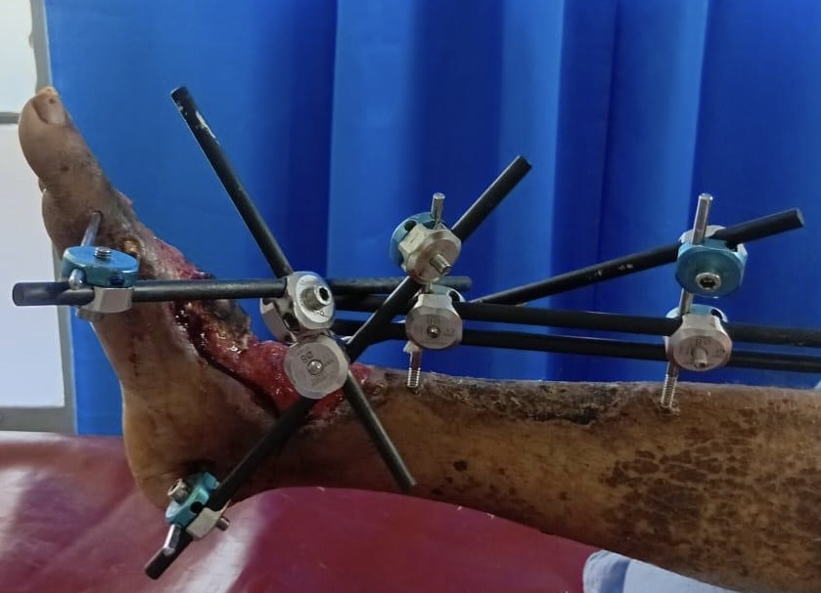
Interventions :
  Radical debridement and sequestrectomy to control the active septic load.
  Application of a modified unilateral low-cost external fixator (100% of cases) to provide immediate post-operative stability.
  3. Post-operative monitoring, including daily assessment of toe movement—the "distal neurological vital sign"—to screen for nerve integrity ( deep peroneal/tibial ) and early vascular compromise.
Comparison:
This study compares the quality of life, limb salvage rates, survival outcomes, wound healing, and complication profiles between amputation and external fixation in patients with Diabetic charcot foot ulcers.

Slide 7
Outcomes
Demographic and baseline characteristics
  Number of patients – Nine
  Mean age -55.8 years
  Male sex -67% (n=7)
  Median duration of Diabetes – 12 years
  Study duration – March 2024 to November 2025
Ulcer characteristics
  Forefoot ulcers -22%
  Midfoot ulcers -11%
  Hindfoot ulcers -67%
  Wagner grade 3,4 – 100%
  Osteomyelitis present -22%

Slide 8
67%
100%
44-56%
Complete wound healing achieved
overall patient survival
six months amputation free limb salvage
78-89%
Frame loosening requiring mechanical readjustment
56-67%
Pin – Tract infections
33%
Ultimately requiring major amputation
Due to Sepsis and bypass failure

Slide 9
Limitations
Small sample size - The study was initiated with 15 patients but could complete the follow up ,up to now only for 9 patients.
Resource scarcity- Lack of affordability of the patients and unavailability of the external fixators at the tertiary care centre.
Single centre study ( Tertiary Care)
Duration of the study
No universal fixation frame

Slide 10
conclusion
Low -cost external fixator provides a resilient salvage pathway in 'No-Option' scenarios but demand intense vigilance for high complication rates.
The technique offers a life-preserving alternative to major amputations despite of its complications.
Even feet considered unsalvageable may still be salvaged with innovation , meticulous debridement and affordable stabilization techniques.
Awaiting long term outcomes of QOL and survival.

Slide 11
Forecast of the study
This study represents only an initial step towards a broader vision of patient-centered limb salvage care.
The ultimate long-term goal is not merely wound healing, but the restoration of meaningful quality of life, functional mobility, and improved survival for these patients.
Achieving this extends beyond ulcer healing and infection control, requiring a comprehensive rehabilitation strategy that incorporates appropriate footwear, orthotic support, gait optimization, and definitive Charcot foot reconstruction where indicated.
This study also serves as an open invitation for closer collaboration with the orthopedic team, fostering a multidisciplinary partnership aimed at achieving the highest standard of patient care and functional recovery.

Slide 12
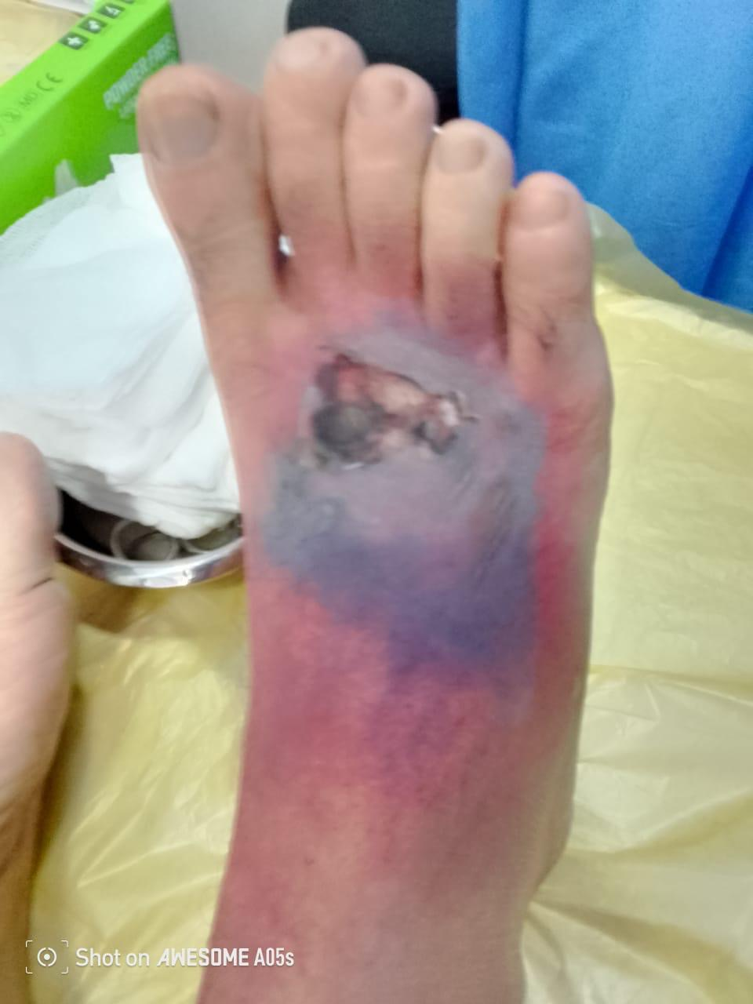
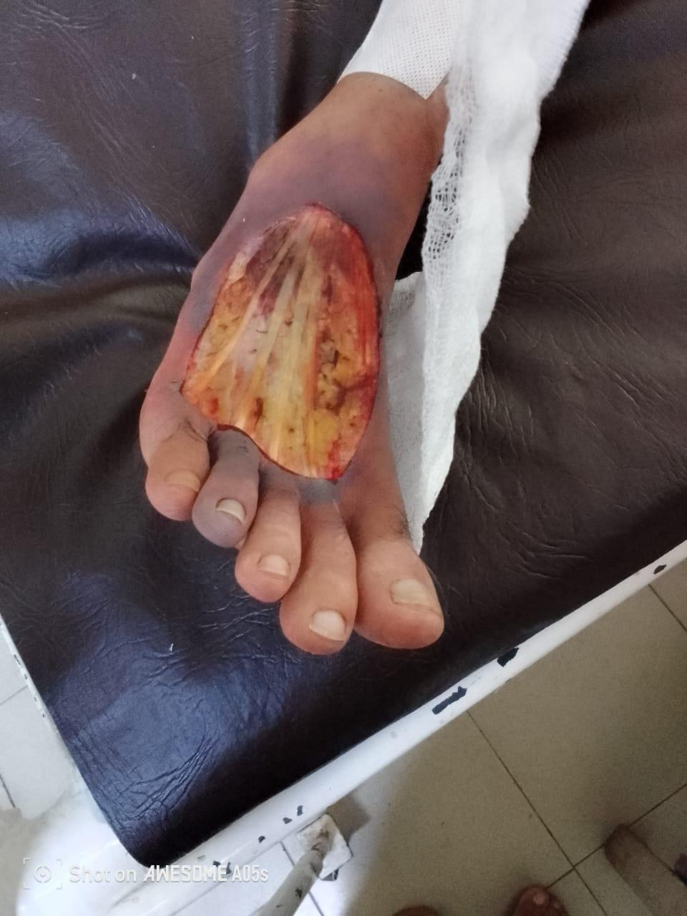
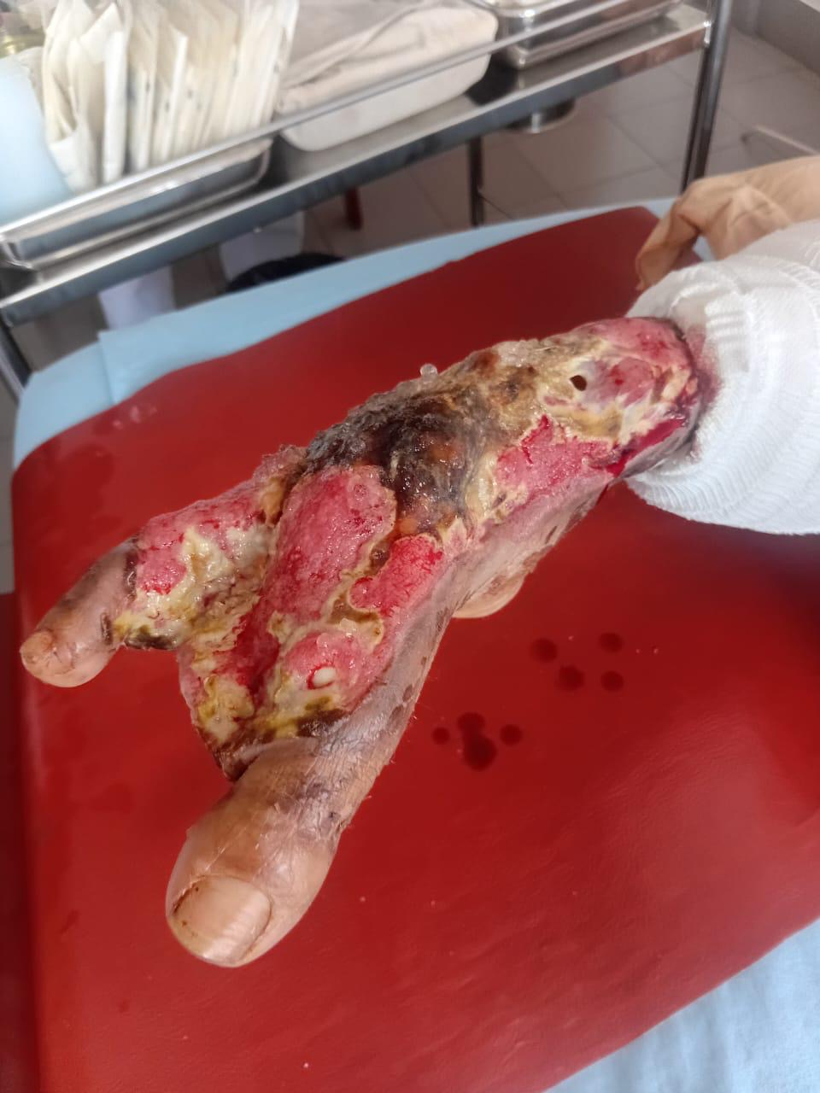
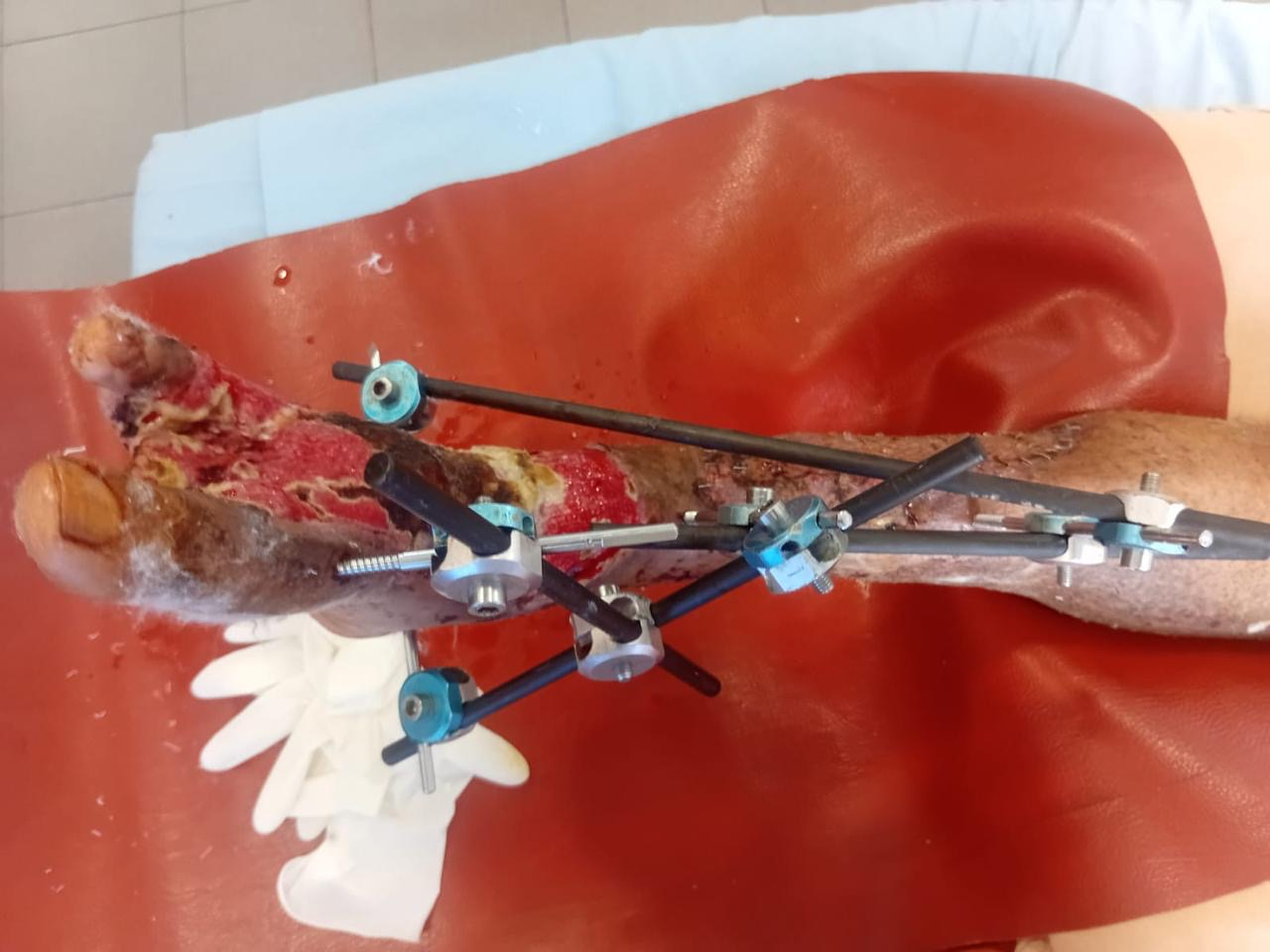
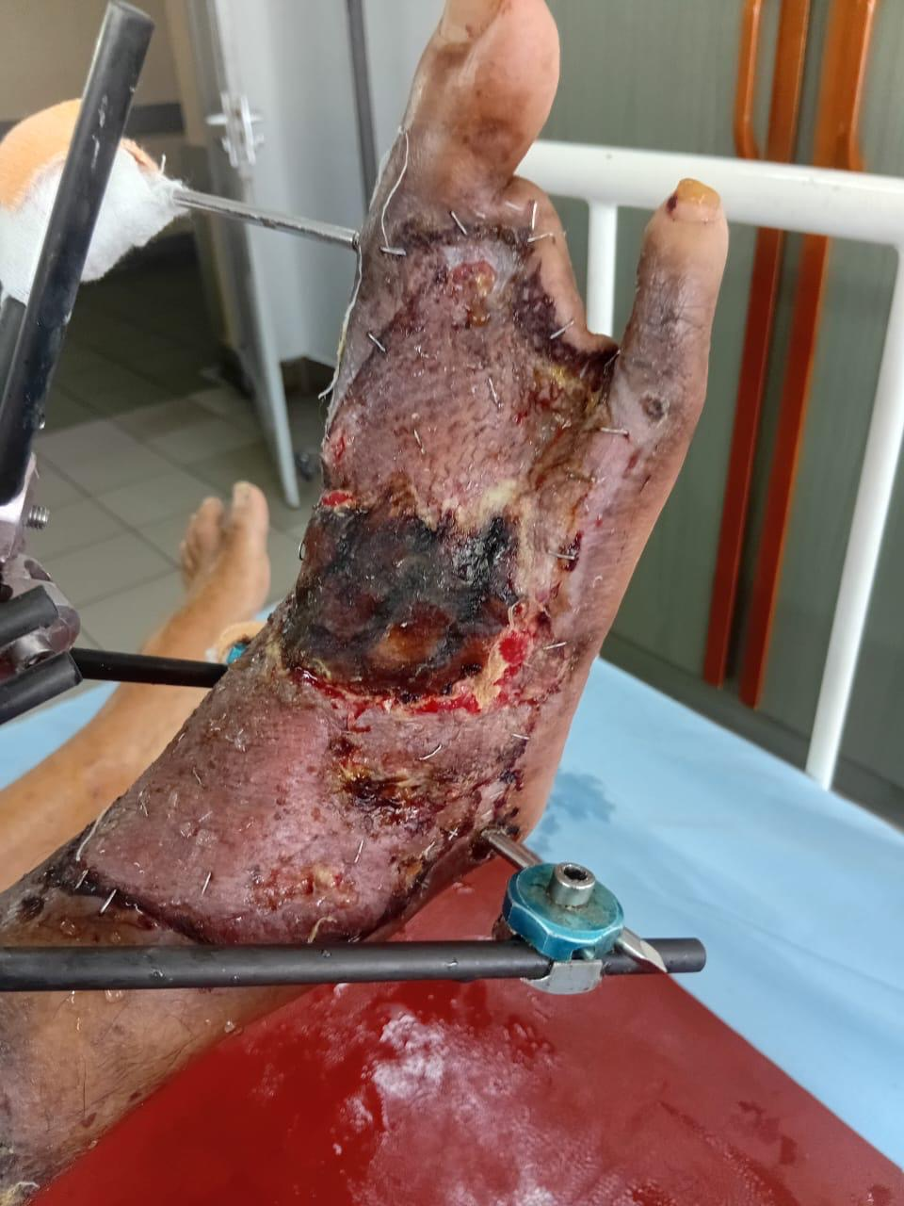
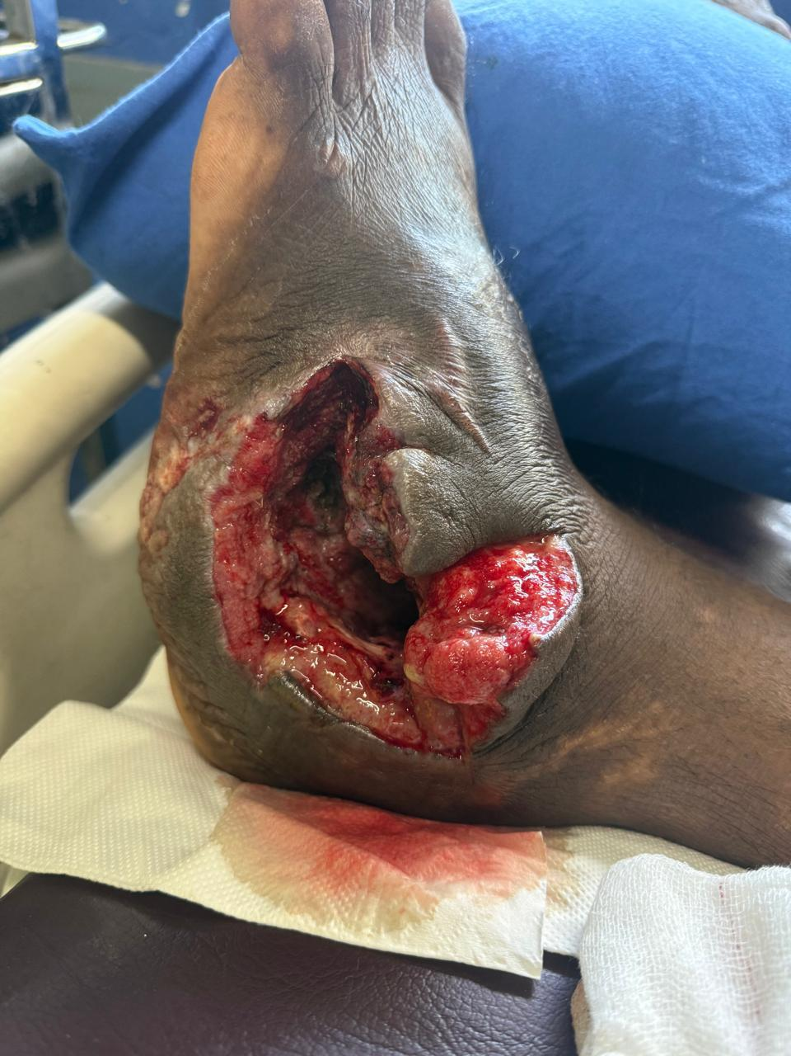
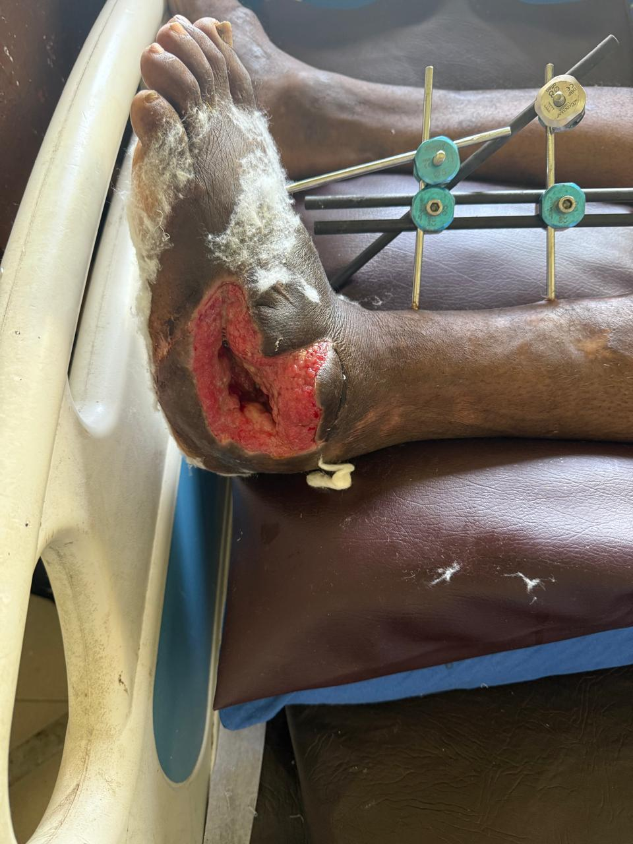
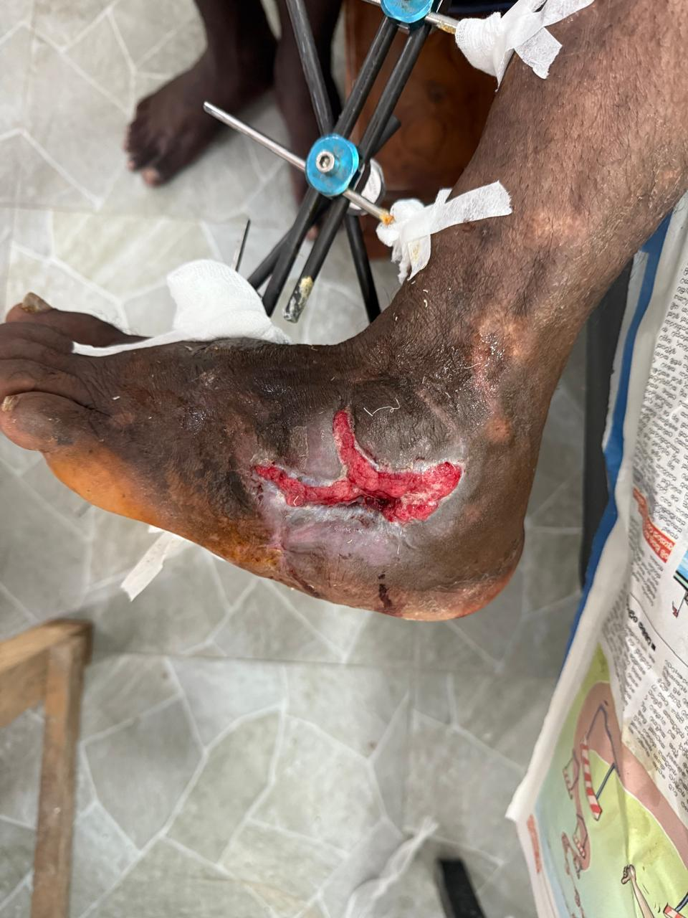
Few of our achievements
Ppatient 1
Ppatient 2

Slide 13
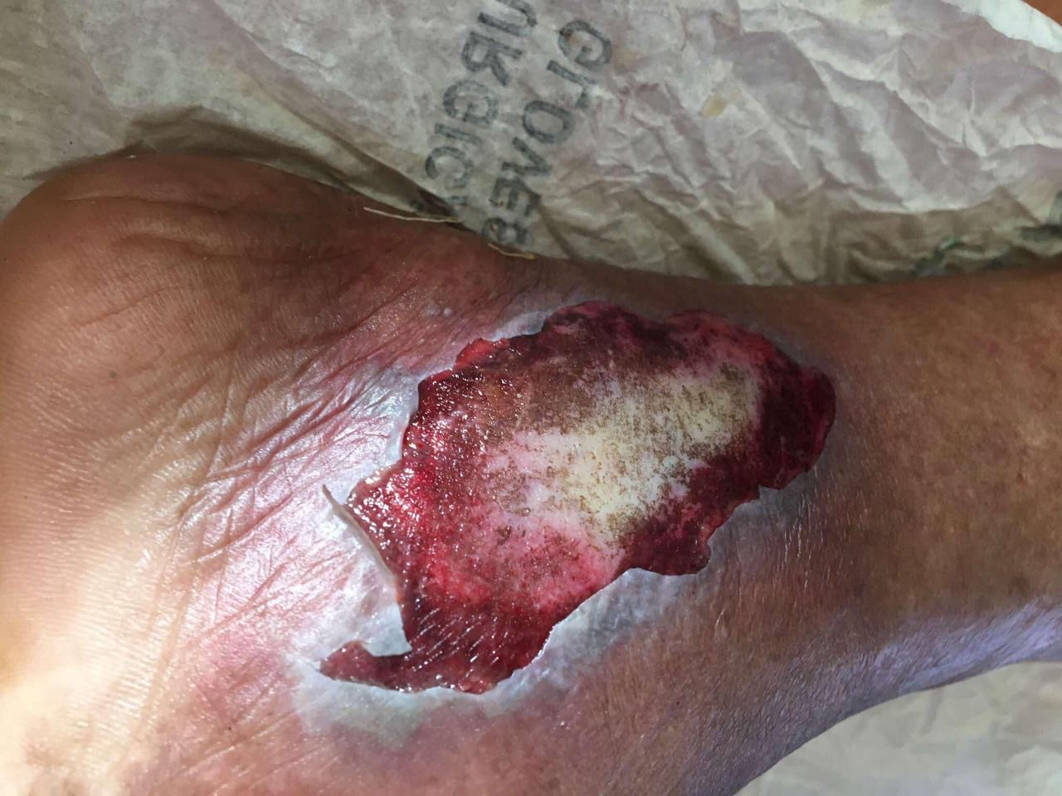
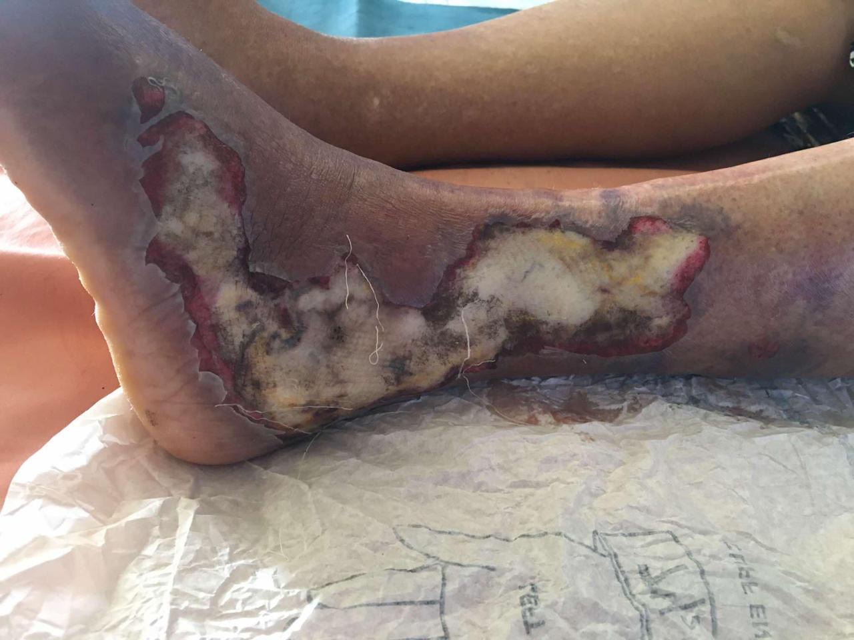
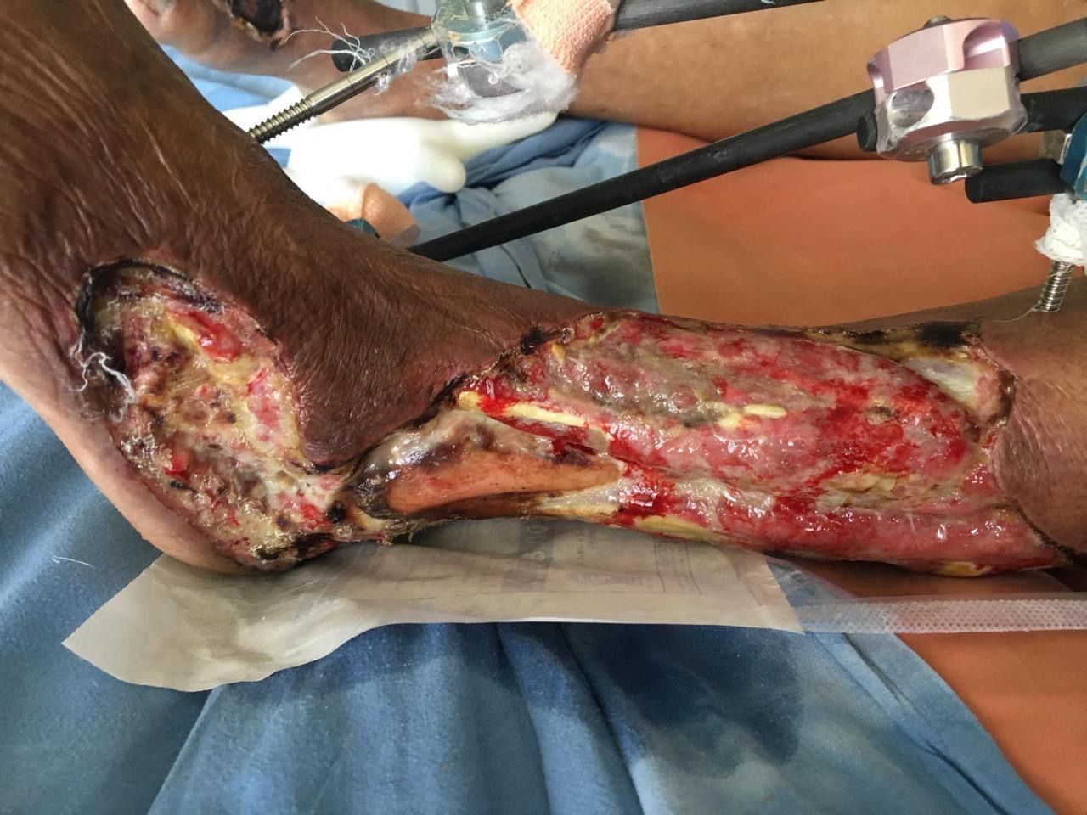
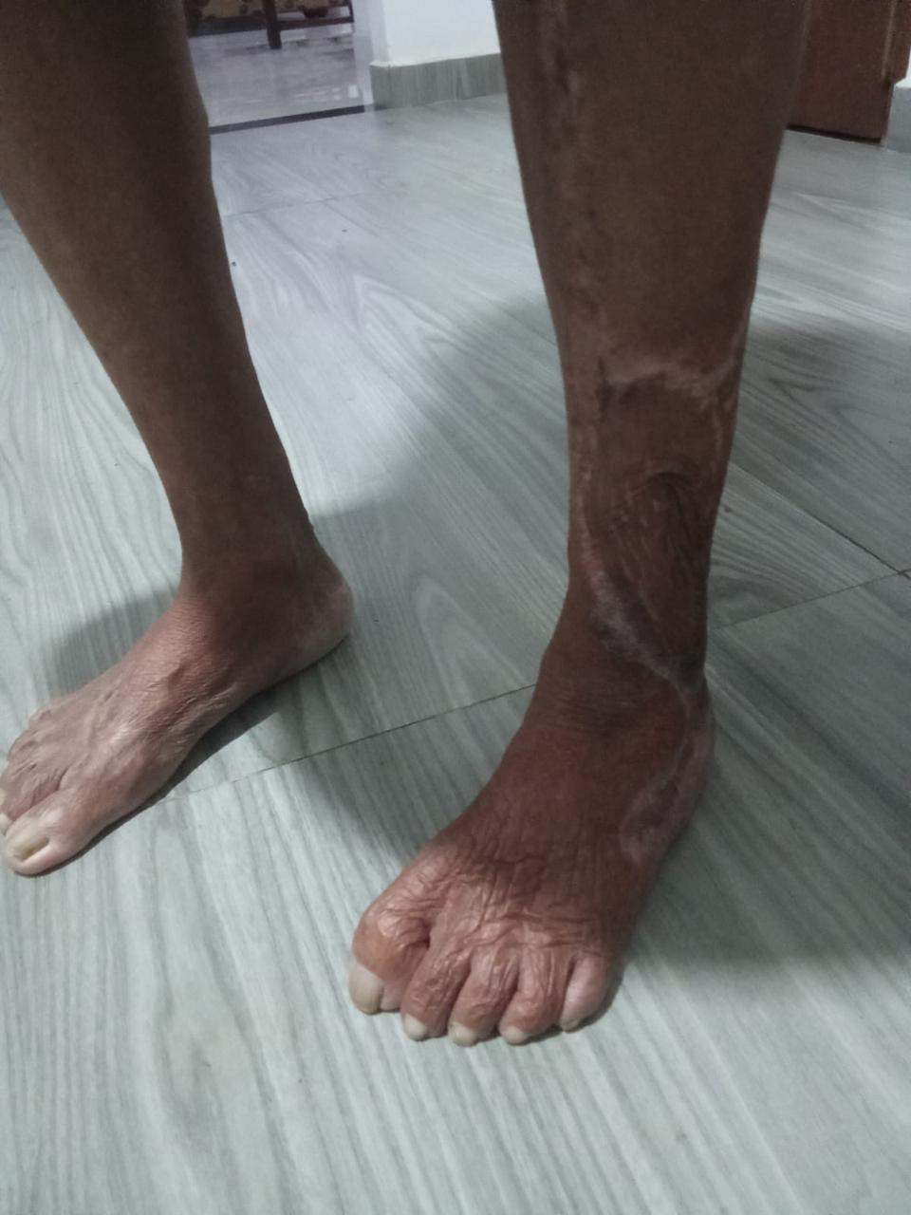
Thank you.
Patient 3

