Slide 1

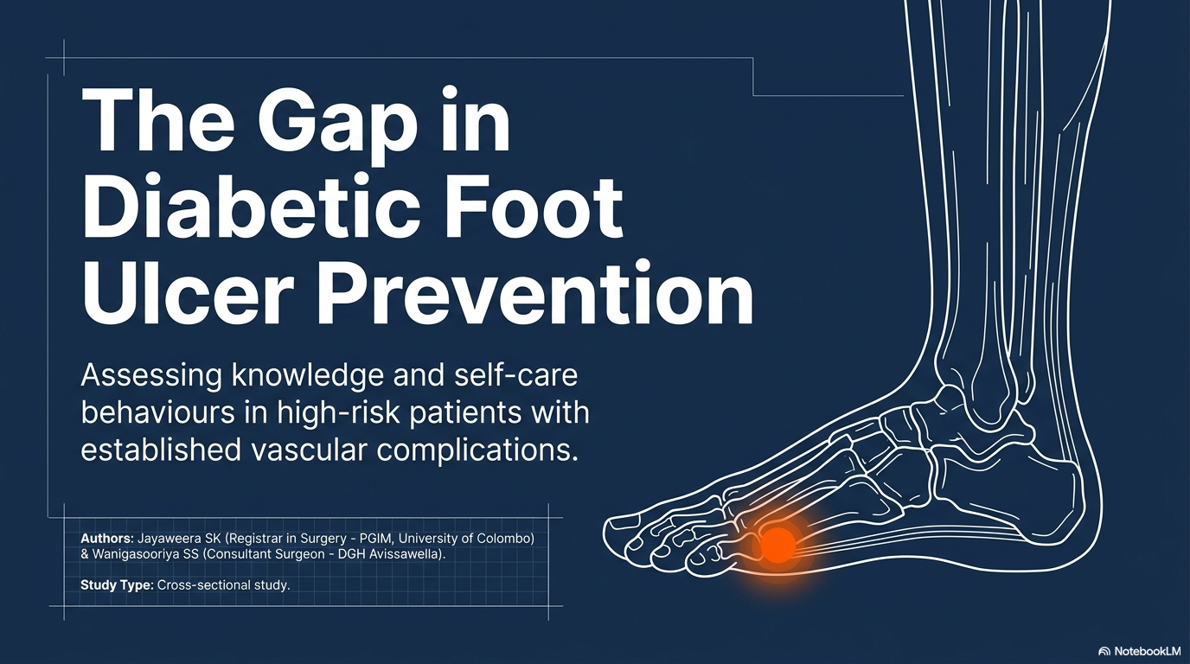
Assessment of knowledge on preventive measures for foot ulcers among Patients with diabetes complicated by microvascular and macrovascular disease: A cross-sectional study
S K JAYAWEERA
REGISTRAR SURGERY-PGIM

Slide 2
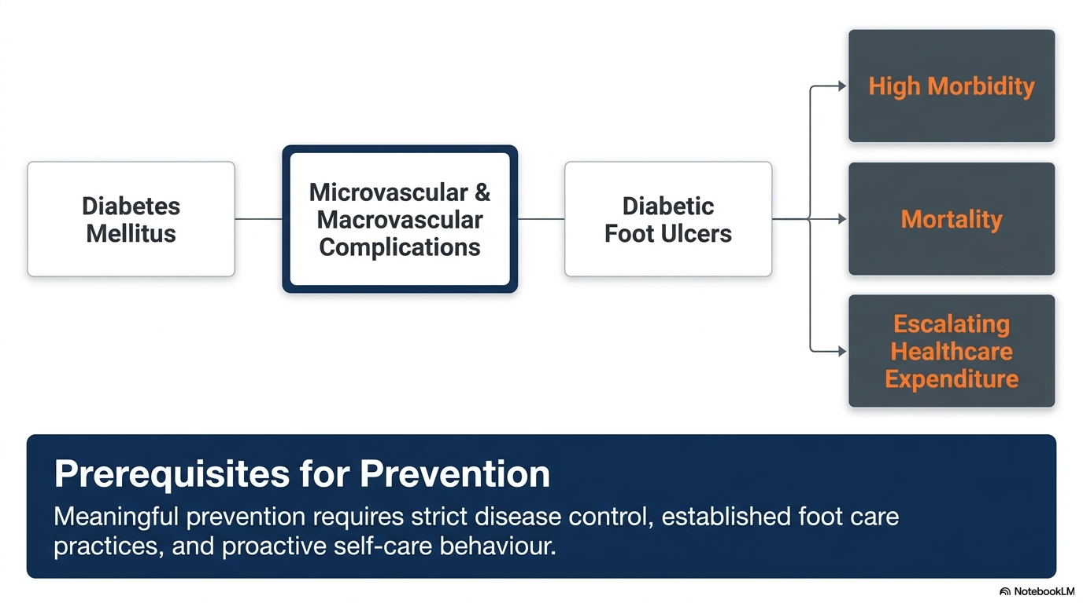
OBJECTIVES

Slide 3
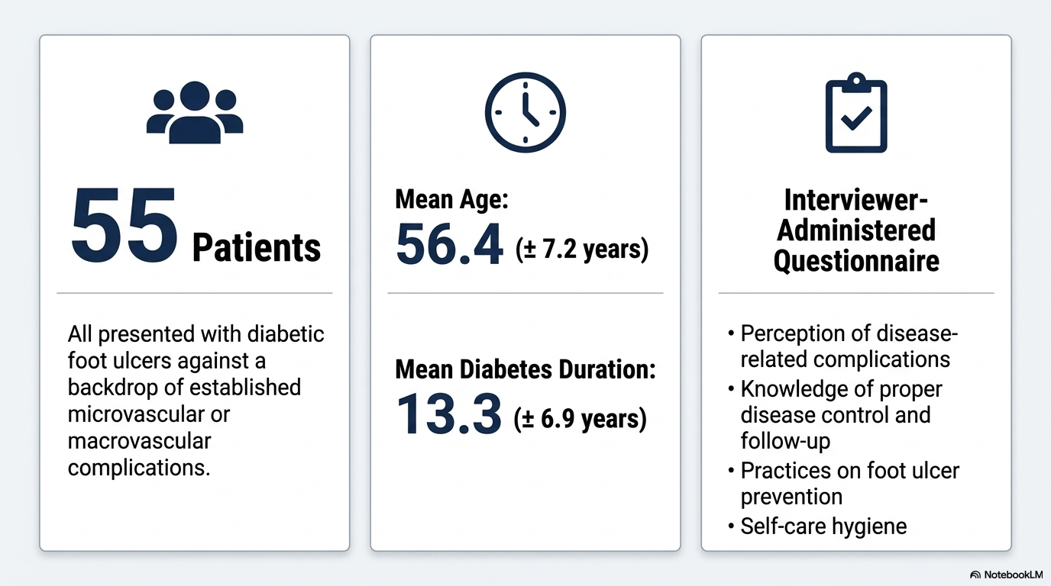

Slide 4
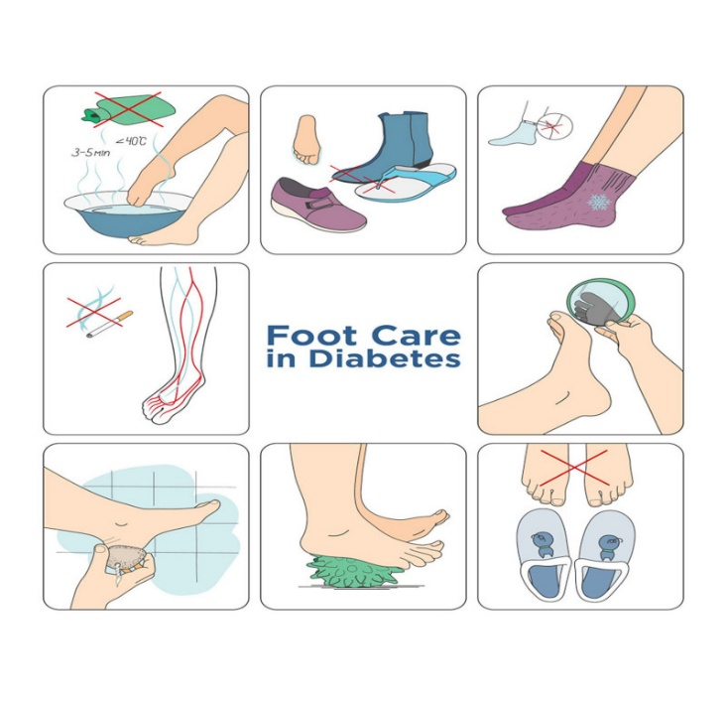
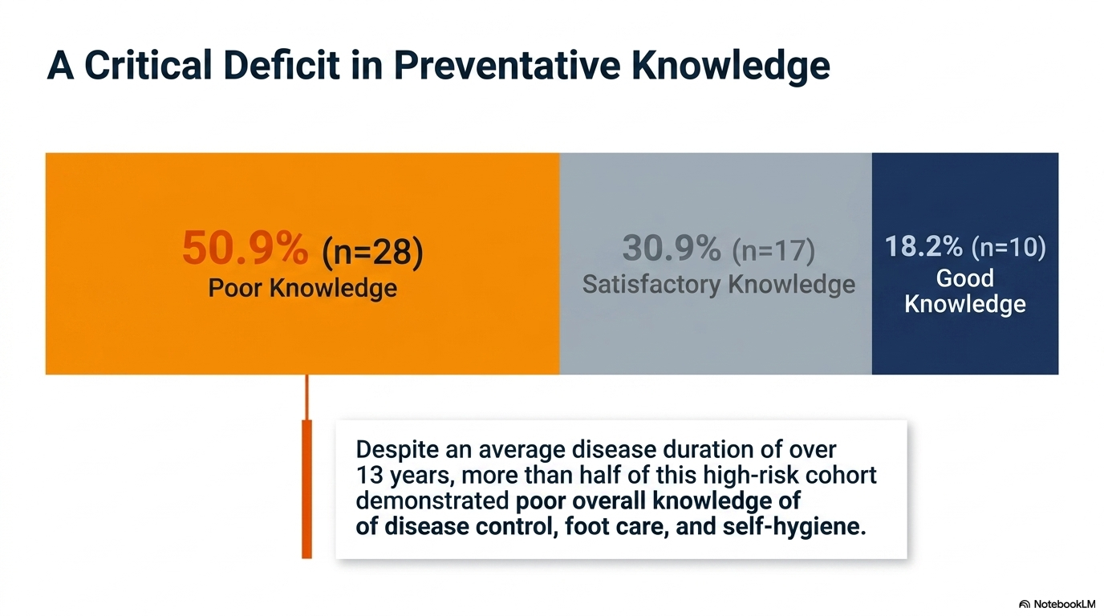

Slide 5
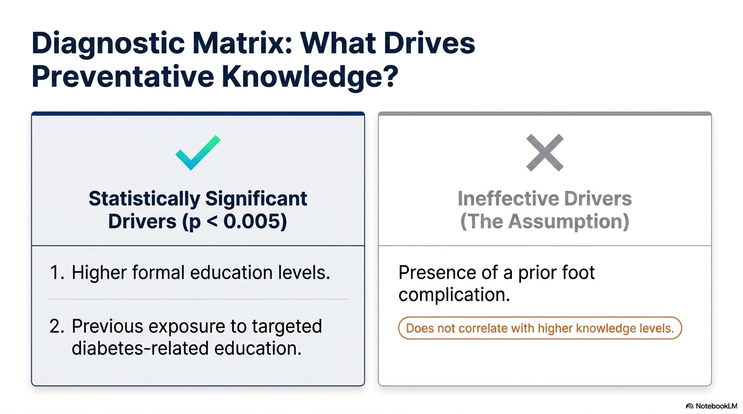

Slide 6
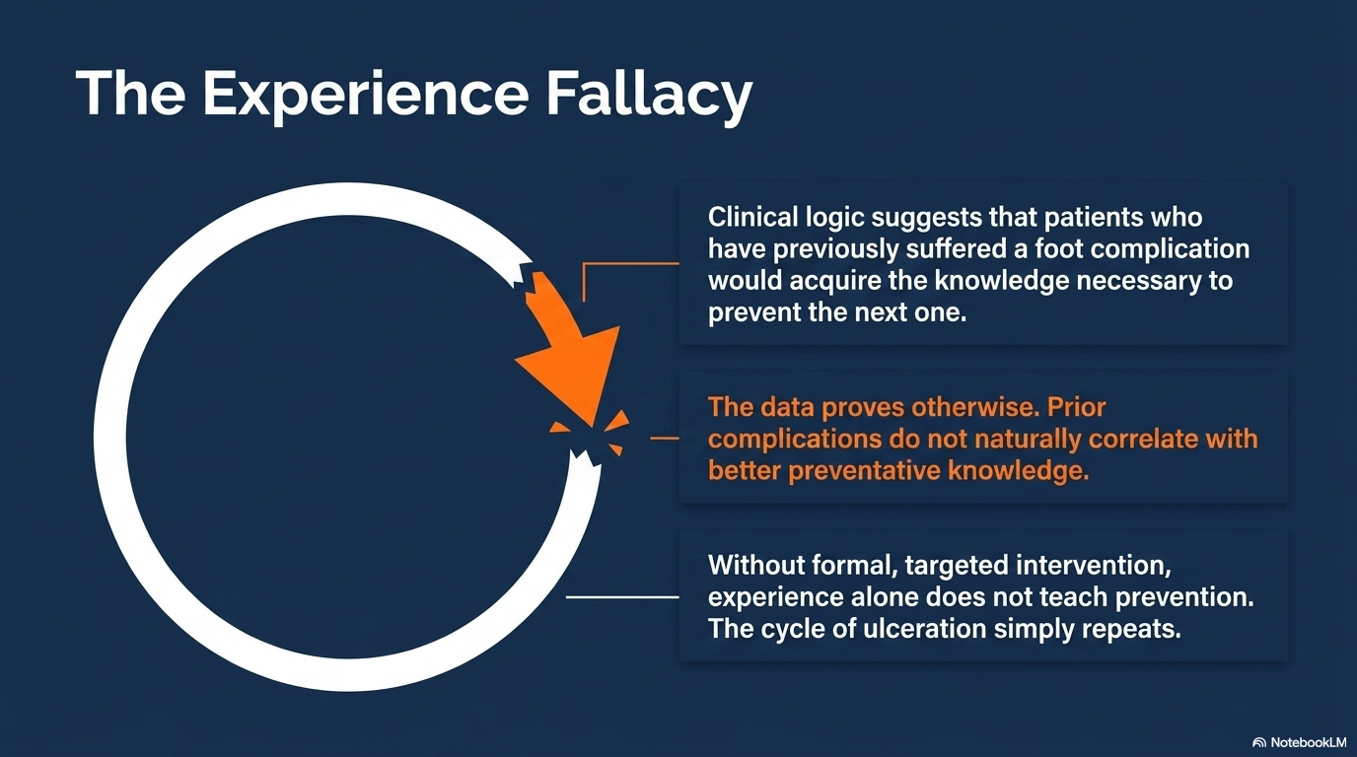

Slide 7


Slide 8
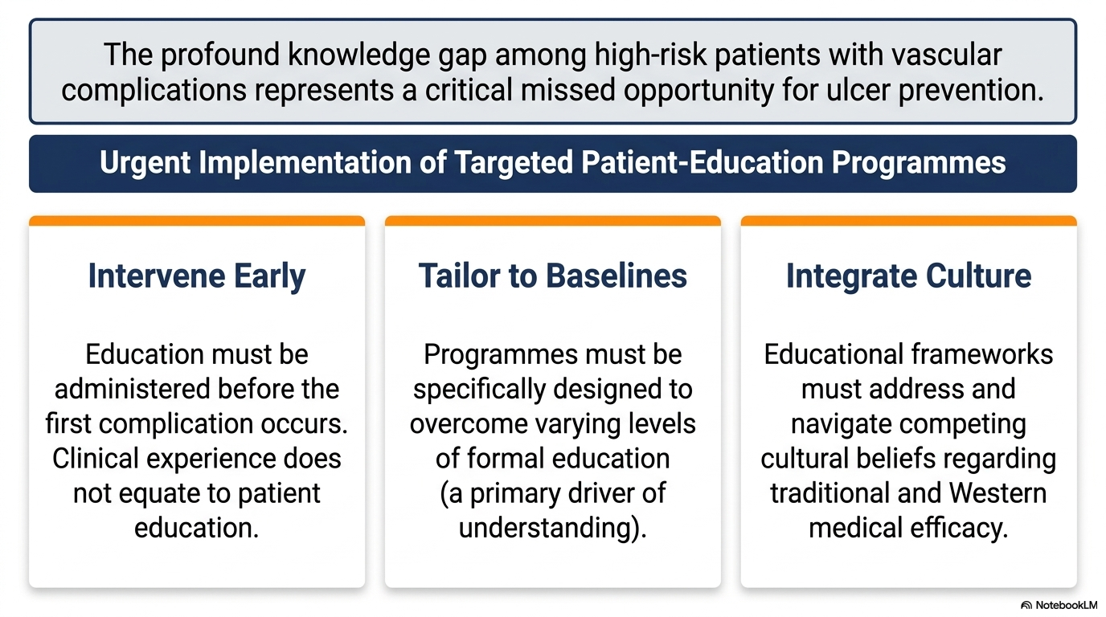
CONCLUSION & SUGGESTIONS

Slide 9


