Slide 1

Outcomes of open versus endovascular revascularization for Chronic Limb-Threatening Ischaemia:
A Single-centre experience from National hospital Kandy
L. Thanoosan¹, B.G. Jayawickrama¹, N.G.S.S. Nanayakkara²
¹National Hospital Kandy, Sri Lanka (Registrar in General Surgery, Consultant Vascular and Transplant Surgeon)
²Temporary Demonstrator, Department of Mathematics,
Faculty of Science, University of Ruhuna

Slide 2
Disclosure → No conflicts of interest to declare.
Background & Rationale
• CLTI is the end stage of peripheral arterial disease
• Associated with high rates of amputation and mortality
• Revascularization is essential for limb salvage
• Open and endovascular techniques are widely used
• Comparative data from resource-limited settings are limited
• This study evaluates outcomes following revascularization for
CLTI at NHK

Slide 3
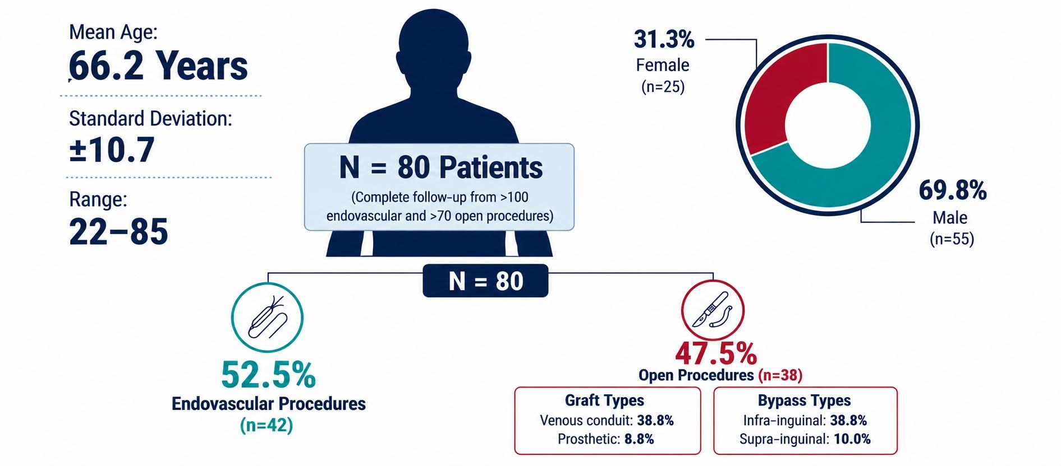
Baseline Characteristics

Slide 4
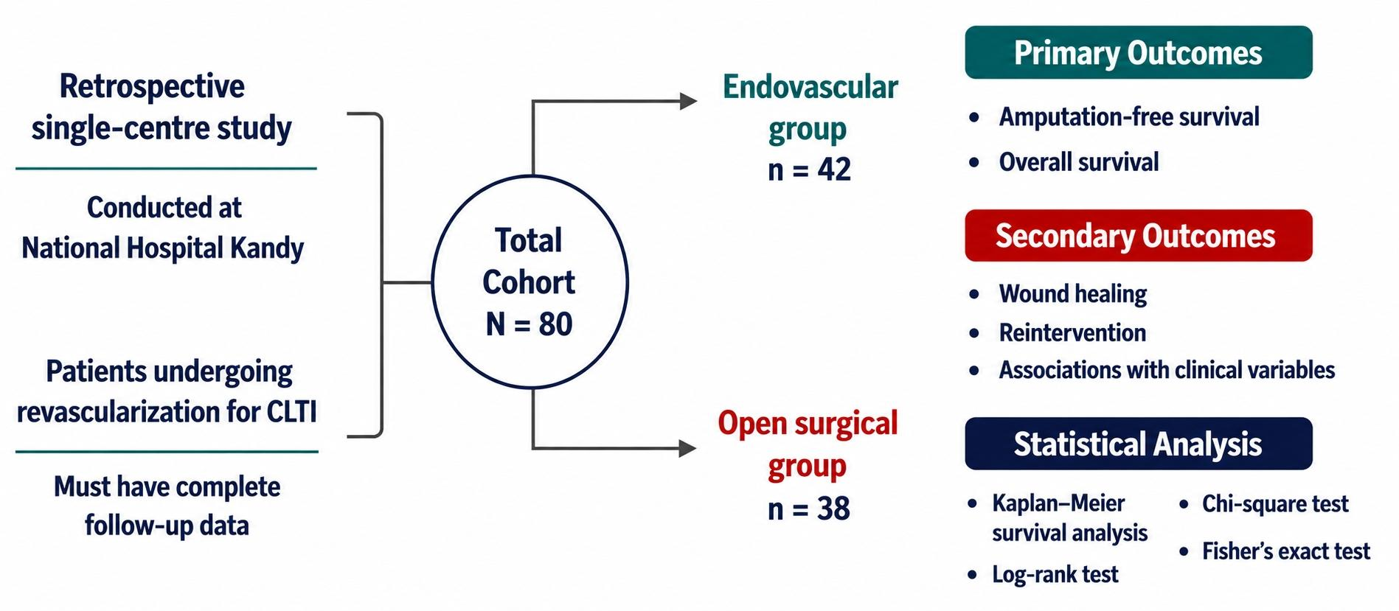
Study design & Methods
Period September 2024 to December 2025

Slide 5
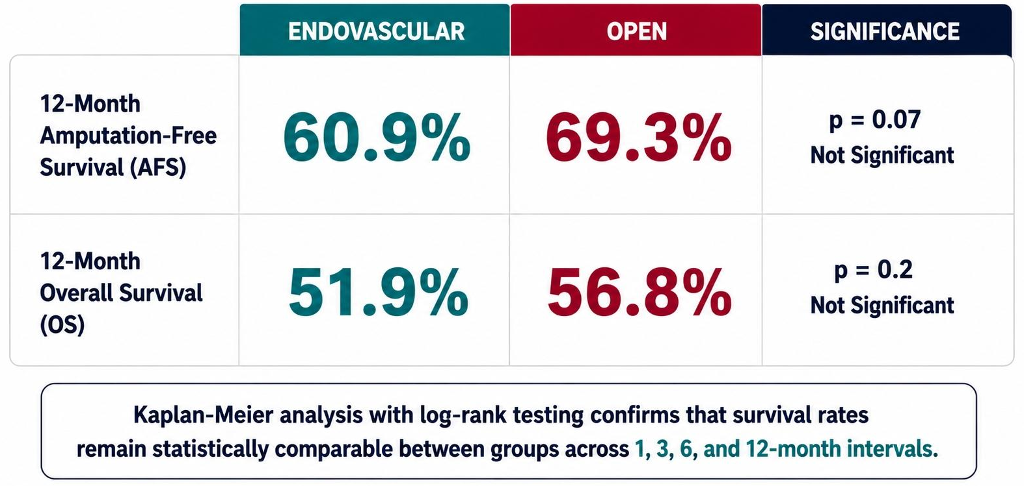
Primary outcomes

Slide 6
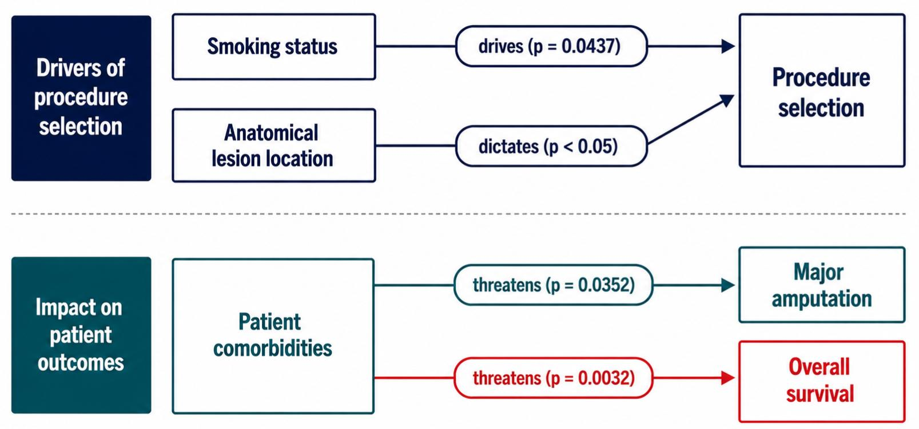
Secondary outcomes & Statistical analysis

Slide 7
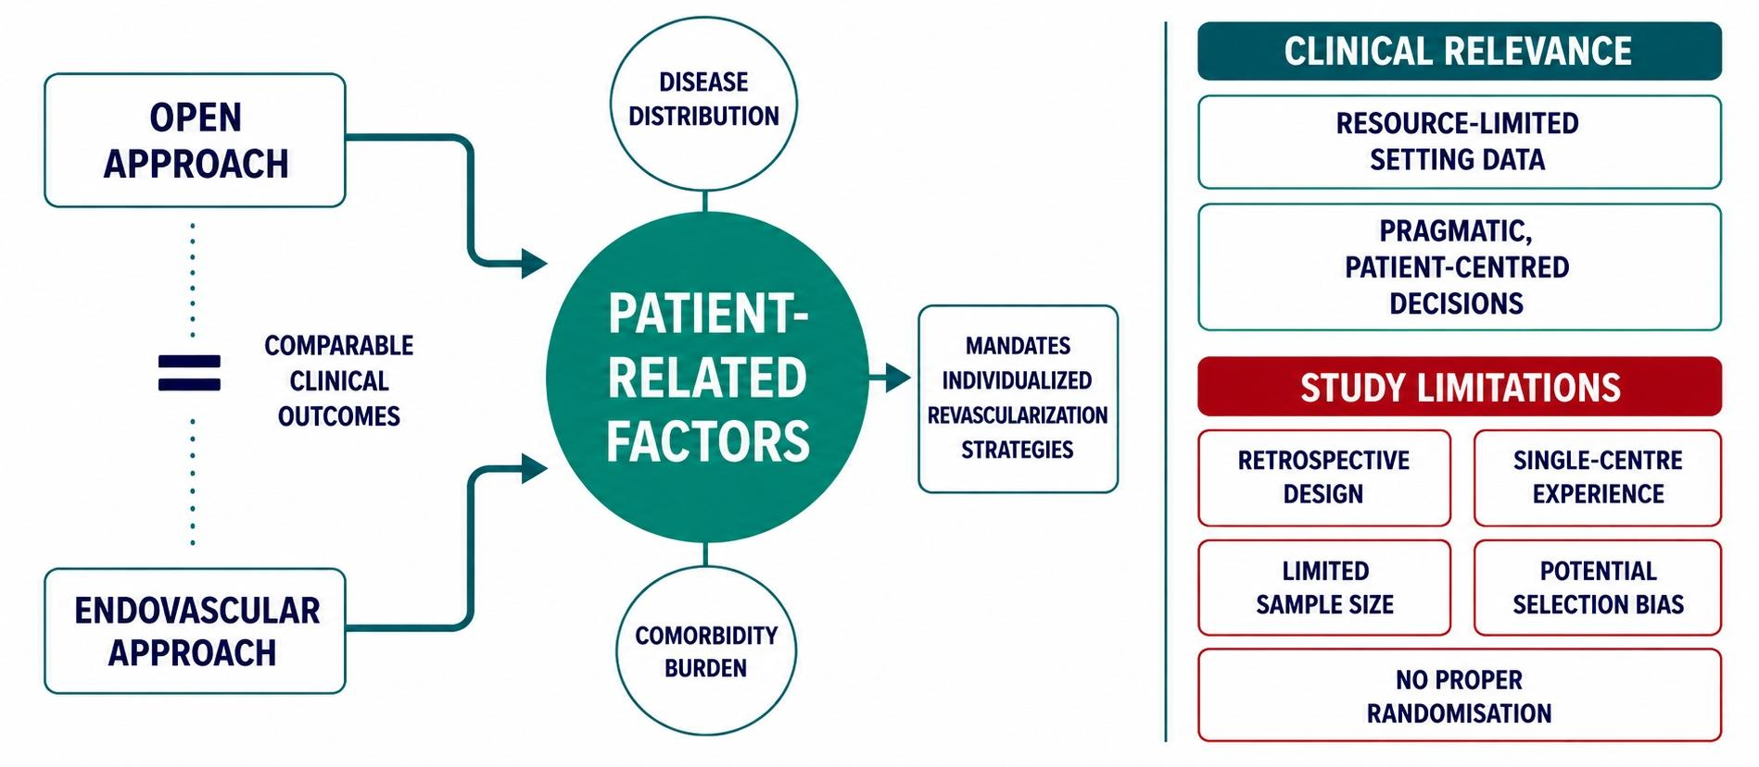
Discussion

Slide 8
Bottom line
“Successful CLTI management depends on tailored intervention rather than a single universal approach.”
Individualized patient-centred treatment remains essential.
Larger prospective studies are needed.

Slide 9
Conclusions & Key take-home message
Comparable outcomes between open & endovascular revascularization.
(Similar 12-month AFS & OS between groups)
Procedure type not a major survival determinant.
Patient comorbidity & disease severity drive prognosis/outcome.
“Individualized patient-centred treatment is essential.”

Slide 10
Thank you...

