Slide 1


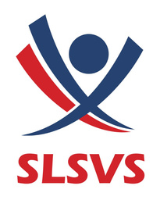
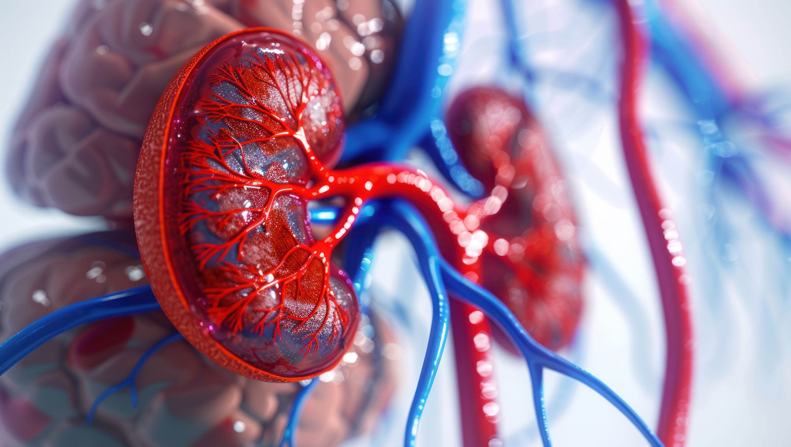


SLSVS_26
Renovascular disease and auto-transplantation:
A single unit experience
Presenting author : W D A G Gunatilleke

Slide 2
SLSVS_26
Introduction
Management of clinically significant Renal Artery Stenosis (RAS) and Renal Artery Aneurysm (RAA) are often quite challenging due to the need to balance potential benefits of revascularization against risks of intervention, while managing high-risk cardiovascular comorbidities.
While medical management (RAS) and interventional endovascular methods (RAA) remain first-line, surgery remains the bail-out option for refractory cases and where non-surgical methods are not feasible.

Slide 3
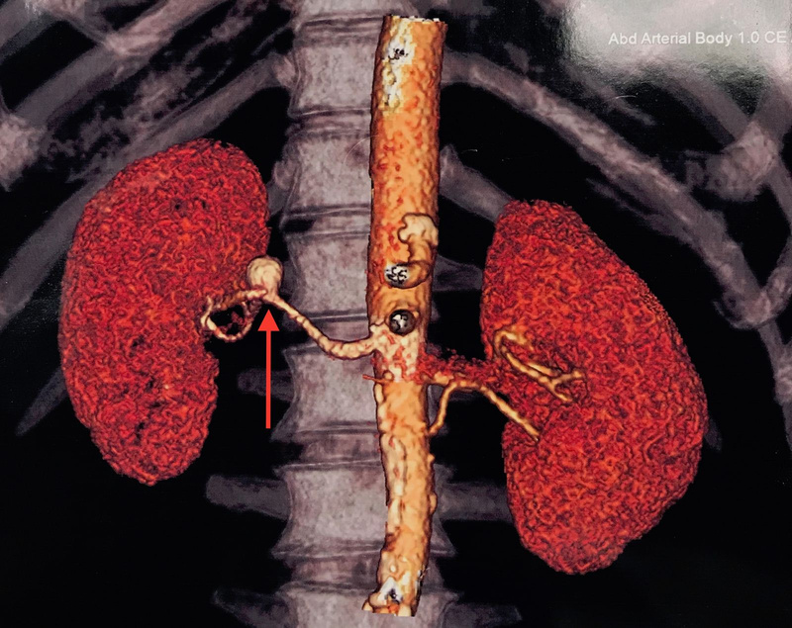
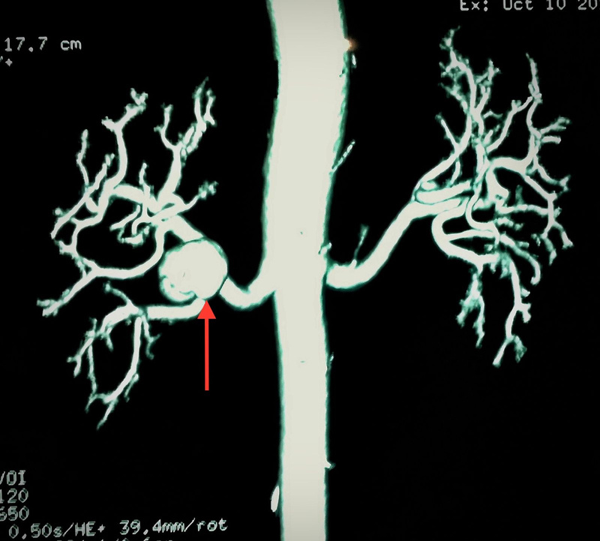
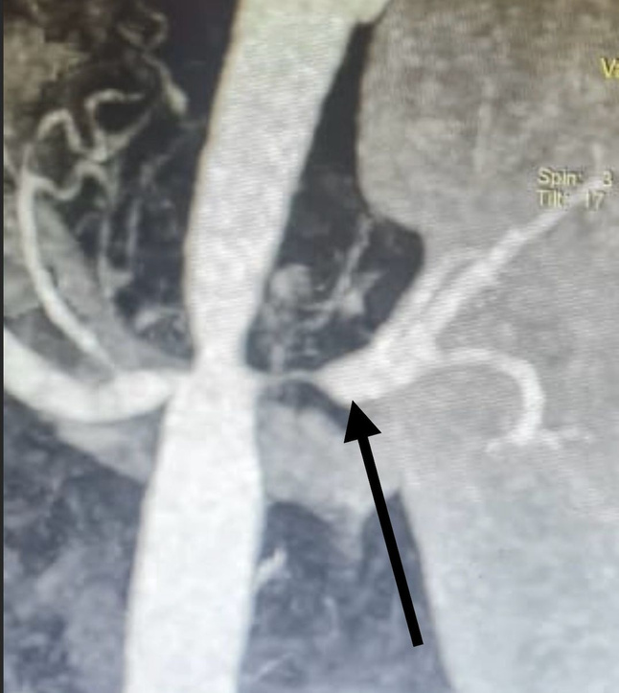
SLSVS_26
Right renal artery aneurysm
at the hilum
Large right renal artery
aneurysm
bilateral severe
renal artery stenosis

Slide 4

SLSVS_26
Methodology
07 cases 04 RAS/ 03 RAA
Successful surgical reconstruction and auto-transplantation were done after failed medical and endovascular management.
All patients with RAS (Female - 24,32,48 yrs /Male -16 yrs)
  Two patients had bilateral extensive RAS, while the other two had unilateral disease.
  had Takayasu Disease with resistant hypertension while on maximal therapy.
  Initial attempts at angioplasty and stenting were also unsuccessful.
All patients with RAA ( Female - 42,48 yrs/ Male - 61 yrs)
  were considered not amenable to management with covered stents due to their precise location in the renal hilum, affecting segmental branching points.
  Median diameter - 2.9 cm ( 2.6 -3.2 cm)

Slide 5
SLSVS_26
  All patients underwent comprehensive pre-operative imaging evaluation
(high-resolution computed tomographic angiography (CTA) and/or magnetic resonance angiography (MRA) to delineate the exact anatomical configuration of the renovascular pathology.
  Standard open nephrectomy was done.
  Cold perfusion and back-table renal artery reconstruction was done.
  In vitro repair was done using autogenous great saphenous vein.
  auto-transplantation done to the right iliac fossa.
  The reconstructed renal artery was anastomosed to the external iliac artery
(end-to-side)

Slide 6
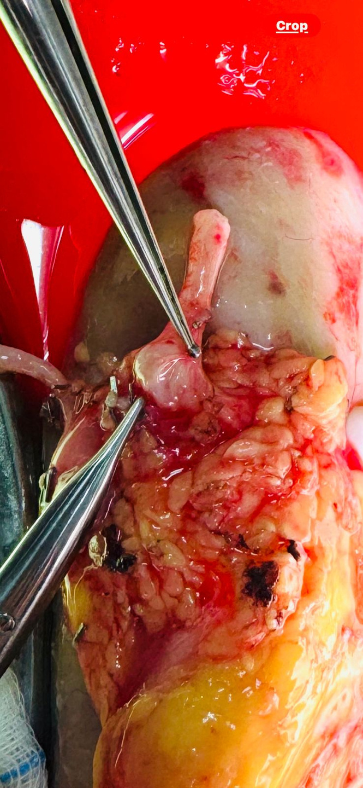
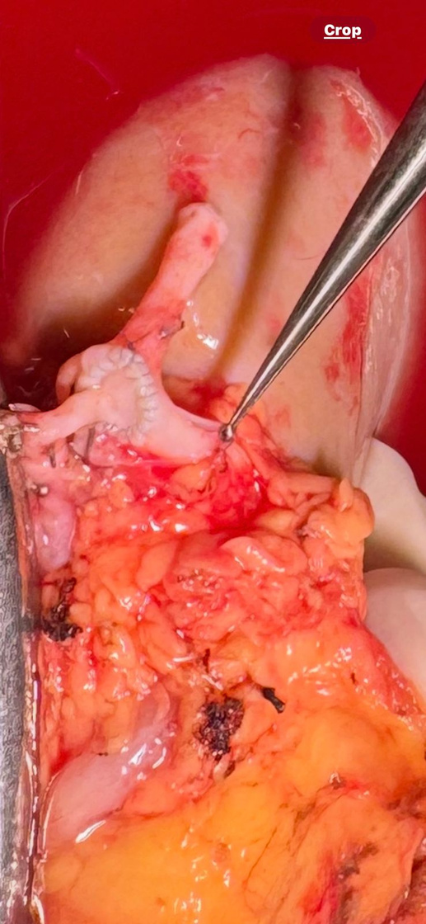
SLSVS_26
In-vitro
reconstruction
of the RAA
Following
in-vitro reconstruction

Slide 7
SLSVS_26
significant in-hospital morbidity | None
mortality | None
Average post-operative hospital stay | 07 days
Follow-up Doppler scan results at 4, 8, 12 ,24 weeks | no evidence of disease recurrence with excellent perfusion and arterial integrity.
 | All 3 RAA - cured 2 RAS with uni-lateral disease : off medication with good BP control 2 RAS with bi-lateral disease : partial resolution of symptoms, awaiting management of the contra-lateral side.
Results

Slide 8
SLSVS_26
Conclusion
Resistant RAS and significant RAA both pose unique challenges in definitive management, especially where initial medical and interventional management options have failed.
While in-situ repair has also been described in certain centres, we believe in-vitro reconstruction and auto- transplantation facilitates a better surgical repair of the diseased artery segments and also allows the re-implantation to be done in virgin territory.
In vitro repair and auto-transplantation offers a viable and safe salvage option for complex renovascular pathology where medical and interventional measures have failed with very encouraging early results.

Slide 9
SLSVS_26
Thank you

