Slide 1

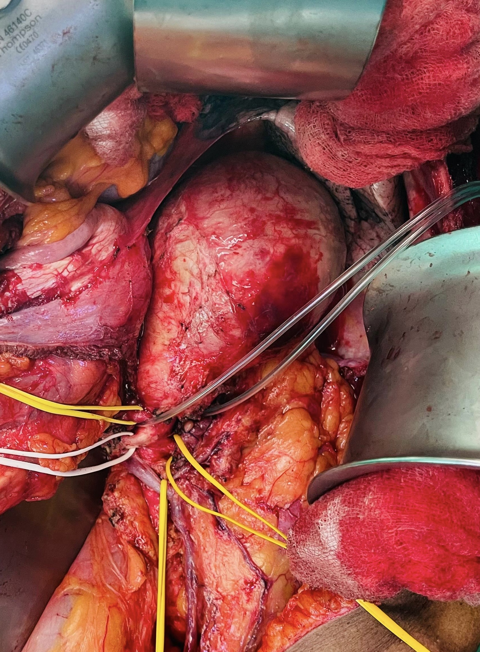
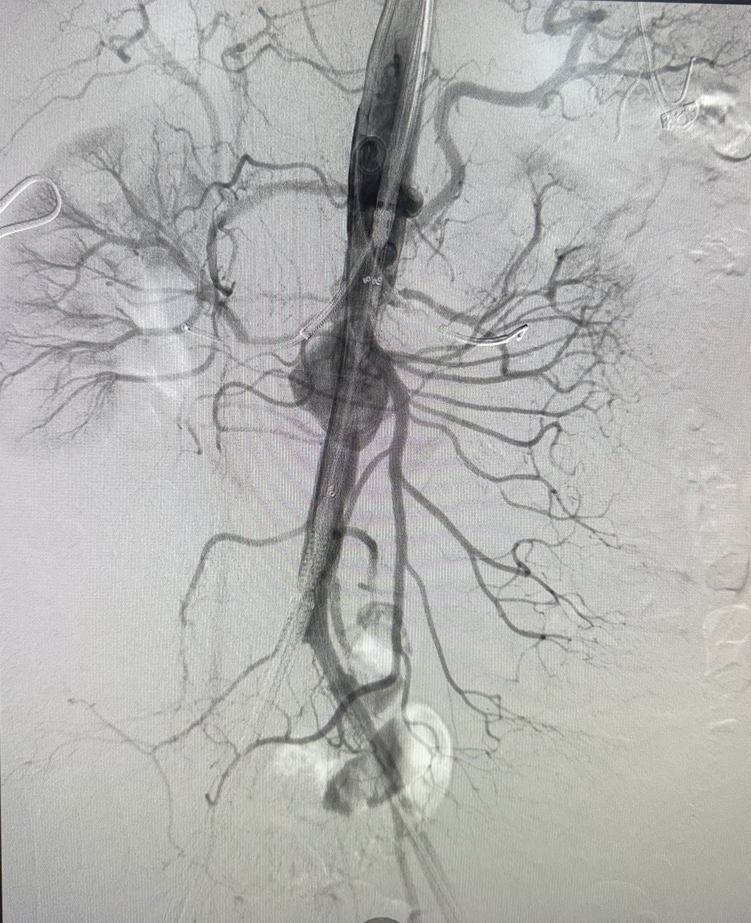
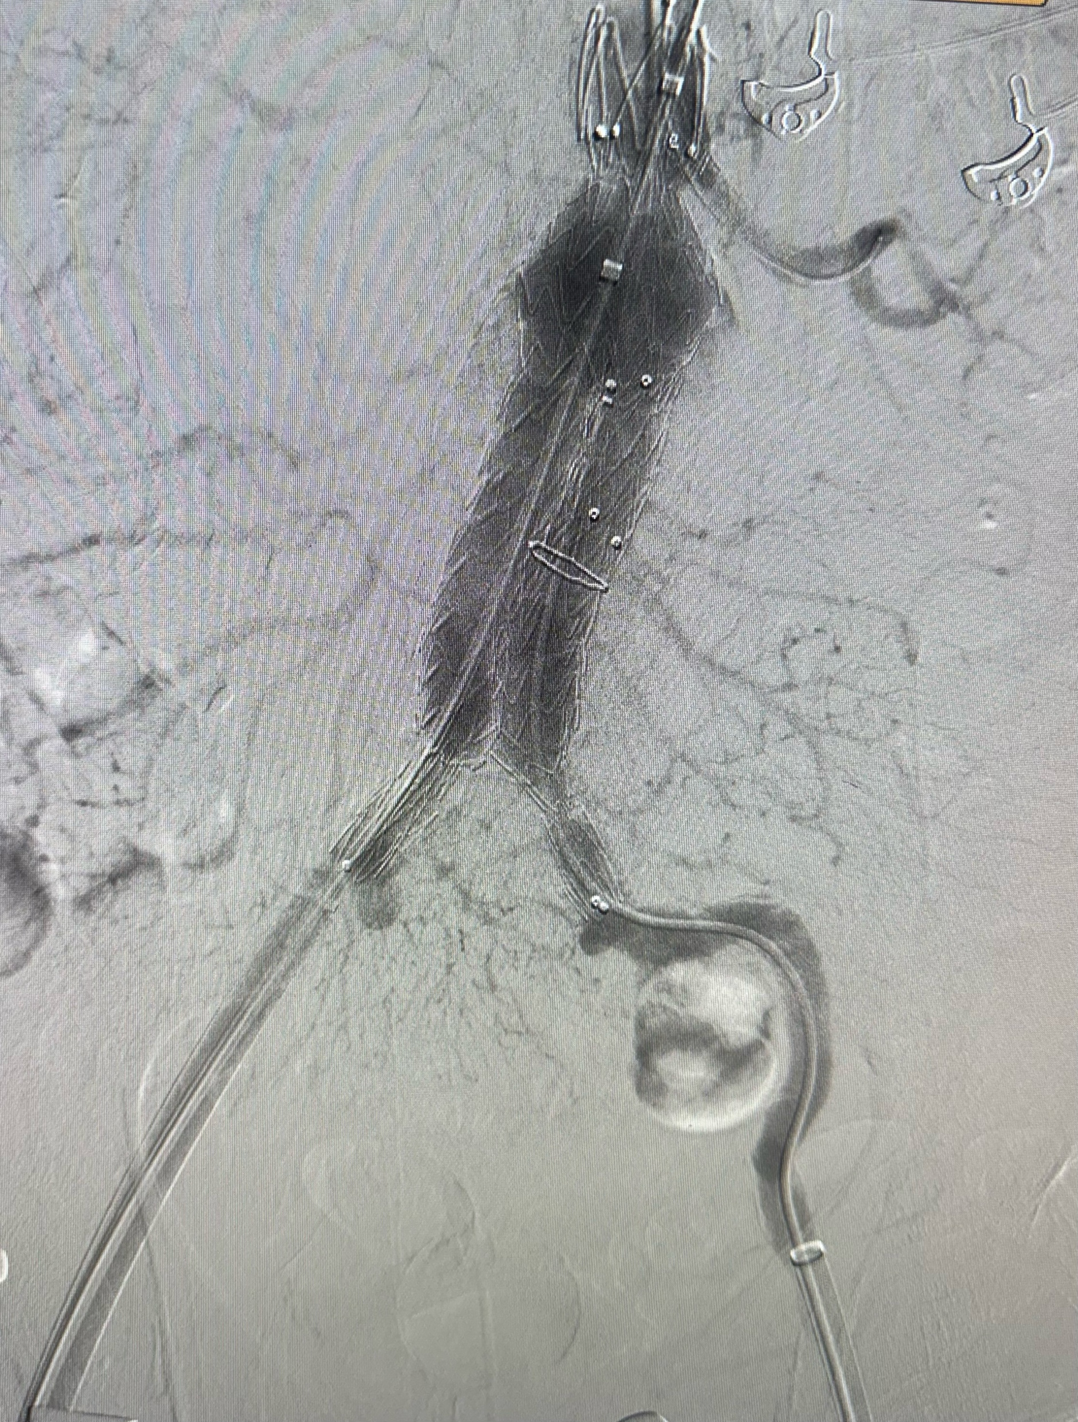
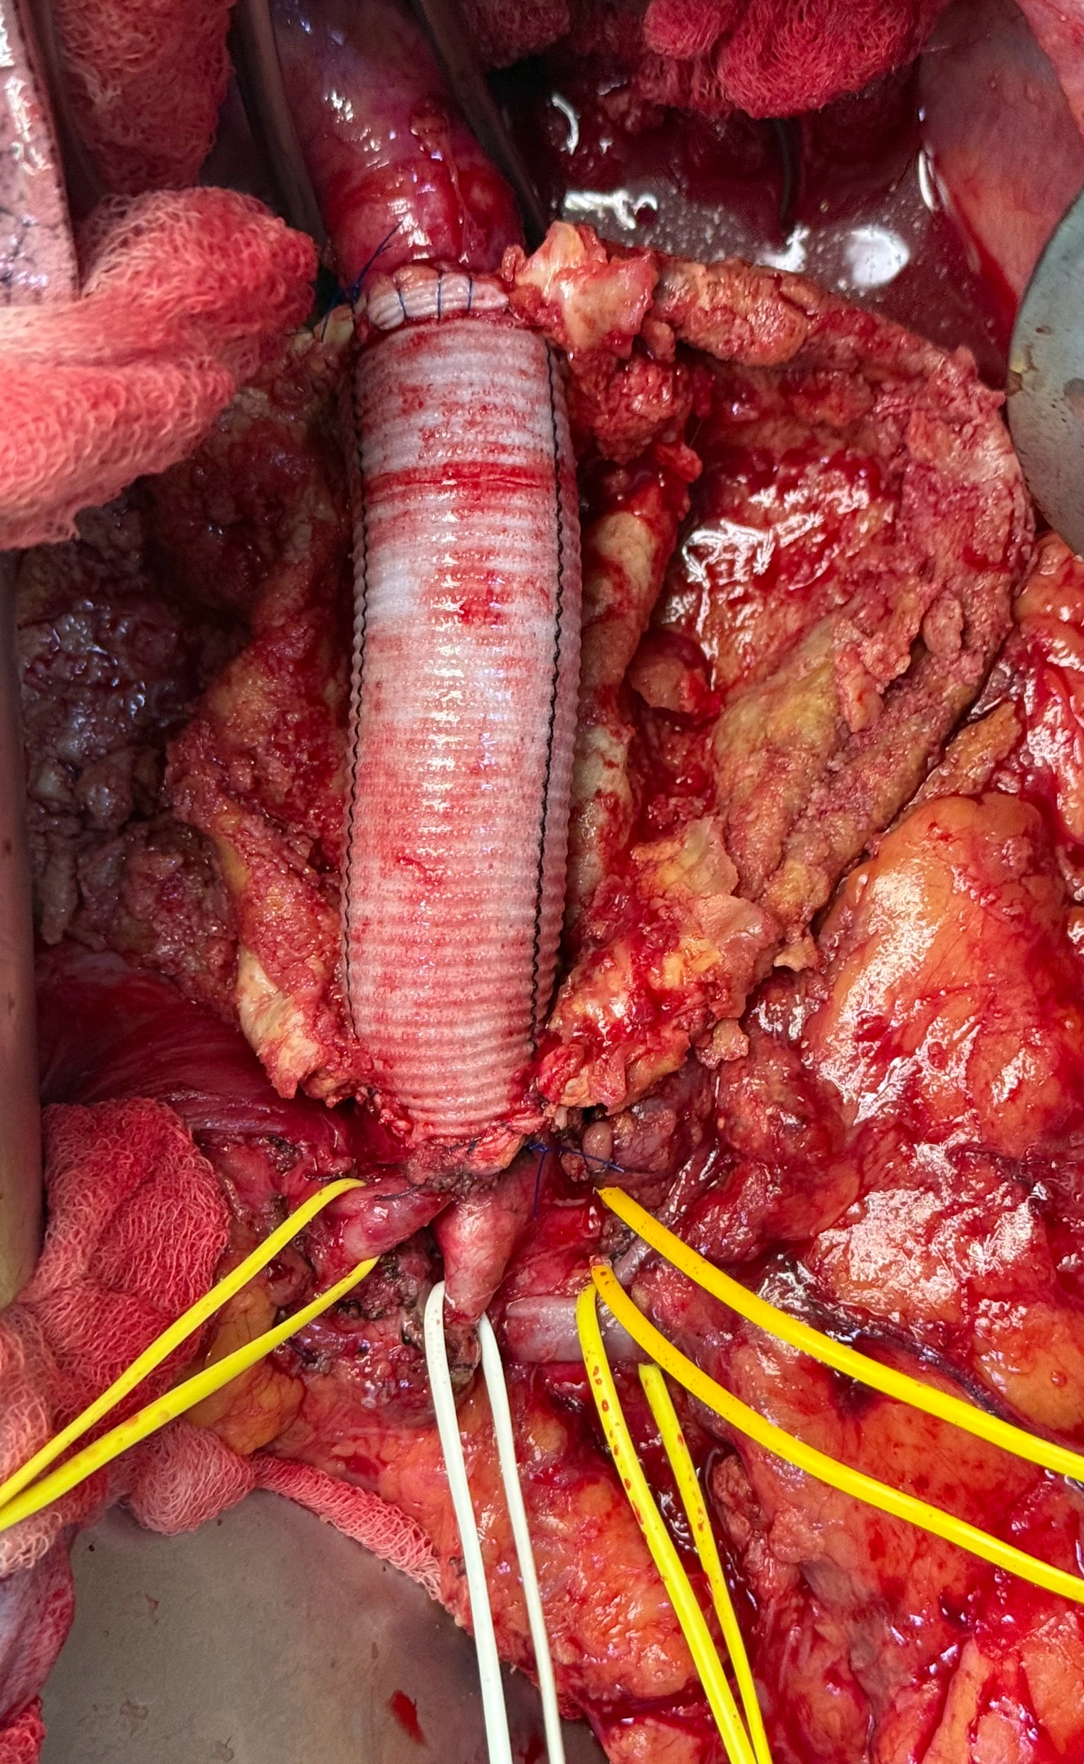
Management and Early Outcomes of Aortic Aneurysm Presentations in a Resource-Constrained Tertiary Center
Presenting Authour : L E D I Kumari
Professorial Vascular Unit
National Hospital Sri Lanka

Slide 2
Introduction
Aortic aneurysms are associated with significant morbidity and mortality, particularly when presenting with rupture or leak.
Endovascular repair predominates in high-resource settings
Limited data in resource-limited environments
Objective:
Evaluate presentation patterns , management strategies, and impact of resource limitations
in decision making

Slide 3
Methodology
Retrospective observational study
Duration - 6 months
Inclusion:
  Radiologically confirmed aortic aneurysm
  Indication for intervention (size, symptoms, emergency)
Exclusion:
  Refusal of intervention
Descriptive statistical analysis

Slide 4
Results – Patient Characteristics
Cohort Summary (n=18)
  Mean age: 68.6 yrs
  Male: 83%
  Mean aneurysm size: 60 mm
Mode of presentation
Presentation | N (%)
Rutured/leaking | 27.8% (5)
Symptomatic | 55.5% (10)
Incidental | 16.7% (3)
Table 1: Presentation distribution

Slide 5
Results – Aneurysm distribution
Chart 1: Aneurysm location distribution (n=18)
Majority presented with symptomatic or emergency pathology

Slide 6
Results – Management & Outcomes
Management strategy | N (%)
Open repair | 9 (50%)
Endovascular (EVAR/TEVAR) | 4 (22.2%)
Conservative management | 5 (27.8%)
Table 2: Management strategy distribution
Resource limitations influenced management decisions in 57% of non-endovascular cases (8/14).
In hospital mortality: 5.6%

Slide 7
Conclusion
Management influenced by clinical status and availability of resources.
Resource availability is a major determinant of decision-making.
Endovascular interventions are underutilized compared to global practice.
Implication:
Improve device access and affordability to align with global standards.

Slide 8
Limitation
Small sample size
Single center retrospective study
Limited long term follow up
Descriptive analysis without multivariable statistics
Findings may not be generalizable to all settings

Slide 9
Recommendation
Improve availability of EVAR/TEVAR devices
Develop cost reduction and procurement strategies
Establish multi-center vascular registries
Promote early referral and aneurysm surveillance
Conduct larger prospective studies

Slide 10
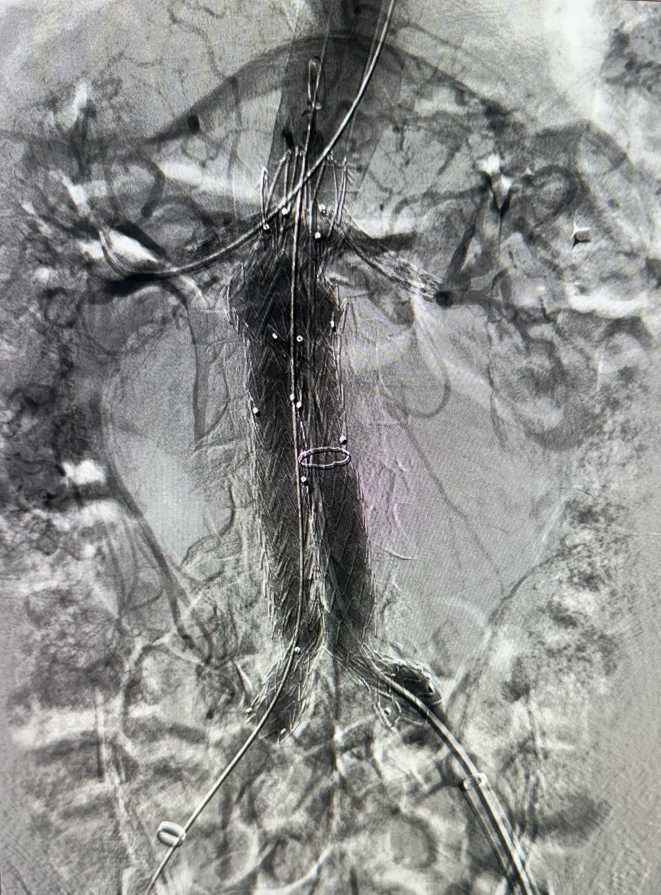
Thank you

