Slide 1

Management of Venous Injuries of the Lower Limb
Joel Arudchelvam, Hansani Hegoda Gedara, Rukshan Siriwardana, Thushan Gooneratne, Rezni Cassim
University Vascular and Transplant Unit, Department of Surgery, University of Colombo.
Notes:
Good afternoon everyone. I am Hansani Hegoda Gedara, a pre-intern attached to the University Vascular and Transplant Unit. I’m here to present the findings of my study on the Management of Venous injuries of the lower limb.

Slide 2
Introduction
Background
Methodology
Lower limb venous injuries account for approximately 20% of severe lower extremity trauma.
Study Period: January 2015 – 2025
Subjects: Patients undergoing lower limb venous repair – all surgeries performed by a single surgeon
The optimal management of deep venous injuries remains controversial, with debates between ligation and primary repair.
Data: Demographics, injury mechanism, and repair type
Notes:
Lower extremity venous injuries account for approximately 20% of severe lower limb trauma. However, the optimal management of these deep venous injuries remains a debate between ligation and primary repair with the experts being divided between the two. While global data are available on this topic, local data regarding lower limb venous injuries and repair are scarce and Our objective was to evaluate our institutional experience to help guide best practices.“ we reviewed data over a ten-year period from January 2015 to 2025, specifically focusing on patients who underwent lower limb venous repair. All surgeries included in this cohort was performed by a single surgeon. We analyzed demographics, injury mechanisms, and the type of repair performed along with the early clinical outcomes.

Slide 3
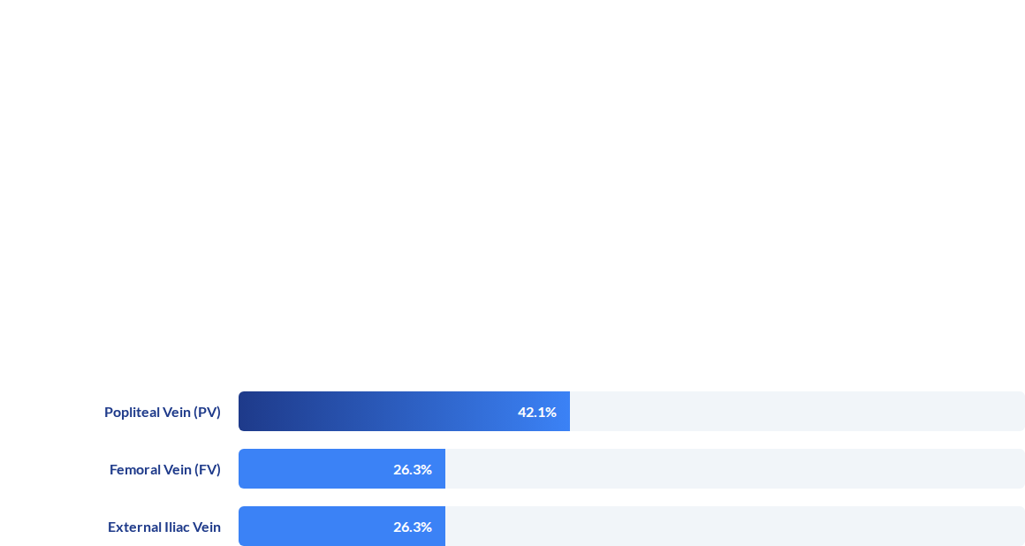


Results: Patient & Injury Profile
Demographics
Mechanisms
Vessel Involvement
N = 19 Patients
•
Road Traffic Accidents 21.1%
Popliteal Vein: 42.1% (n=8)
•
Trap Gun Injuries 21.1%
Male: 73.7% (n=14)
Iatrogenic Causes 21.1%
Femoral Vein: 26.3% (n=5)
•
Female: 26.3% (n=5)
•
Workplace Injury (n=1)
External Iliac vein: 31.5% (n=6)
Mean Age: 36 years (4-61)
Vessel Distribution
31.5%
Notes:
Our cohort included a total of 19 patients. Demographically, the majority were male, making up 73.7% of the cases while 26.3% of the patients were female, and the mean age was 36 years, ranging from 4 to 61.
When analyzing the mechanisms of injury, we observed an even distribution across three primary causes. Road traffic accidents, trap gun injuries, and iatrogenic causes each accounted for 21.1% of cases, alongside one workplace injury. Anatomically, the popliteal vein was the most frequently injured vessel, seen in 42.1% of patients. This was followed by the external iliac vein accounting for 31.5% and the femoral vein, accounting for 26.3%.

Slide 4
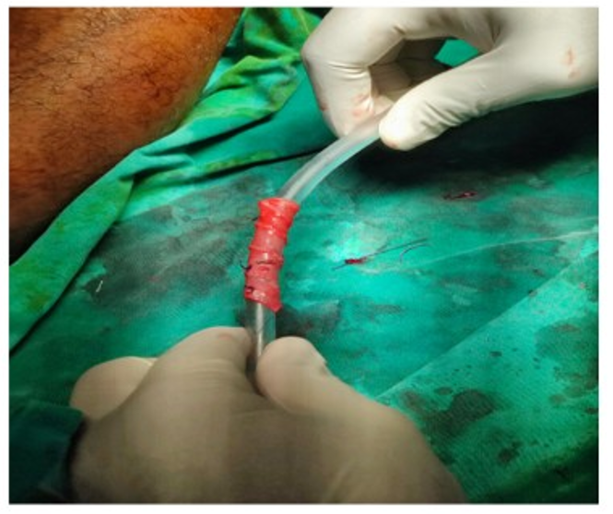

Results: Repair and early outcomes
Type of Repair
Direct Venous Repair: 57.9%
Saphenous Panel Graft: 21.1%
Early clinical outcomes
n = 18 – successful repair and limb salvage
n = 1 - Developed reperfusion syndrome and underwent ligation
No expected major surgical complications i.e thrombosis and embolism were reported
Fig 1: Venous repair of the Superficial Femoral Vein
Notes:
Finally, looking at the management: the majority—57.9%—were managed with direct venous repair and saphenous panel grafts were utilized in 21.1% of cases. 18 cases were successfully repaired with limb salvage while one patient developed reperfusion syndrome following direct venous repair and subsequently underwent ligation.
Here we have also included an image of a spiral graft reconstruction for a venous repair of the femoral vein of a patient from this cohort.
No complications such as thrombosis was reported in the early postoperative period.

Slide 5

Conclusions & Recommendations
Conclusions:
•
This series shows that venous repairs can be done with acceptable success.
This avoids complications of ligation such as venous hypertension, limb swelling, and potential limb loss.
•
Management Recommendations:
•
Any vein above popliteal should be repaired.
•
Native grafts are preferred.
Size matching required with graft reconstruction (paneled or spiral).
•
Notes:
Outcome will be reported, why does the venous thrombosis occur?

Slide 6
Strengths and Limitations
Strengths of the Study
Local institutional data from a tertiary care center
Data spanning over 10 years duration
Limitations of the Study
Sample size – 19 patients
No comparison cohort with those who underwent venous ligation
Long term outcomes not reported
Notes:
Moving on to the strengths and limitations of the study, we present data from a local tertiary care center with data spanning over a ten year period. However, the sample size included were 19 patients and a larger data set would yield more significant results. We have also not included a comparison cohort of patients who underwent venous ligation in the study. And while the long term outcomes are not reported, the patients are being followed up to include those data in the future analysis of the study.

Slide 7
References
Quan, R. W., Adams, E. D., Cox, M. W., Eagleton, M. J., Weber, M. A., Fox, C. J., & Gillespie, D. L. (2006). The management of trauma venous injury: Civilian and wartime experiences. Perspectives in Vascular Surgery and Endovascular Therapy, 18(2), 149–156.
Shahzad, N., Moosa, M. A., Siddiqui, N. A., & Shaikh, F. A. (2026). Ligation versus repair of isolated traumatic peripheral venous injury: A systematic review and meta-analysis. Annals of Vascular Diseases, 19, 25-00107.
Qi, Y., & Gillespie, D. L. (2011). Venous trauma: New lessons and old debates. Perspectives in Vascular Surgery and Endovascular Therapy, 23(2), 74–79.

Slide 8
Thank You

