Slide 1
Limb Reduction Surgery for Advanced Lower Limb Lymphoedema
1st - Quality of Life Outcomes from Sri Lanka
PL Wasula , T Gooneratne

Slide 2
Introduction
Lower limb lymphedema (LLL) significantly impairs quality of life.
Mostly conservative therapy done in Sri Lanka for all grades of disease
Limb reduction surgery is rarely performed.
No prior local post surgical QoL outcome data available.

Slide 3
Aim of the study
To evaluate quality of life following limb reduction surgery In patients with advanced lower limb chronic lymphoedema.
Identify complications of surgery

Slide 4
Methods
Study period: 2024–2025
Population: Patients who have undergone limb reduction surgery for chronic lymphoedema
Tool: LYMQOL questionnaire
Data collection: Telephone conversation
Retrospective study

Slide 5
Demography
Total patients: 10
Mean age: 46.2 years
Female: 80%
Primary lymphedema: 90%
Bilateral disease: 20%
All Brunner stage 3

Slide 6
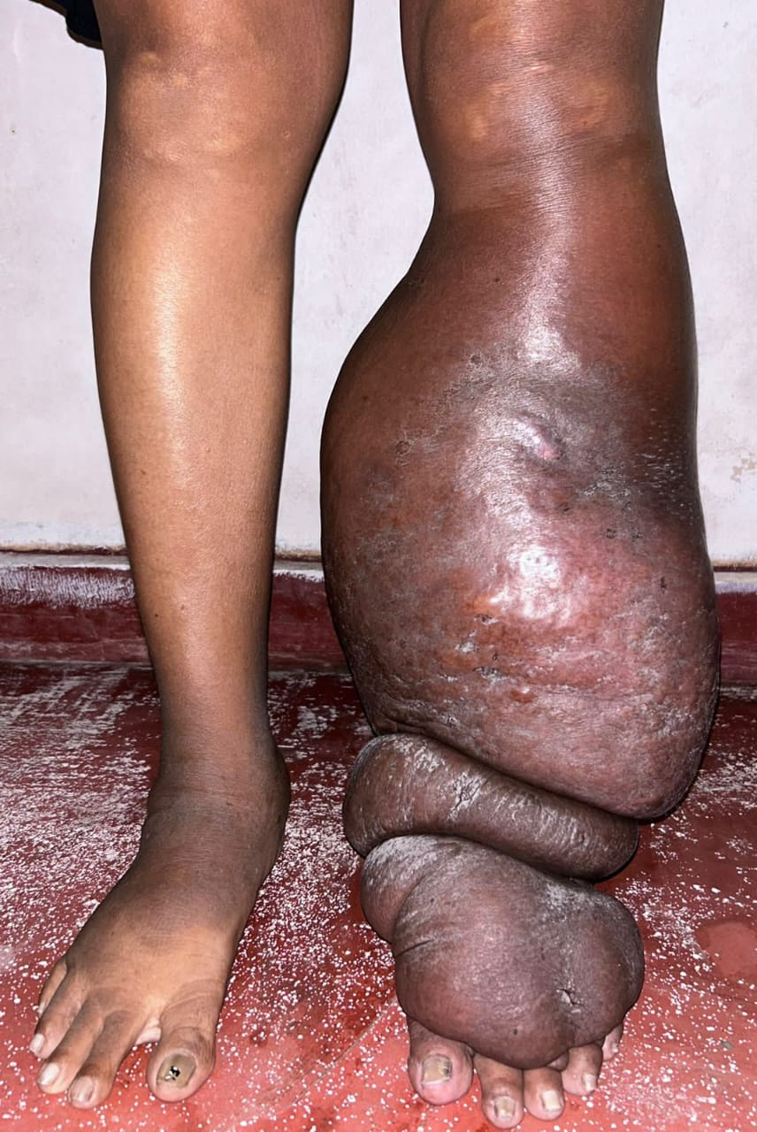
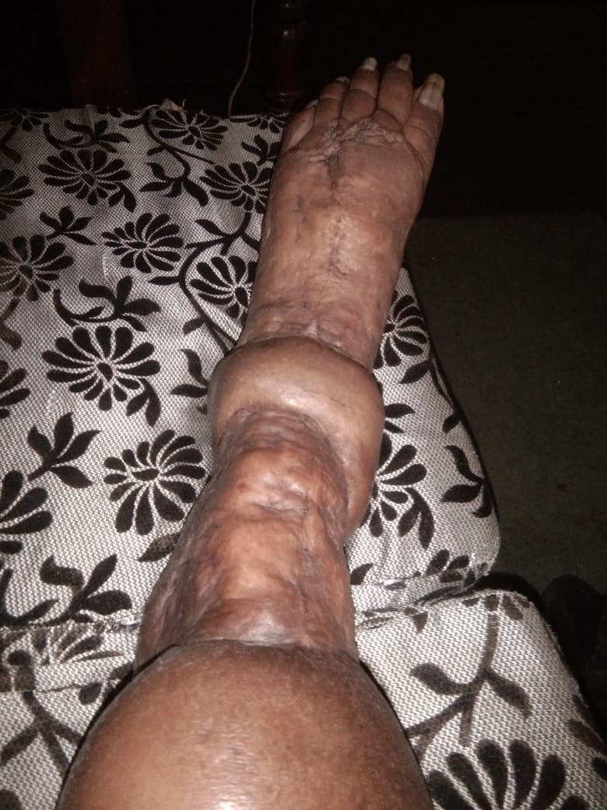
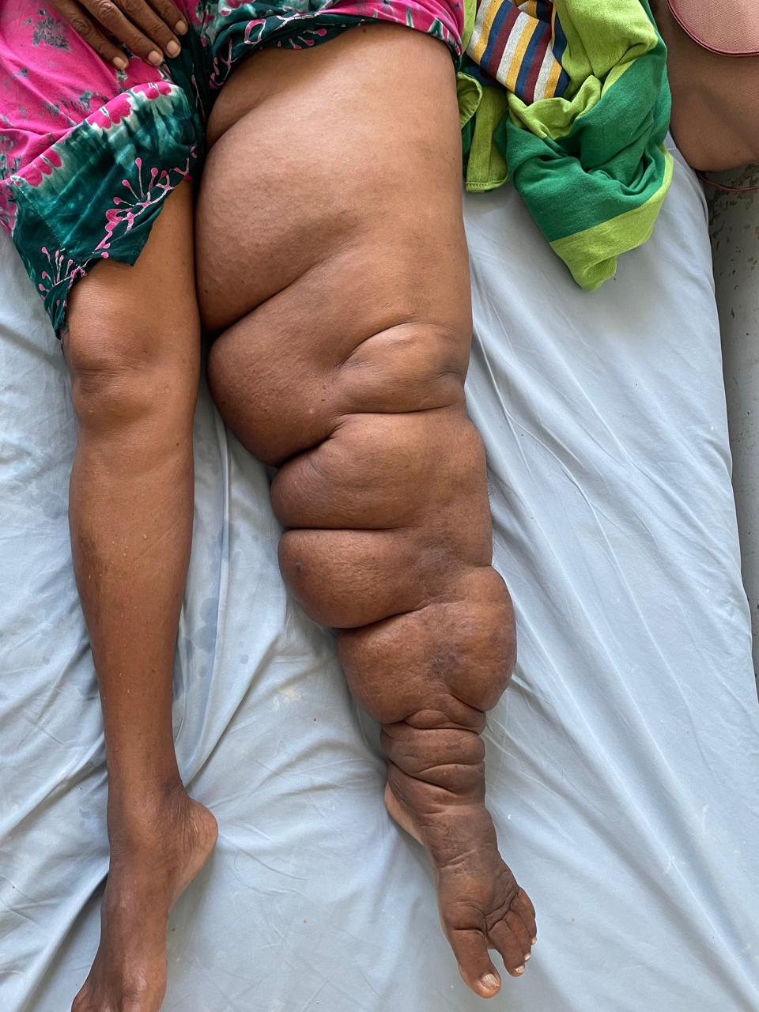
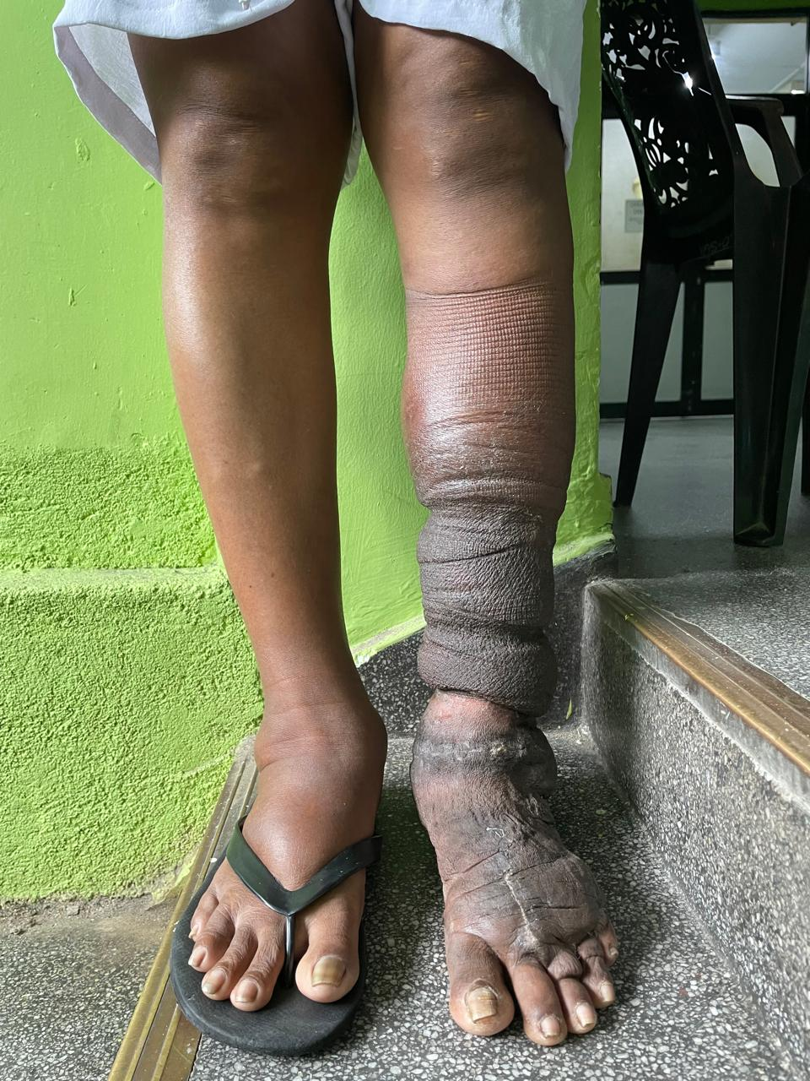
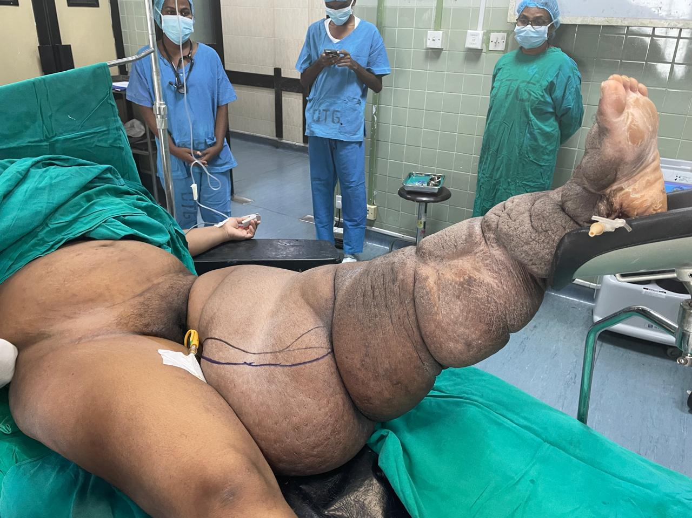

Slide 7
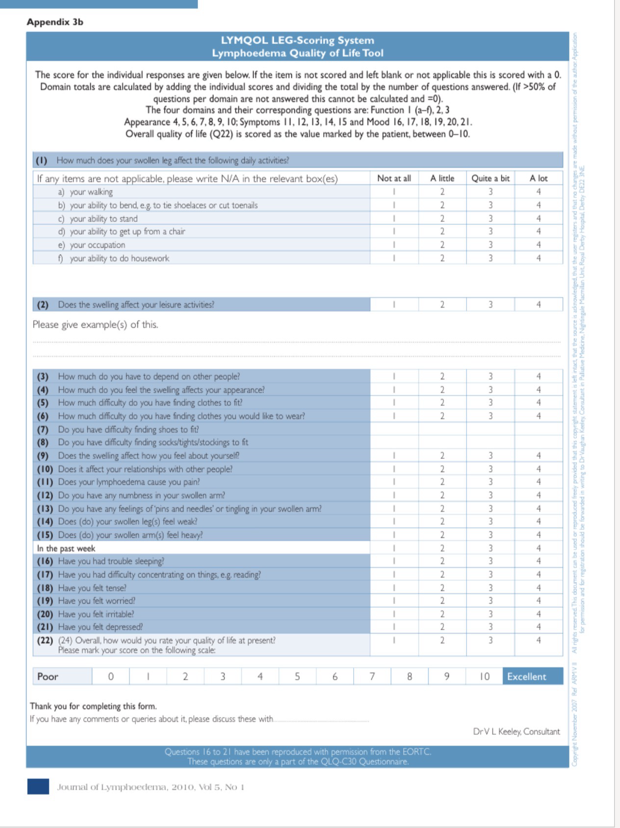
LYMQOL QUESTIONARE

Slide 8
Results – LYMQOL Scores
Category | Before Surgery | After Surgery
Function | 2.71 | 1.42
Appearance | 2.21 | 1.10
Symptoms | 1.14 | 0.677
Mood | 1.58 | 1.48
Overall QoL | 3.0 | 7.0

Slide 9
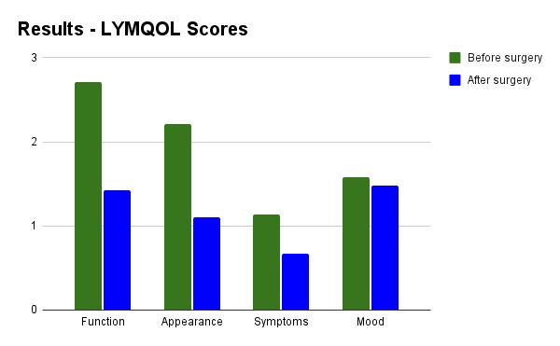
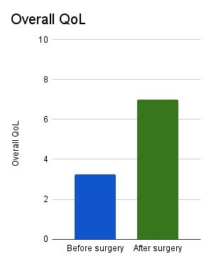

Slide 10
Preoperative inward stay
Six weeks
Stages of surgery performed
One stage- 08
Two stage- 02

Slide 11
Post-op complications
Complication | Number | Percentage
Wound infection | 01 | 10%
lymphorhoea | 02 | 20%
Bleeding | 01 | 10%
Skin gfaft failure | 01 | 10%

Slide 12
Conclusion
Limb reduction surgery improves the quality of life in all domains – Function,Activities,Symptoms,Mood
Improves overall QoL

Slide 13
Discussion
Surgery improves overall QoL in advanced disease
Integrated rehabilitation services after surgical intervention would further improve the quality of life
It’s not a common treatment strategy in Srilanka for significant lymphoedema due to lack of resource personnel and potential complications
A large scale study is warranted to have a descriptive statistical analysis

Slide 14
References
1. Keeley V. LYMQOL Tool Development
2. ESVS Guidelines on Lymphedema
3. Rockson SG. Lymphedema management
4. International Society of Lymphology Consensus Document 2020
5. Recent surgical outcomes literature

