Slide 1

Impact of Time from Diagnosis to Surgery on Outcomes in Symptomatic Carotid Stenosis
Prasanga RPS¹, Vishwajith RMP¹, Fonseka HFDGD¹, Sancheevan S¹, Gunawansa N²
National Hospital of Sri Lanka

Slide 2
Background
Symptomatic carotid stenosis → high stroke risk
Guidelines recommend CEA within 2 weeks
Real-world delays are common
Impact of delay → not fully clear

Slide 3
Aim
To evaluate the impact of time from diagnosis to surgery on outcomes following CEA
Focus:
  Perioperative outcomes
  Mortality

Slide 4
Methods
Outcomes:
  Perioperative complications
  Mortality
Retrospective study
120 consecutive CEA patients
Symptomatic carotid stenosis
Groups:
<2 weeks → Early
2–4 weeks → Intermediate
4 weeks → Delayed

Slide 5
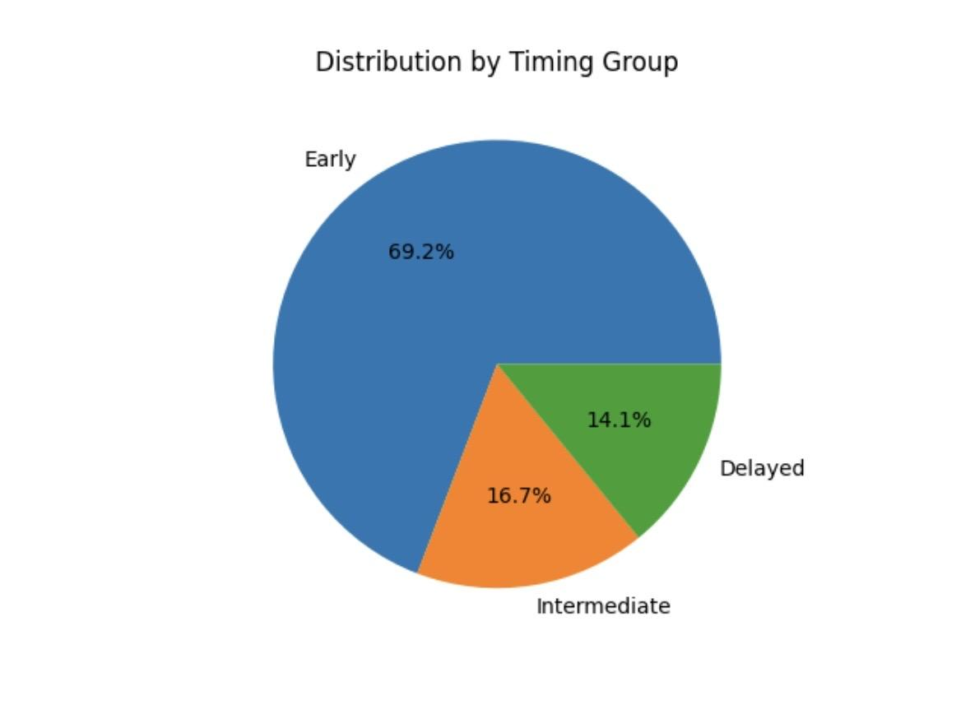
Patient Distribution

Slide 6
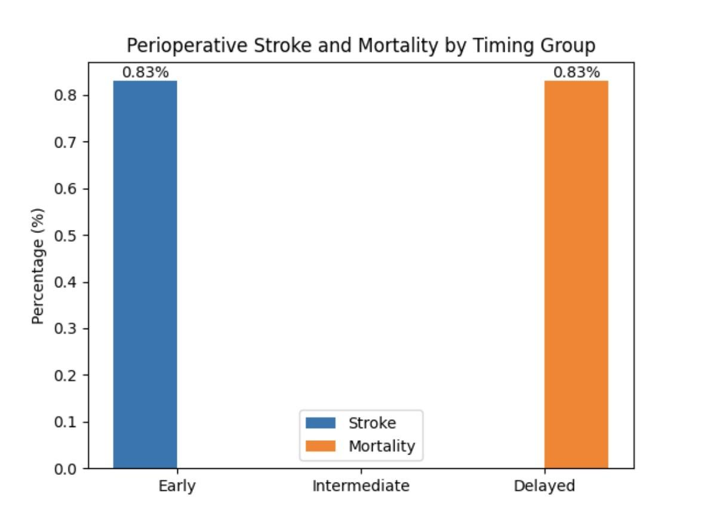
Perioperative Outcomes

Slide 7
Key Observation
* One perioperative stroke (in early group)
* No perioperative strokes in other groups
* Single death: following Myocardial infarction

Slide 8
Conclusion
CEA → safe with excellent outcomes
Early (<2 weeks) remains optimal
Delayed surgery still viable in:
  Carefully selected
  Medically optimized patients

Slide 9
Thank you!

