Slide 1

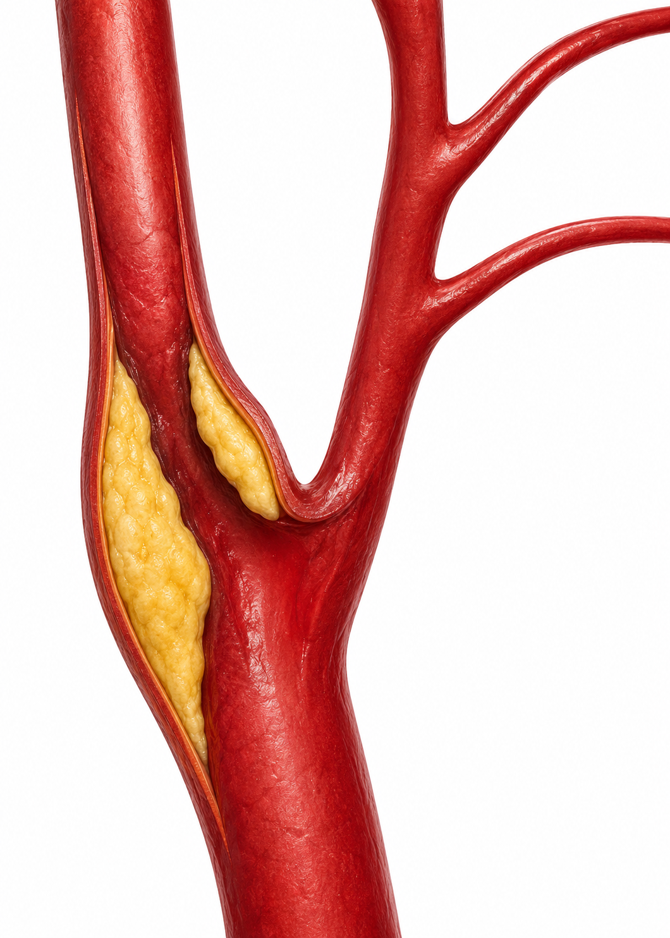
Symptomatic Carotid Artery Stenosis - Demography in a Tertiary Vascular Referral Service
Presenting author - Sancheevan S
RMP Vishwajith, RPS Prasanga, S Sancheevan, LA Indunil, HFDG De Fonseka, N Gunawansa
National Hospital of Sri Lanka.

Slide 2
Background
Symptomatic carotid artery stenosis is a major cause of ischemic stroke and transient ischemic attack.
CEA reduces recurrent ischemic stroke risk
Elderly patients are often under referred due to perceived risk

Slide 3
Aim
To evaluate demographic characteristics and perioperative and long term outcomes following CEA for symptomatic carotid artery stenosis.

Slide 4
Methodology
Retrospective study in a tertiary vascular centre
Period - June 2018 - August 2025
120 patients who underwent carotid endarterectomy for symptomatic carotid artery stenosis - 50% or more
Preference - General anaesthesia, Routine shunting, autologous venous patching

Slide 5
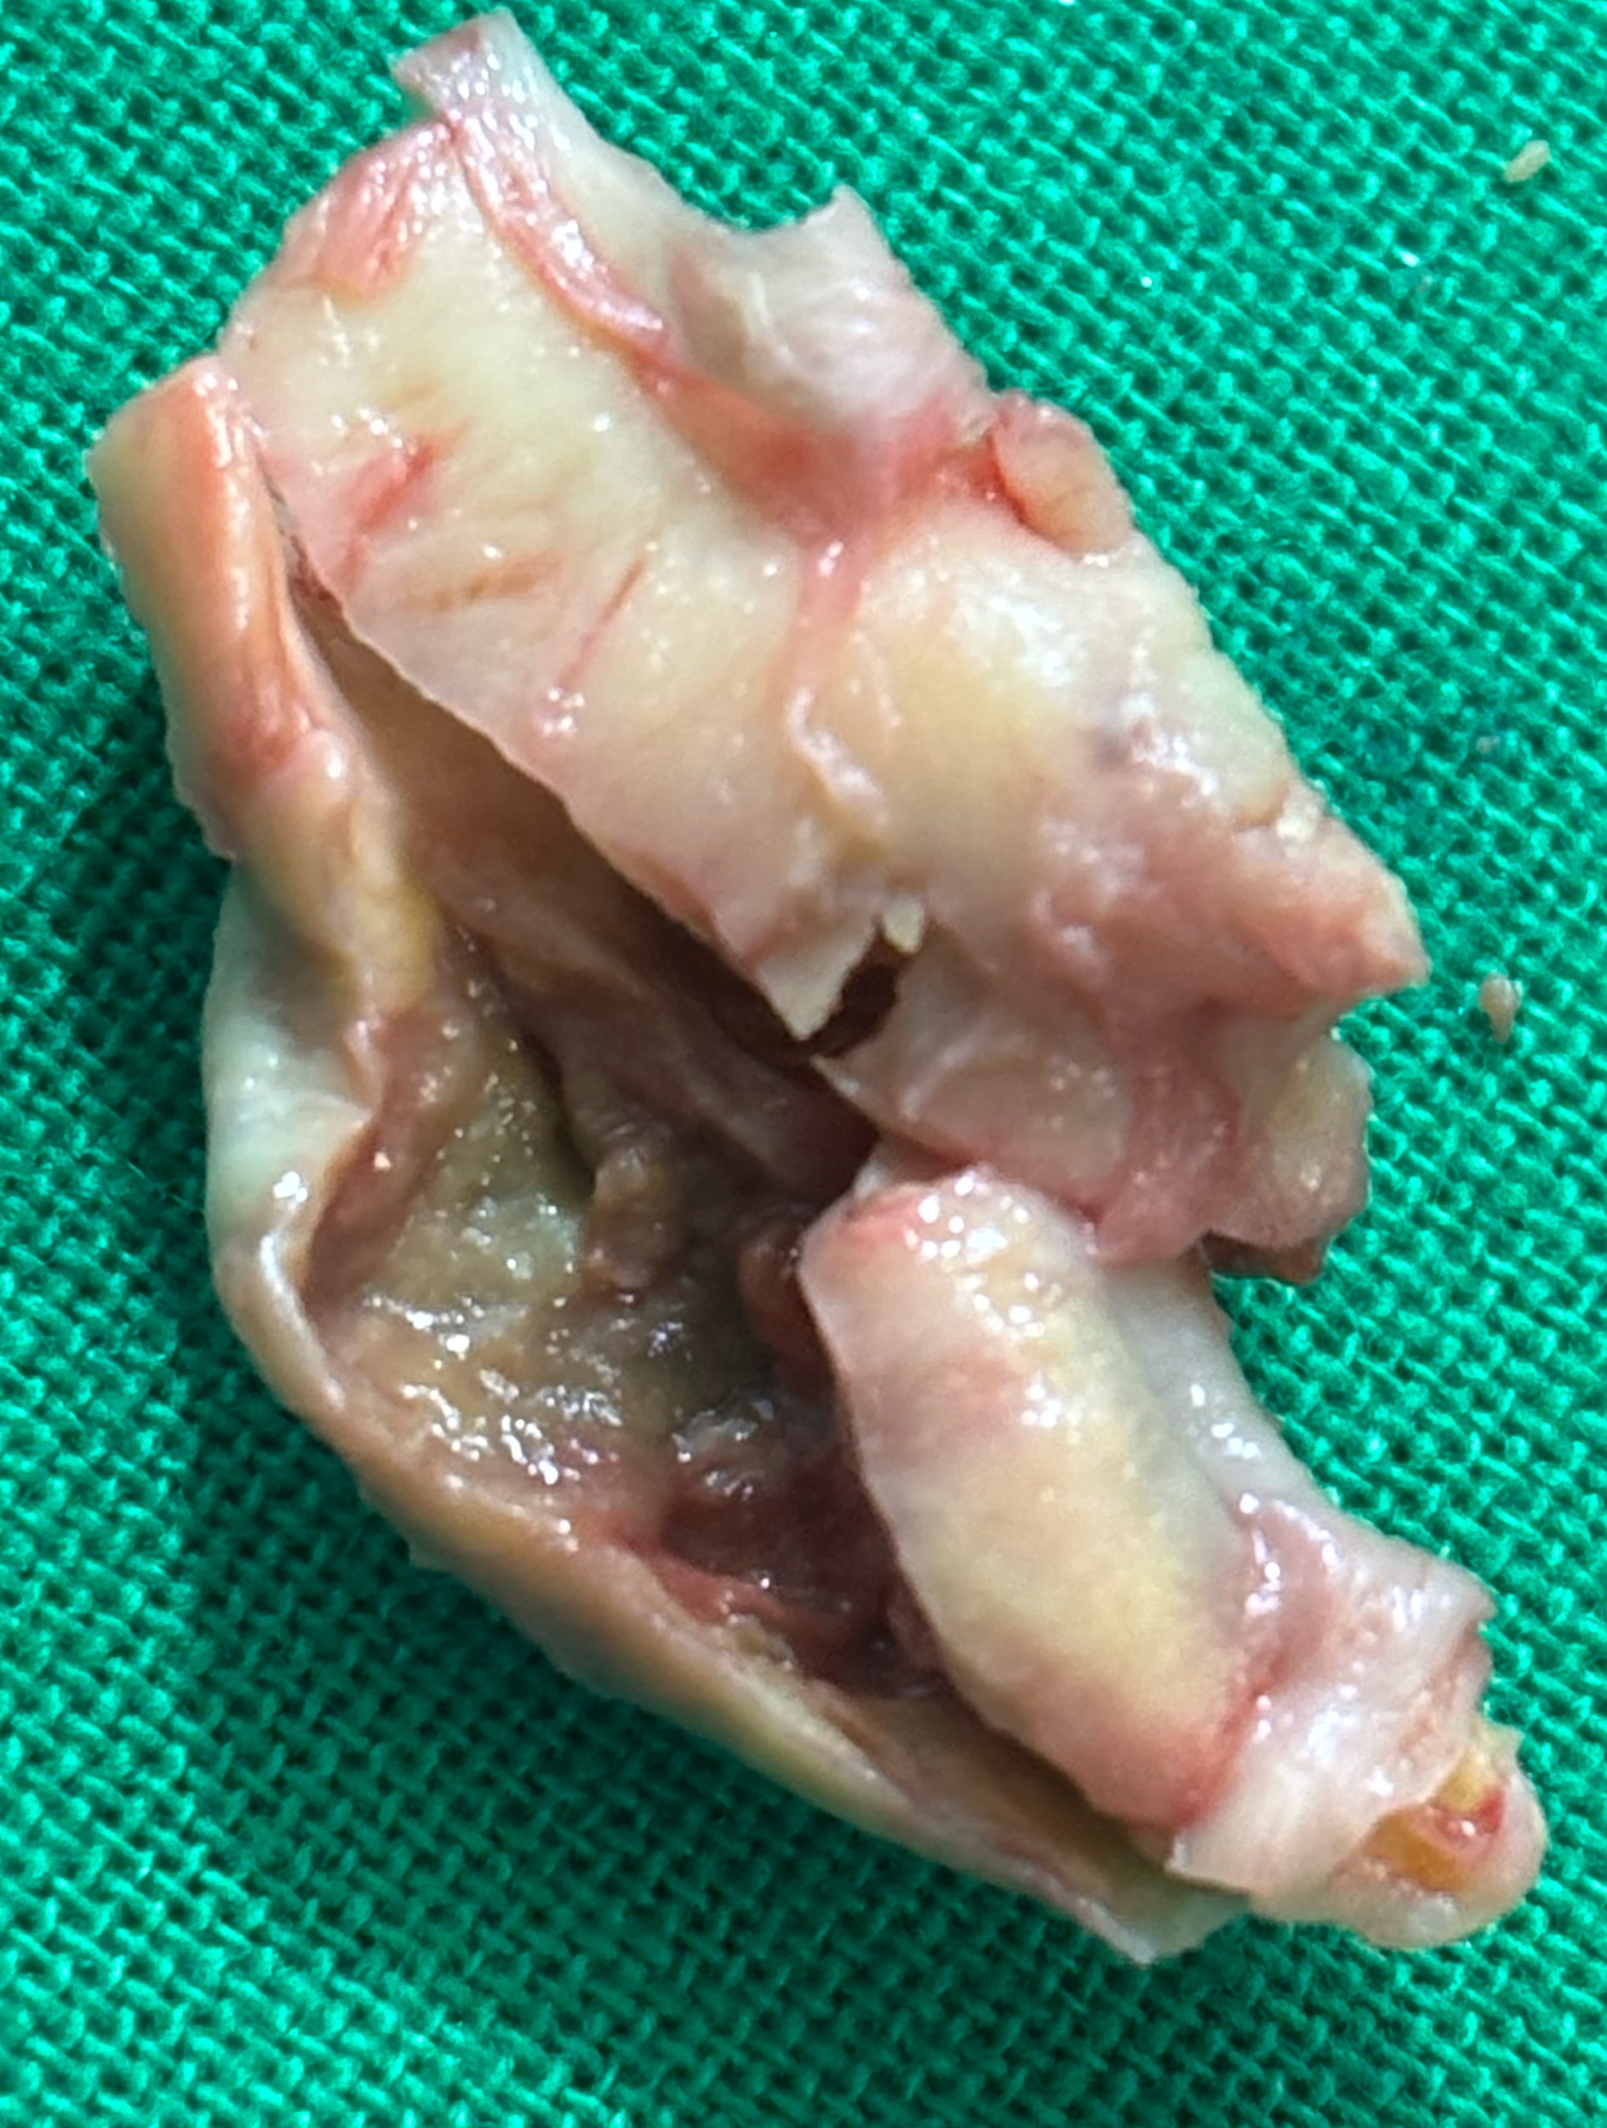
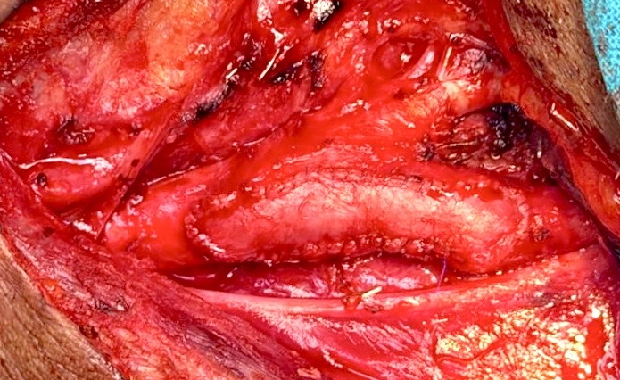

Slide 6
Demographic characteristics, perioperative outcomes, and long-term follow-up data were reviewed.
Patients were stratified into three age categories
      <60 years
      60–75 years
      >75 years.

Slide 7
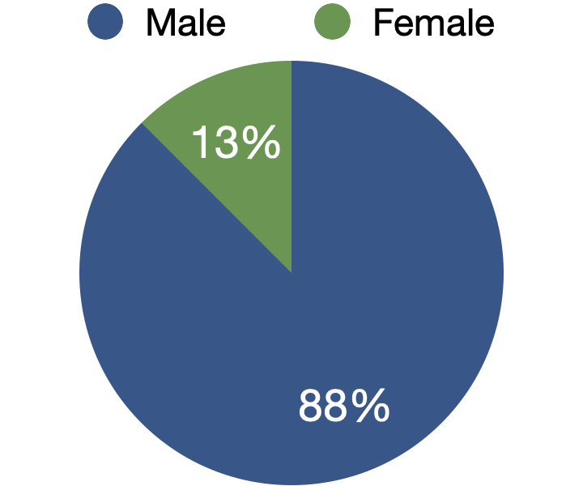
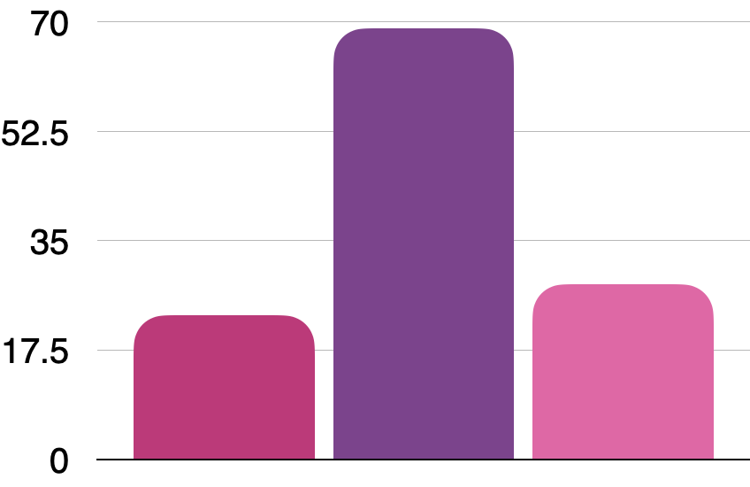
Age
  Gender
Mean age of 67.8 years
Age range 45–92
  15
  105
<60 years
60-75 years
>75 years

Slide 8
  Perioperative stroke
  Perioperative mortality
1.7%
  0.8%
Long-term stroke-free survival exceeded 98% across the cohort.
Patients aged over 75 years demonstrated outcomes comparable to younger patients when managed with meticulous perioperative care.
The oldest patient (92 years) had an uncomplicated postoperative course and excellent long-term outcome.

Slide 9
Conclusion
In a tertiary vascular referral service, carotid endarterectomy for symptomatic carotid artery stenosis demonstrates excellent outcomes across a broad demographic spectrum.
Advanced age alone should not be considered a contraindication to intervention in appropriately selected patients.

Slide 10
Thank you

