Slide 1


Angiographic Patterns of Infra-inguinal Disease in CKD Patients with CLTI
The Arterial Blue Print- The First Sri Lankan Study
Authors: Rukshan Siriwardana, Thushan Gooneratne, Rezni Cassim, Hansani Hagodagedara, Joel Arudchelvam, Wasula Lokuge
Vascular and Transplant Unit, Faculty of Medicine, University of Colombo

Slide 2

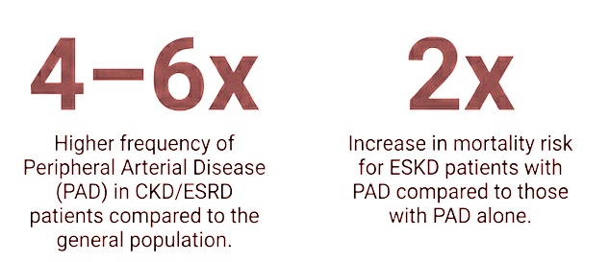

Background
The Sri Lankan Burden
Rising CKD prevalence in Sri Lanka has significant implications for CLTI management, yet local patterns remain largely unstudied until now.
Objective
To compare infra-inguinal angiographic patterns between CLTI patients with and without CKD and to evaluate the "Renal Foot" concept—a distinct pattern of disease in CKD patients—locally
Matsushita, K., Ballew, S.H., Coresh, J. and colleagues, 2025. Clinical management of peripheral arterial disease in chronic kidney disease—a comprehensive review from the European Renal Association CKD-MBD Working Group. Clinical Kidney Journal.

Slide 3
Methodology
Study Design: A retrospective cross-sectional study conducted on 175 patients with CLTI.
Cohort: Analysis of 58 patients with CKD compared against 117 patients without CKD.
Assessment: Lower limb digital subtraction angiography was used to map Target Arterial Paths (TAP) and pedal arch status.

Slide 4
Clinical Profile
 | CKD (n=58) | Non-CKD (n=117)
Diabetes Mellitus | 57 (98.3%) | 108 (92.3%)
Male Gender | 35 (60.3%) | 66 (56.4%)
Mean Age (Years) | 62.4 | 63.1
Ejection Fraction >45% | 45(77.6%) | 80 (72.7%)
Mean S. Cr (mg/dL) | 1.86 ± 0.97 | 0.99 ± 0.66 (p<0.001)

Slide 5
Clinical Profile
 | CKD (n=58) | Non-CKD (n=117)
Intermittent Claudication | 20% | 24.32%
Rest pain | 51.78% | 41.81%
Tissue Loss | 94.82% | 92.7%
Rutherford stage > 4 | 100% | 100%
No Statistical significance!

Slide 6
Rutherford Stage
 | CKD (n=58) | Non-CKD (n=117)
Rutherford stage 4 | 5.4% | 7.6%
Rutherford stage 5 | 64.4% | 68.2%
Rutherford stage 6 | 30.2% | 24.2%
No Statistical Significance!

Slide 7
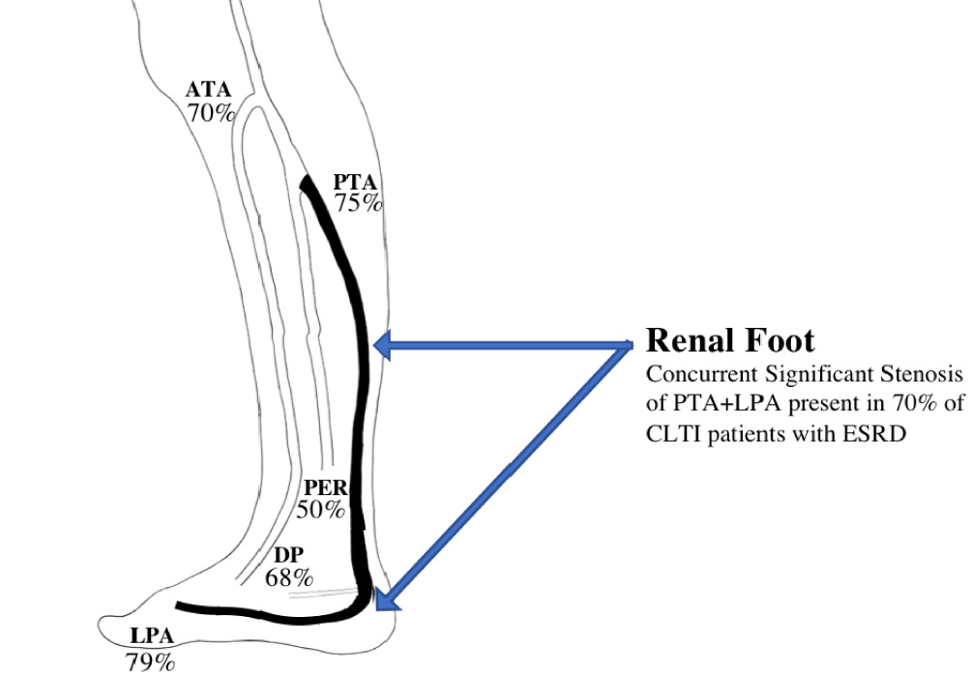
The "Renal Foot"
A distinct angiographic pattern characterized by severe distal disease, often thought to involve isolated posterior tibial artery and lateral plantar artery in ESKD patients
Our cohort…
4 ESKD patients (6.77%) with CLTI only
stage 3A | 12
stage 3B | 7
stage 4 | 23
post KT | 12
Reference: The renal foot Baghdasaryan PA, Bae JH, Yu W, Rowe V, Armstrong DG, Shavelle DM, et al. The renal foot: Angiographic pattern of patients with chronic limb threatening ischemia and end-stage renal disease

Slide 8
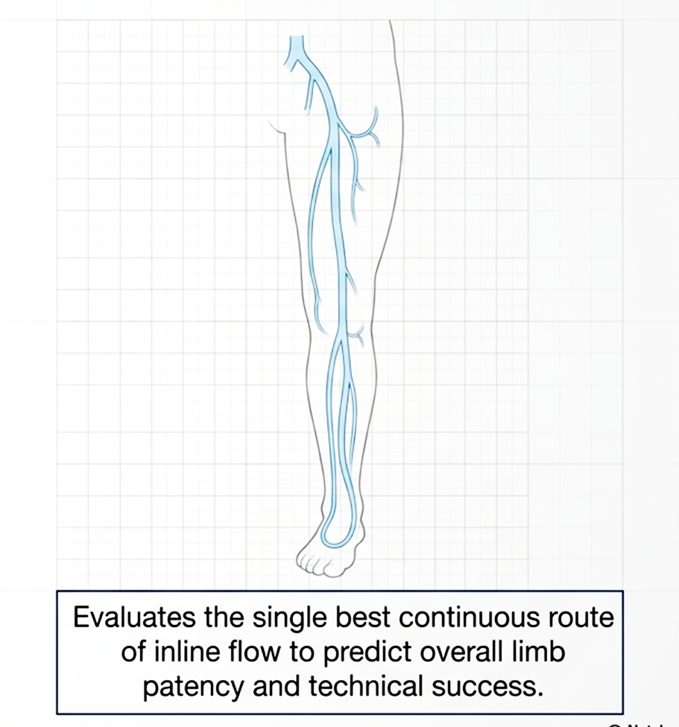
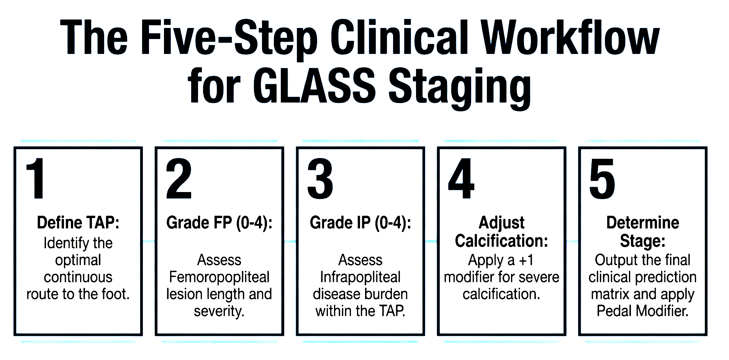
GLASS Classification
Reference: Conte, M.S. et al. (2019) 'Global vascular guidelines on the management of chronic limb-threatening ischemia', Journal of Vascular Surgery, 69(6S), pp. 3S-125S.e40.
Notes:
3 components - FP, IP (talks about the disease infra inguinal but above ankle, both FP and IP contribute to the overall GLASS stage) and pedal descriptors to talk about disease beyond ankle, FP/IP grade can be modified if the pt has calcifications

Slide 9

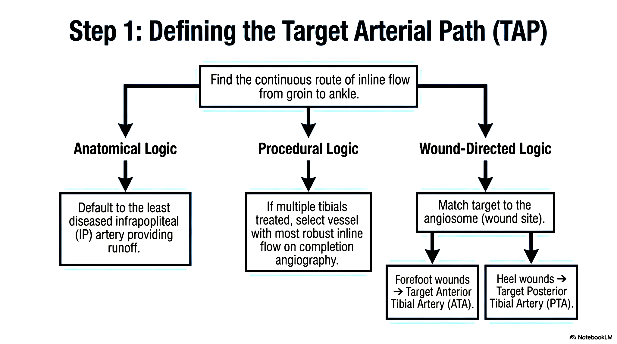
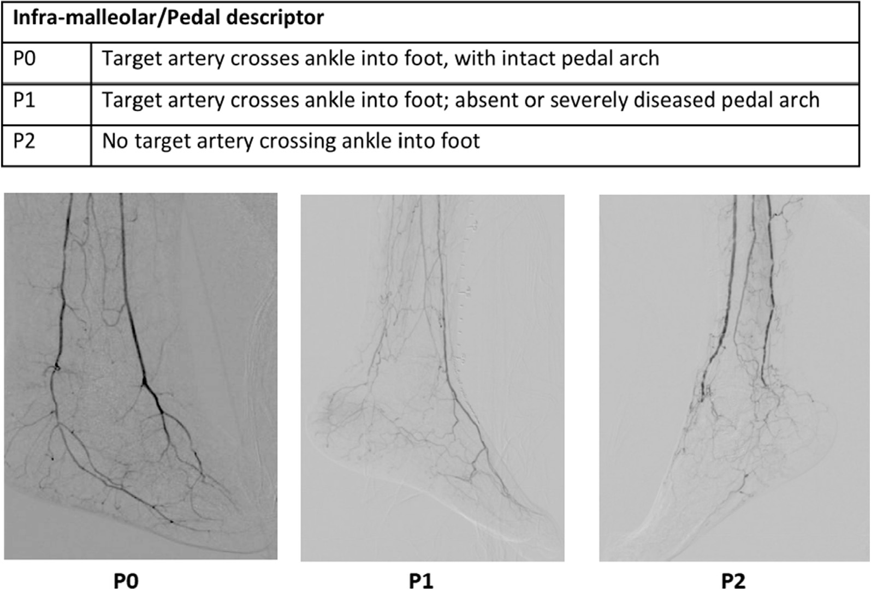
GLASS Classification
Reference: Conte, M.S. et al. (2019) 'Global vascular guidelines on the management of chronic limb-threatening ischemia', Journal of Vascular Surgery, 69(6S), pp. 3S-125S.e40.

Slide 10
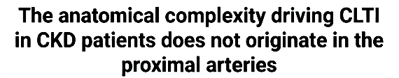
In our cohort…
GLASS parameter | CKD (n=58) | Non-CKD (n=117) | p-value
FP score>=3 | 5 (8.6%) | 28 (23.9%) | 0.015
IP score >=3 | 44 (43.1%) | 25 (37.6%) | 0.048
GLASS stage 111 | 15 (22.9%) | 26 (22.2%) | 0. 593

Slide 11
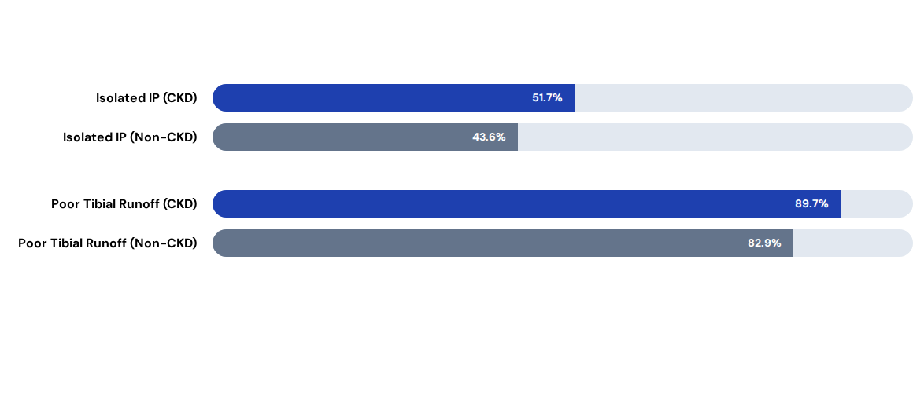
Anatomical Disease Distribution
CKD patients showed higher rates of single vessel outflow compared to non-CKD (p=0.237 for overall trend).
Notes:
and as you can see, when we look at the disease distribution, isolated IP disease with poor runoff/single vessel run off to the foot was seen with CKD (there was a trend observed, although not statistically significant)

Slide 12

Pedal Arch Integrity
The status of the pedal arch is critical for wound healing outcomes and revascularization success.
P2 Disease (No target artery crossing with a severely diseased pedal arch)
CKD: 51.2% vs Non-CKD: 24.3%
p = 0.002
Notes:
higher number of CKD pts having severe pedal disease (P2 - no target artery crossing with an absent pedal arch!)

Slide 13
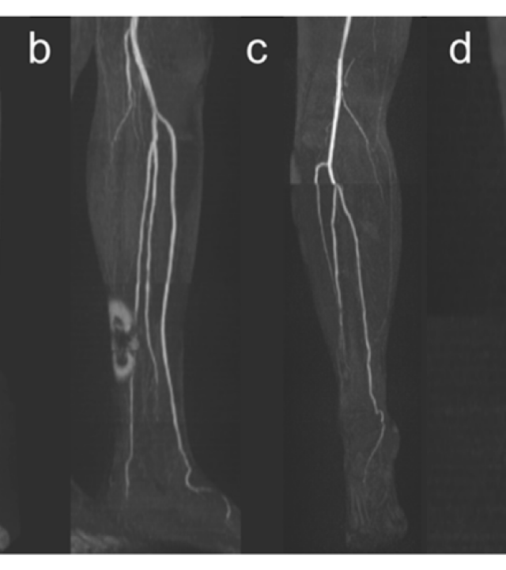
Tibial Pattern in CKD with CLTI
Selective Vessel Involvement seen!
Anterior Tibial: Significantly higher stenosis in CKD (63.8% vs 47.0%, p=0.036).
•
•
•
Peroneal Artery: Highly significant occlusion in CKD (74.1% vs 39.3%, p<0.001).
Posterior Tibial: Relatively preserved patency compared to ATA/Peroneal!
Notes:
we ve just described the disease using GLASS
but if we have a look at the IP vessels in a more detailed fashion to try and get a better idea on the distal disease
in CKD - selective vessel involvement seen than generalised vessel involvement, ATA, peroneal with relatively patent PTA
challenges the classic renal foot concept - significantly stenosed PTA!

Slide 14
Anterior Tibial Artery in CKD with CLTI
Of those with significant (>50%) ATA stenosis;
1. 75.7% had critical (>90%) stenosis
2. 62.2% had multifocal stenotic disease
3. 8.% had continuous long segment stenosis
Mean cumulative stenotic length in ATA 5.6 (1-28) cm
Significant proportion of CKD patients showed crtitically stenosed multifocal ATA disease

Slide 15
Peroneal Artery in CKD with CLTI
Of those with significantly occluded peroneal artery;
79.1 % had Continuous long-segment occlusions
Mean cumulative occlusion length in peroneal: 22.15 (2-30) cm
Significant proportion of CKD patients showed a peroneal occlusive phenotype with extensive continuous long-segment occlusions

Slide 16

https://docs.google.com/presentation/d/17G55dkjtgYJE0kgfwVO_YeWuQE86HHSW-U46w9WXKYM/edit?usp=sharing
Significance of Peroneal Disease
74.1%
A Major Technical Barrier
The peroneal artery often serves as the "last remaining runoff vessel" or collateral source. Its dramatic loss in CKD patients:
Peroneal Occlusion in CKD
Technical success | CKD Group | Non-CKD Group | p-value
Immediate Radiological Success | 62.5% | 80.0% | 0.125
Angiosomal Correction | 54.2% | 67.5% | 0.286
Limits technical endovascular options.
Reduces distal bypass target selection
Worsens limb salvage potential significantly.
Notes:
immediate radiological success was seen in 62.5%! angiosomal correction was done in 54.2% compared to non CKD and were successful and the rest having an intact pedal arch- least diseased artery was corrected
peroneal occlusion poses a serious problem; a major technical barrier limiting technical endovascular options…..

Slide 17
Post Angioplasty Outcomes in CKD
0.5 vs 2.25 Months
Low Mean time to death (p= 0.002)
6.14 vs 4.67 Months
Longer Mean wound healing time(p= 0.287) with 43.5% vs 66.7% achieving wound healing
18 vs 13.99 Months
Low Amputation free survival (p= 0.806)
Notes:
talk a bit about post angioplasty outcomes to see how the disease has affected the outcomes;
although not statistically significant the following trends were observed!
explain the findings in the slide - longer wound healing time, low AFS and early death following procedure noted with CKD pts!

Slide 18

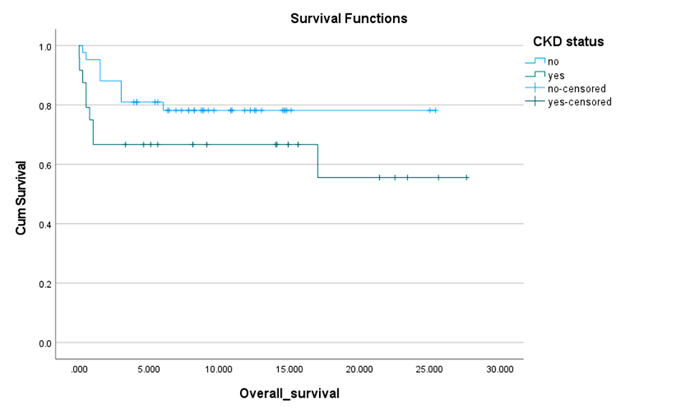
Overall Survival in CKD
17.39 vs 20.36 Months
Poor Mean Overall survival time (p= 0.146)
Notes:
reduced overall survival seen
all these outcomes can be attributed to - the complicated disease anatomy associated with CKD!

Slide 19

Clinical Implications - Revascularization Strategy
CKD Group
Non-CKD Group
Likely Outflow: Posterior Tibial Artery (PTA) is often the "last usable vessel."
Multivessel Runoff: Preserved flexibility for target artery selection.
Preferred: Endovascular-first (PTA-directed single vessel revascularization) recanalization.
Endovascular: Selection based on wound-specific angiosome (ATA/PTA/PER).
Rationale: Heavy calcification & high surgical risk associated with bypasses makes Balloon/DCB Angioplasty a choice of revascularization
Bypass: More distal targets available (Fem-ATA, Fem-PTA, Fem-Per).
Clinical Advantage:
Notes:
so how to help and guide the revasc. strategy?

Slide 20


Beyond Optimal Selection…
The GLASS Framework
If PTA is Unavailable!
Indirect Revascularization: Correction of stenotic lesions in ATA if intact pedal arch
GLASS mandates choosing a single Target Artery Path (TAP). However, our data reveals a significant clinical gap:
Pedal/Plantar Bypass: Ultra-distal targets (Dorsalis Pedis) for advanced CLTI.
Forced vs. Selected: In CKD, the TAP is often an anatomical necessity, not an optimal choice.
Hybrid Procedures: Combining endo-inflow with distal surgical bypass.
Constraint: With ATA/Peroneal frequently unavailable, PTA becomes the salvage runoff.
Conservative Management: Aggressive wound care & offloading if futility is reached.
"The Renal Foot highlights constrained target selection over optimal hemodynamics."
Primary Amputation: Guided by Global Vascular Guidelines for unsalvageable loss.

Slide 21

Thank you
Q & A?

