Slide 1

Comparison of Health-Related Quality of Life Between Patients with Arteriovenous Fistula and Central Venous Catheters
Authors
Nivetha M ¹, Vishnupiriya R¹, Shathana P¹, Jane Varmiya A¹, Vinojan S¹,
¹ Department of Surgery, Faculty of Medicine, University of Jaffna, Sri Lanka.

Slide 2
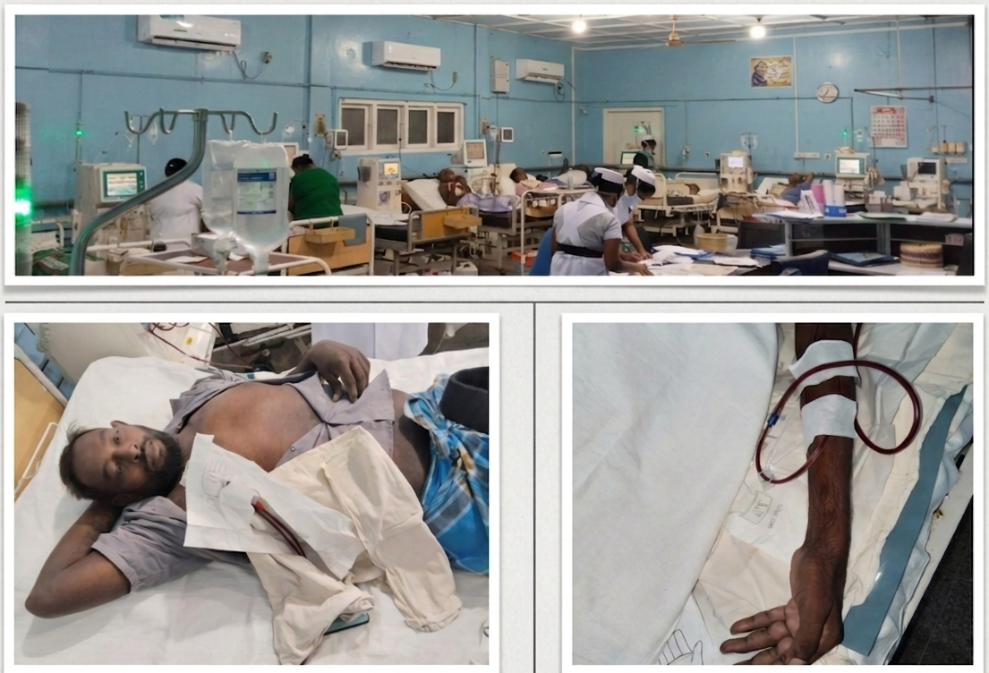
Background
Vascular access type influences health-related quality of life in maintenance hemodialysis patients, with Arteriovenous Fistula (AVF) preferred but Central Venous Cathether (CVC) still commonly used.
Objective
Compare HRQOL between AVF and CVC patients

Slide 3
Methods
Study Design: Descriptive cross-sectional study.
Setting: All Government haemodialysis centers in Northern Province.
Study Period :From 1st May 2025 to 1st March 2026.
Participants: 430 Patients

Slide 4
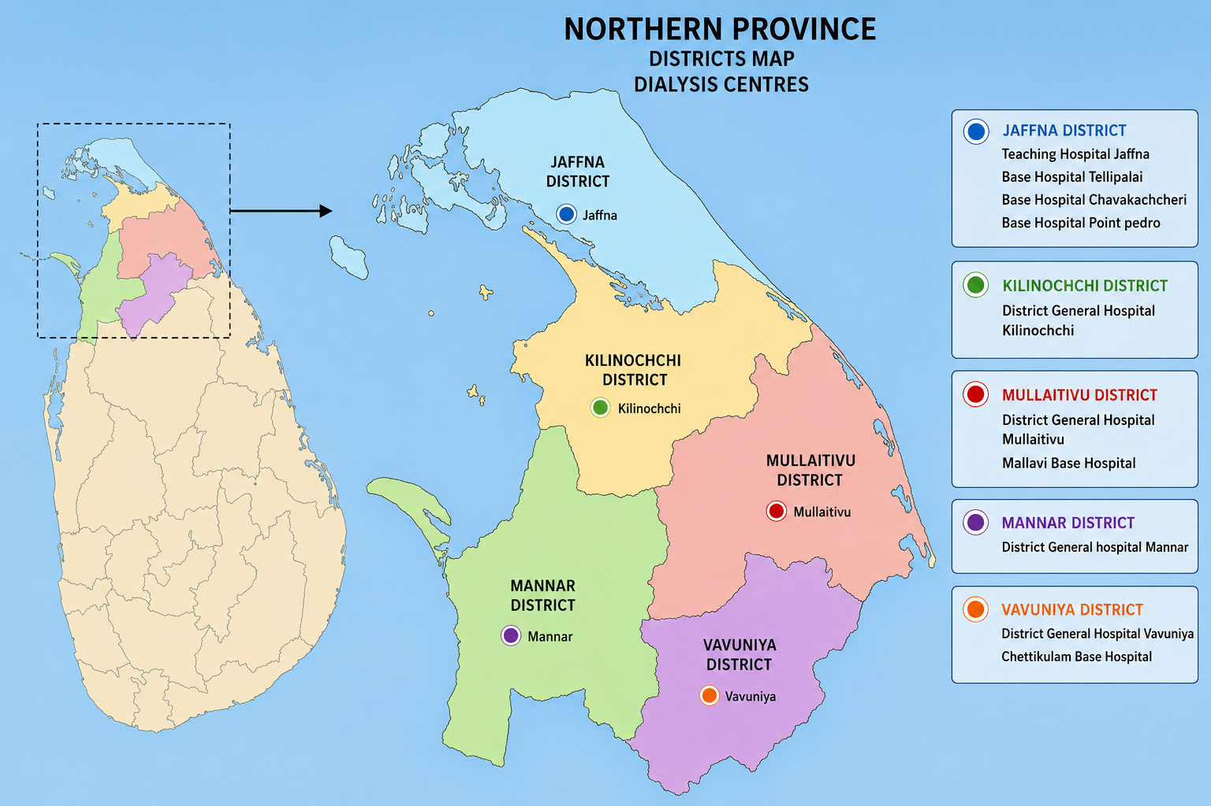

Slide 5
Inclusion Criteria
Patients undergoing haemodialysis at Government haemodialysis centres in the Northern Province of Sri Lanka.
Duration of haemodialysis greater than 3 months
Age above 18 years
Able and willing to provide informed consent

Slide 6
Methods
Ethical Approval: Ethical Review Committee, THJ.
Analysis: Statistical analysis- SPSS version 26 (ANOVA test)
Study tool: Validated instrument covering physical, mental, and kidney disease–specific domains.- KDQOL-SFTM1.3

Slide 7
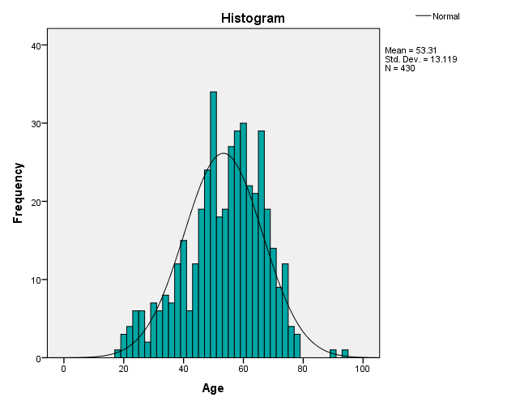
Results
Gender
    Male - 342 (79.5%)
    Female - 88 (20.5%)
Mean age - 53.31
Access - AVF - 323 (75.1%)
CVC - 107 (24.9%)

Slide 8
Results
Domain | Variables | AVF | Central | p value
Physical component summary | General health | 32.67 SD 19.72 | 32.75 SD 24.19 | 0.0004
 | Physical functioning | 29.22 SD 19.34 | 28.69 SD 21.19 | 0.095
 | Pain | 52.34 SD 26.69 | 57.35 SD 30.52 | 0.015
 | Role limitation – physical | 4.56 SD 16.49 | 3.50 SD 13.49 | 0.229

Slide 9
Results
Domain | Variables | AVF | Central | p value
Mental component summary | Emotional wellbeing | 53.54 ± 16.78 | 53.57 ± 20.86 | 0.0004
 | Role limitation – emotional | 43.85 ± 47.49 | 35.51 ± 46.97 | 0.161
 | Social function | 39.28 ± 24.91 | 39.25 ± 24.06 | 0.943
 | Energy fatigue | 46.51 ± 18.90 | 42.80 ± 21.70 | 0.029

Slide 10
Results
Domain | Variables | AVF | Central | p value
Kidney disease component summary | Symptom / problem list | 67.42 SD 15.54 | 67.11 SD 15.03 | 0.819
 | Effects of kidney diseases | 43.91 SD15.45 | 44.59 SD 17.64 | 0.053
 | Burden of kidney disease | 18.24 SD 17.84 | 21.90 SD 20.82 | 0.017
 | Work status | 10.99 SD 24.82 | 11.68 SD 24.35 | 0.751
 | Cognitive function | 64.12 SD 16.61 | 62.80 SD 17.59 | 0.266
 | Quality of social interaction | 61.15 SD 18.56 | 61.93 SD 21.18 | 0.075
 | Sleep | 51.13 SD 19.68 | 51.23 SD 23.17 | 0.031
 | Social support | 70.27 SD 27.25 | 75.07 SD 25.11 | 0.536
 | Dialysis staff encouragement | 93.80 SD 12.78 | 92.28 SD 12.57 | 0.409
 | Patient satisfaction | 76.70 SD 17.94 | 79.28 SD 13.70 | 0.042

Slide 11
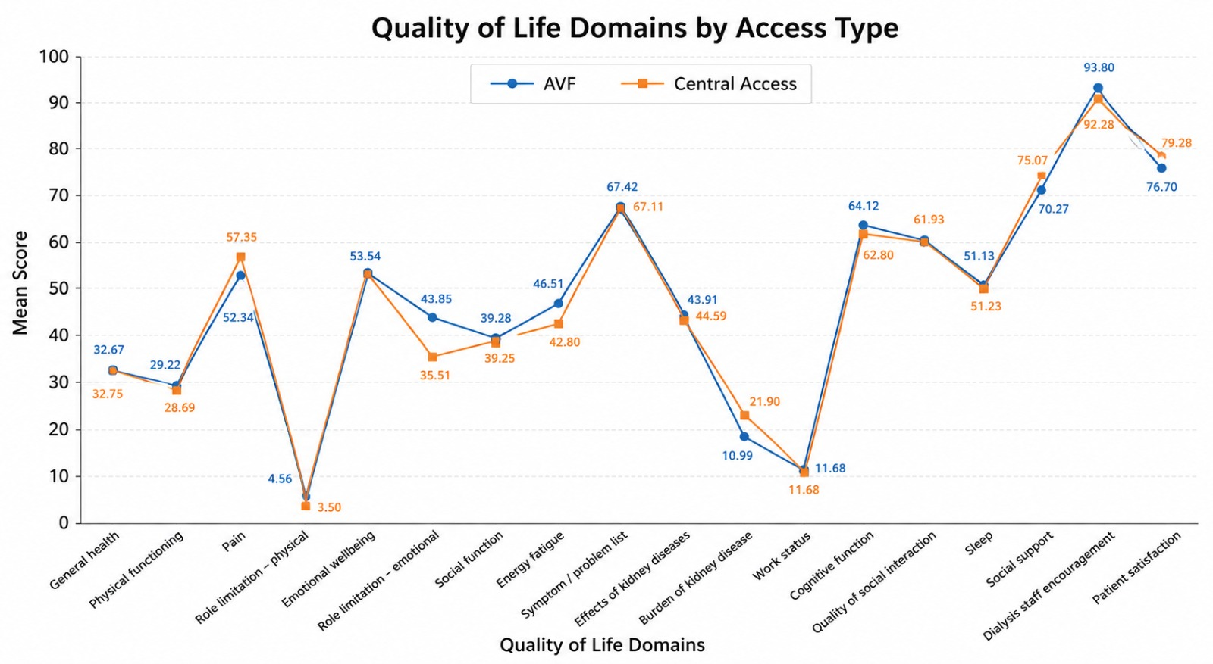

Slide 12
Conclusion
Although AVF is clinically preferred, differences in health-related quality of life were modest.
CVC patients reported greater pain and disease burden, whereas AVF patients demonstrated better energy levels, underscoring the importance of multifactorial and patient-centred vascular access planning.

